Slide 1
Adult Direct Education Evaluation Mid-Year Check-In
March 18, 2025
Hosted by Amanda Linares

Slide 2
Access the recording & slides
Find the webinar recording and this slide deck on the Adult DE Eval Website

Slide 3
Agenda
Project timeline & refresher
Statewide findings from FFY 24
Data products
Info & resources
Q&A

Slide 4
Project timeline & refresher

Slide 5
Adult DE Eval Timeline
Mid-October
Evaluation begins
Pre/post required for all 4+ session DE
September
CFHL Adult Survey Administration Training
Website/survey updates
Mid-October-August 31
November
Datasets & data products from previous FFY released
Conduct DE series, pre/posting participants in S123 or via paper (entered in S123)
Mid-March
Mid-Year Check-In
August 31
CFHL Adult Survey closes
PEARS opens
HARD DEADLINE!

Slide 6
August Direct Education & Evaluation
The survey will close August 31st (or final weekday of the month) annually.
If you have any series that you cannot online post-test (or complete paper data entry) by August 31st, then you do not need to evaluate the series.
All series that take place between September 1st and mid-October are not subject to evaluation.
If you want to evaluate a series in this period, reach out to me first to discuss feasibility.

Slide 7
Evaluation Requirement
Evaluate if you deliver any adult DE that has 4 or more sessions, over 4 or more weeks.
This applies to all program activities delivered, i.e., not a sample.
Requirement applies to all 4+ session nutrition and PA-focused curricula.

Slide 8
Curriculum | Lessons | Curriculum cont'd | Lessons
A Taste of African Heritage | 6 | Fresh from the Garden | 12
Around the Table | 6 | Healthy, Happy Families | 8
Around the Table: Nourishing Families | 6 | Making Every Dollar Count | 8
Bingocize™ | 24 | Matter of Balance (MOB) | 8
Cell-Ed Eat Healthy, Be Active Community Workshops | 6 | MyPlate for My Family Education Toolkit | 4
Cell-Ed Eat Smart, Live Strong: Nutrition Ed for Older Adults | 4 | Nutrition 5 Class Series | 5
Chronic Disease Self Management Program | 6 | Parent Lesson Plans: Advocating for Healthier School Environments | 4
Cooking for Health Academy | 6 | Plan, Shop, Save and Cook | 4
Cooking Matters (national) | 6 | Seniors Eating Well | 9
Create Better Health | 8 | Staying Healthy through Education & Prevention (STEP) | 9
Eat Healthy, Be Active Community Workshops | 6 | Tai Chi for Arthritis | 12
Eat Smart, Live Strong: Nutrition Education for Older Adults | 4 | Tai Chi: Moving for Better Balance (a.k.a. Tai Ji Quan) | 48
Eating Smart, Being Active | 9 | Telephonic Health Coaching Intervention Toolkit | 6
Enhance® Fitness | 4+ | Turtle Island Tales Family Wellness Program | 12
Everybody Loves Line Dancing | 6 | TWIGs: Teams With Inter-Generational Support | 30
Faithful Families Eating Smart and Moving More | 9 | UCCE Connects to You! | 10
Families Eating Smart and Moving More | 21 | Walk with Ease | 18
Fit & Strong! | 24 | Young at Heart | 4+
Food Smarts for Adults | 3-6

Slide 9
Evaluation Process
Administer a pre-test before the DE series begins
All participants present that day
Administer a post-test after the DE series is complete
All participants present that day
Participants completed surveys online?
You’re done!
Participants completed surveys on paper?
Enter them into the online link
Surveys are never entered into PEARS

Slide 10
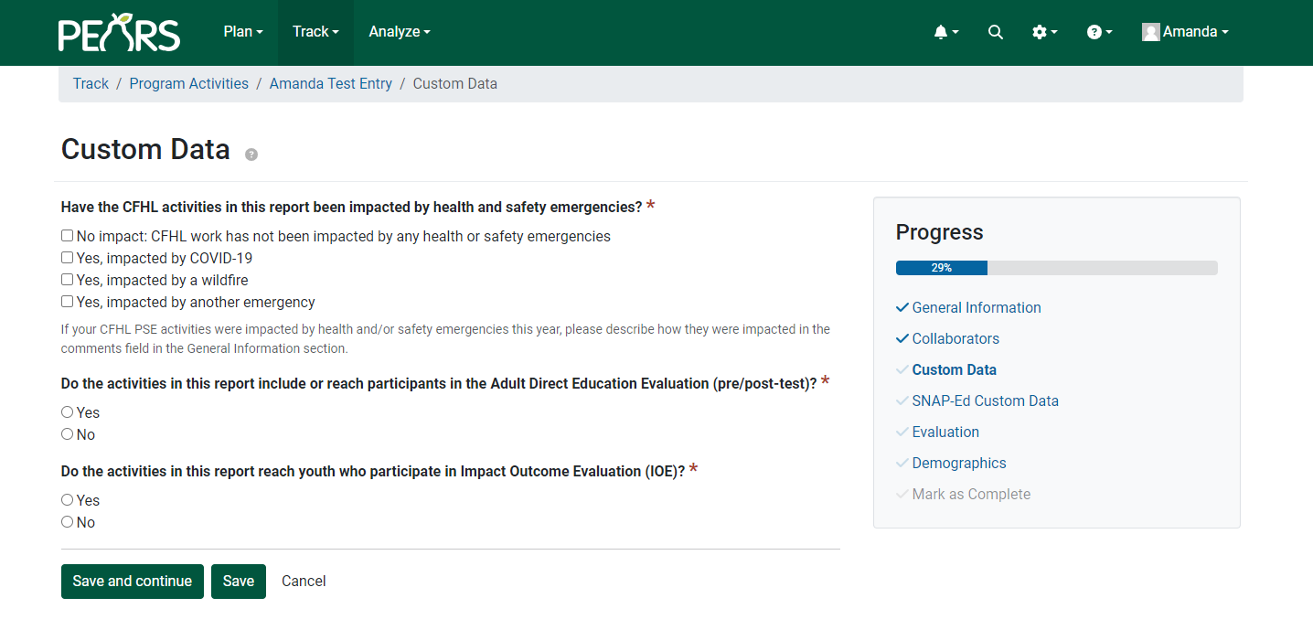
Adult DE Eval & PEARS
Surveys should never be entered into PEARS.
Do identify that the program activity was evaluated.

Slide 11
PEARS Program Activity IDs
Important!
PEARS Program Activity IDs are how we identify the DE delivered
To match pre to post, the same Program Activity ID must be used
All series-based DE should be entered under a single Program Activity ID
Program Activity ID ≠ Site ID
Program Activity ID should be 6 digits >853000

Slide 12
Statewide findings, FFY 24

Slide 13
FFY 24 data
15 LHDs
6 LHDs with samples >30
209 program activities
185 pre
160 post
724 matched pairs
1,706 pre
1,248 post
~8-9 participants per
program activity

Slide 14
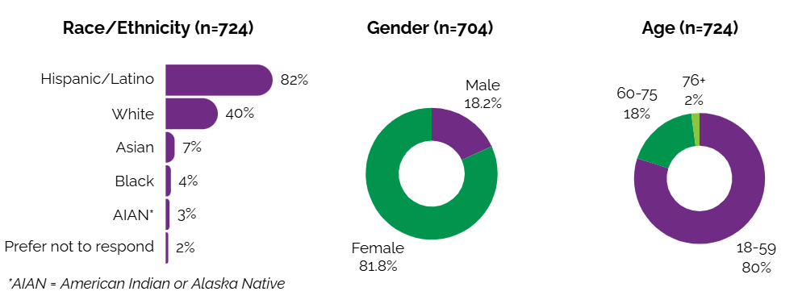
Participant demographics

Slide 15
Participants with children in school, OST & ECE

Slide 16
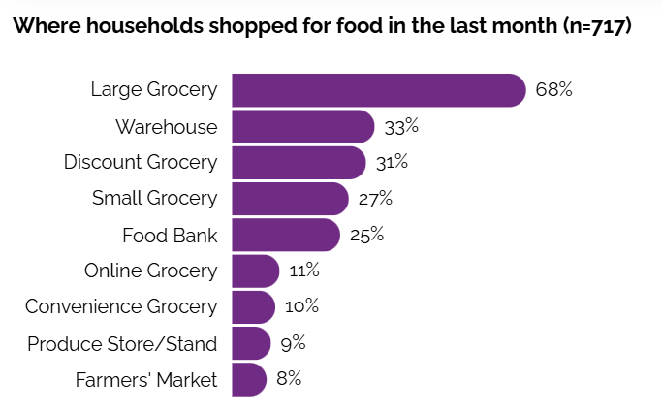
Household food shopping

Slide 17
Interpret with caution
With the exception of those meeting the moderate-to-vigorous physical activity recommendation, all findings show in the following slides are significant at p<0.05.
Pre-post changes shown here are outcome data only, i.e., lacking a control sample.
As such, we cannot attribute the findings here to the intervention.

Slide 18
Cups of fruits & vegetables
Outcome | N | Mean (cups) | Adjusted p-value | Interpretation
Average Fruit Consumption |  |  |  | There was a significant increase in the average fruit consumption from pre to post-test among adults who attended direct education classes.
Pre-test | 713 | 1.11
Post-test |  | 1.29
Change from pre to post-test |  | 0.18 | < 0.0001
Average Vegetable Consumption |  |  |  | There was a significant increase in the average vegetable consumption from pre to post-test among adults who attended direct education classes.
Pre-test | 714 | 1.20
Post-test |  | 1.43
Change from pre to post-test |  | 0.23 | < 0.0001

Slide 19
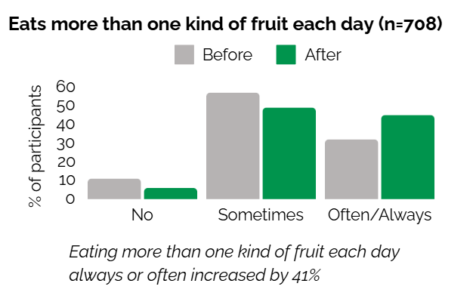
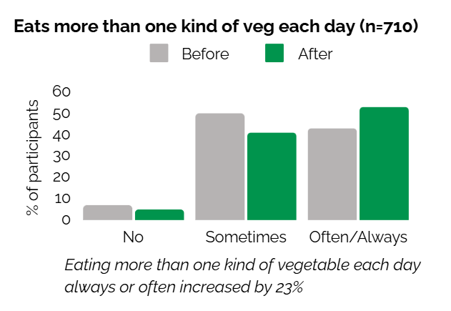
More than one FV per day

Slide 20
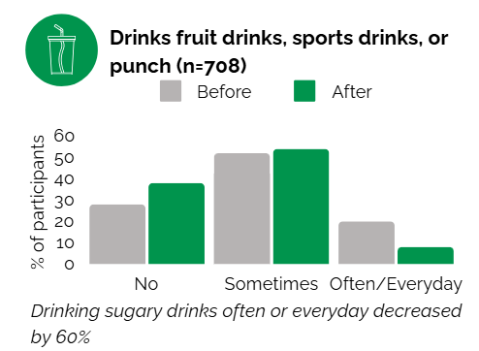
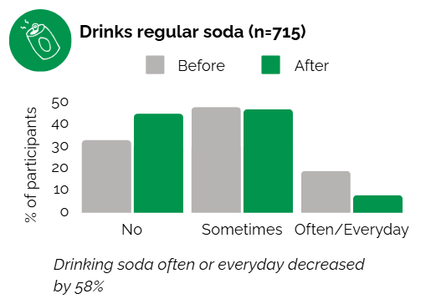
Sugary drinks

Slide 21
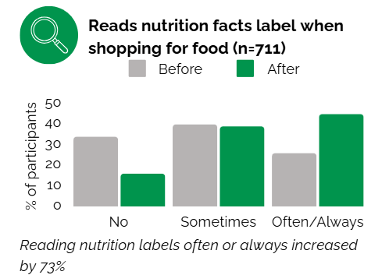
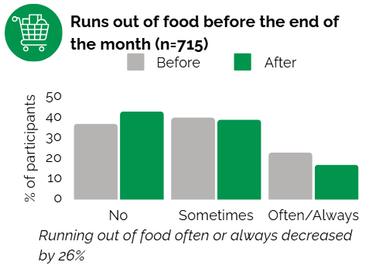
Food resource management

Slide 22
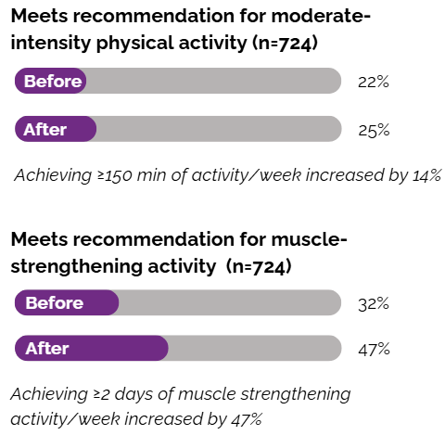
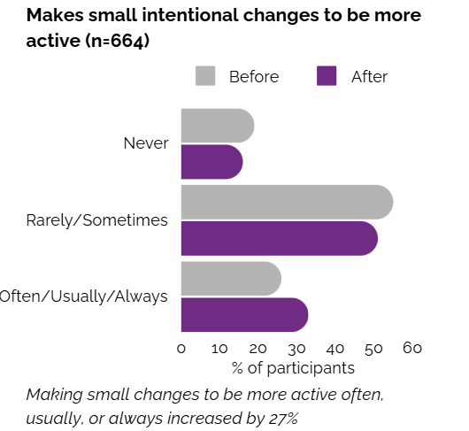
Physical activity

Slide 23
Data products

Slide 24
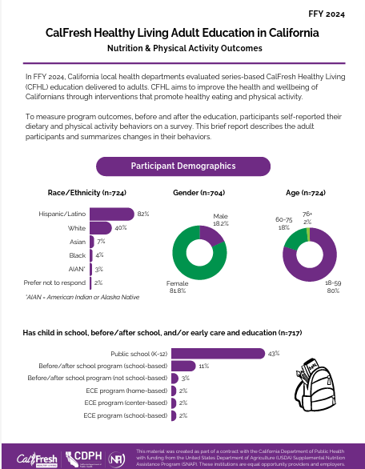
Data Products
New products for FFY 25!
In the fall we will provide a matched, cleaned, and interactive dataset and an infographic template in Canva.
Excel-based dataset will auto-calculate p-values and you can filter results (>30) by activity ID or curriculum.
This approach will allow you to customize your data products.

Slide 25
Info & resources

Slide 26
FFY 26
Catholic Charities continues validation work on a new modular adult survey.
At this time, it’s unknown if it will go into use in FFY 26.
When we adopt a new survey, languages offered will likely be more limited and based on surveyed languages from the past few evaluation years, i.e., English, Spanish, traditional and simplified Chinese, and Russian.
As a reminder! If you enter paper surveys in non-English languages, be sure to select that language in the language drop down before you submit.

Slide 27
Updates & new data releases
Coming soon!
LHD landing page overhaul and project website alignment
Leaders in Eating & Activity Practices (LEAP) Awards
FFY 24 LHD Data Briefs:
At a Glance
Educational Activities
PSE Change Efforts
Partnerships & Multi-Sector Coalitions
Assessment of Policies, Practices & Outcomes
FFY 24 Data Storytelling Toolkits

Slide 28
Upcoming Dates
Thursday, March 20th: NPI Cross-Project Office Hours
Friday, August 29th: All CFHL Adult Surveys due in S123
Stay tuned for a September FFY 26 CFHL Adult Survey training date!

Slide 29
Project resources
Adult DE Eval website
Adult DE Eval listserv
Contact: amlinares@ucanr.edu
916-200-5188

Slide 30
Questions

