Slide 1
Introduction to Freeze Drying
Presented by: Eileen Hidahl and Donna Cirelli
Title: Master Food Preserver
Date 07/13/2024

Slide 2
Freeze Drying
(Lyophilization/Cryodesiccation/`Sublimation)
UNITS
*Home
*Pharmaceutical
*Industrial
Commercial HR 100
2024 Brands:
Harvest Right, Cuddon, Fisher Scientific, Wave, Cube,
4Patriots, Blue Alpine. Stay Fresh

Slide 3
History
* Early—13th Century Incas in Andes
* Ist patent--1934
* WW II—developed to transport blood products and antibiotics to wounded
* NASA—refined technology for lightweight, nutritious meals for astronauts
Ice Cream story
*1950, 1960--Pharma
*Harvest Right—2018 for home preservation (Salt Lake City, Utah)
*Prep4life, THE CUBE (Utah)—early 2023

Slide 4
Dehydrating vs Freeze Drying
Dehydrating Freeze Drying
Heat/Fan Sublimation ice->vapor) freeze & heat
Wicks Moisture 60-70% 97% moisture sublimation (vapor)
*Desiccant (silica packet) *Oxygen Absorber (Iron oxide)
mineral: silicon + O2 Iron + O2
absorbs moisture absorbs O2 (300cc)
Pre freeze: 24 hrs
Temp 105 F-165 F Temp -40 F + Heat (105-145)
Timer 0-26 hours Time 24-36 hrs
Shelf Life: 1-4 years Shelf Life: 25 years
Storage
eliminate O2, light, moisture

Slide 5
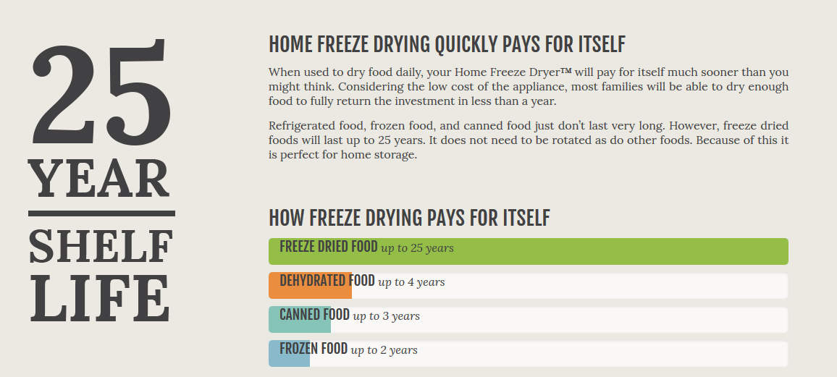
Information from Harvest Right Re: Shelf Life

Slide 6
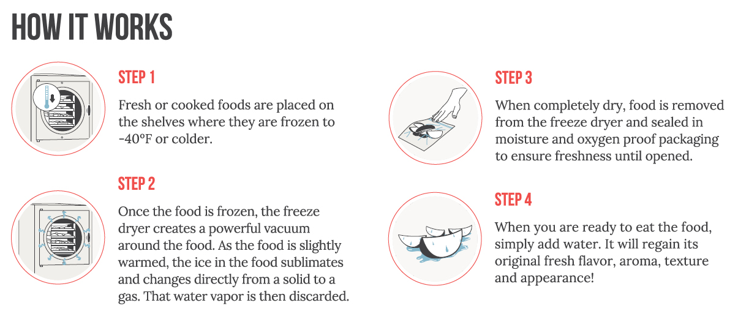
Brief Overview of Process

Slide 7
Maintenance Tips
* Wash freeze dryer trays with soap and water after ever batch
* Remove front gasket--washing with soap and water
* Periodically check seal contact to door
* Occasionally wash interior walls with soap and water or bleach (remove inner tray unit)
* Defrost and Drain after each cycle
* Empty bucket each cycle (prevent water from being pulled back and ruining product)
* Check oil level before each cycle use (gauge between high/low)

Slide 8
Benefits
Fits Every Lifestyle
*Emergency Prep: Emergency Supply/Lightweight/Survival/Backpackers
*Garden/Orchard: Nutritional value/nutrients/vitamins/minerals
*Camping/Hunting: Lightweight/easy to rehydrate
*Food Storage: No refrigeration/Easy to prepare
*Healthy Living: No preservatives, emulsifiers, additives
*Pet Food
*Taste: Appearance/Color/Texture/Aroma/Flavor/Nutrition
*Shelf Life: 25 years
*Versatility: Fruits/Vegetables/Meats/Fish/Eggs/Dairy
Cheese/Snacks/Meals/Casseroles/Soups/Gravy/Sauces/Stock/
Desserts/Ice Cream/Candy, Flowers
*Waste Not/Want Not: leftovers, excess foods, canned goods expiring

Slide 9
Freeze Drying
Preserve food for up to 25 years with 97% its flavor, color, nutrition, vitamins, natural enzymes
Process results in high quality food preservation/Superior method of preserving
University Research—very little thus far (quality, longevity, bacterial studies) Utah State Extension
Blanch or pretreat with ascorbic acid (prevent oxidation)
Doesn’t do well…Honey, peanut butter, chocolate, high sugar items, baked goods, oils/rancid
Does not destroy bacteria/microorganisms…dormant
Rehydration 1:1 ratio--spritz
Easy-to-use – just press start & the freeze dryer will beep when finished allowing you to walk away and come back to it later
Smart technology calculates the necessary dry time & automatically monitors the freeze dry process to completion (~20-40 hrs)
Freeze dry up to 3,000 lbs. fresh food per year* (*This would require a person to use the freeze dryer 4 times a week for 50 weeks a year)
~ cost-$1.25-2.80 per day
Foraging, Cannabis, Taxidermy

Slide 10
Smart Technology
Easy to operate-pre programmed
USB/upgradable software
Prefreeze food 24 hours/-40degees/heat/extra dry cycle
mTorr: pressure variance d/t elevation (vacuum pressure)
calculates extra dry time

Slide 11
Harvest Right Units
*Small: 4 trays/434 sq. inches (110 volt/15 amp)
6-10 lbs per batch ~$ 2,295
*Medium: 5 trays/675 sq. inches (110 volt/15 amp)
10-15 lbs per batch ~ $ 2,895
*Large: 6 trays/1107 sq. inches (110 volt/15 amp)
18-27 lbs per batch ~ $ 3,600
*X Large: 7 trays/ 2251sq. inches (110 volt/15 amp)
40-50 lbs per batch ~ $5,000
*Commercial- HRC100:9 trays/ 2925 sq. in (220 volt/30 amp)
90 lbs per batch ~ $10,000 (EDC Food Bank)

Slide 12
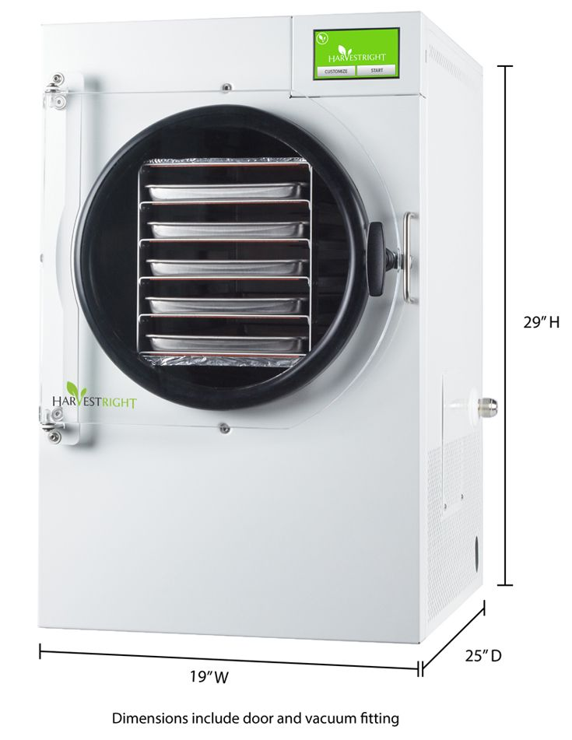
Harvest Right Pro-Freeze Dryer Specifications
Dimensions
Weight and warranty
Fully Automated
Software upgradable/USB
Weight of freezer dryer 119 lbs
Three year limited warranty
Sizes: Small, Medium, Large, X-Large
Commercial
Medium Size-5 trays
Dimensions (19” W x 29” Ht x 25” D)
Commercial Grade-Stainless Steel (+$200)

Slide 13
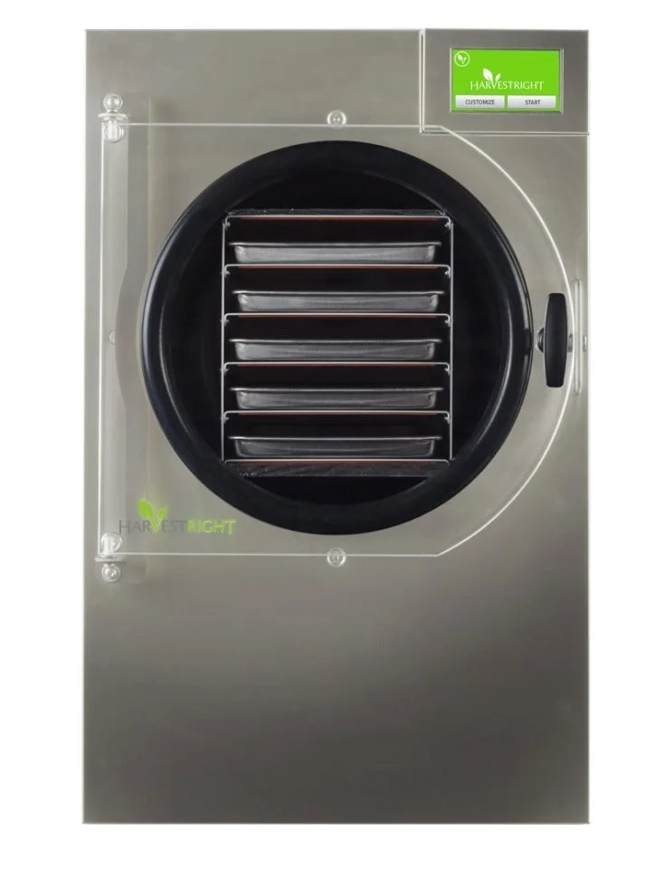
Harvest Right Pro Freeze Dryer Components
Appearance
Parts
Freeze dryer Commercial grade vacuum pump (18” X 9” X 14”)
Five stainless steel trays (7.5”X18”X.75”)
Silicone liners/Parchment
Mylar starter kit of 50 mylar bags, a mylar bag sealer and 50 oxygen absorbers
Oil filter/Oil
Insulator door pad/Gasket + (Backer Rod)
Power cord (100V)
Owner’s manual
Guide to Freeze Drying

Slide 14
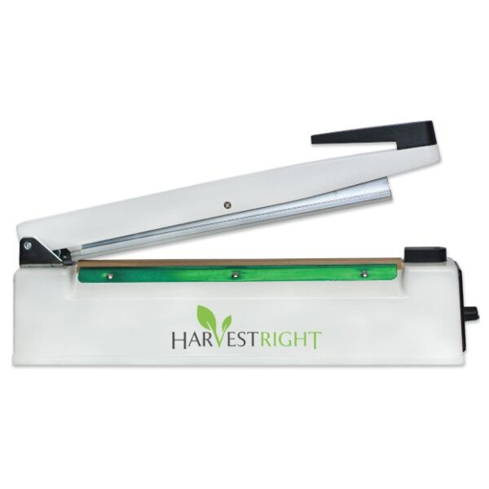
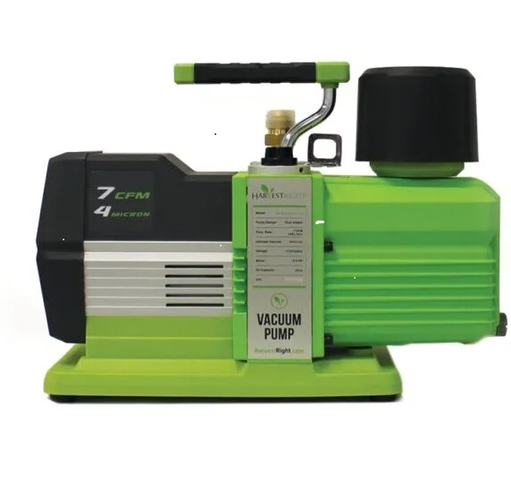
Items included with purchase (cont’d)
Harvest Right 12” Impulse Sealer
Harvest Right Freeze Dryer Vacuum Premium Pump Oil/Oiless

Slide 15
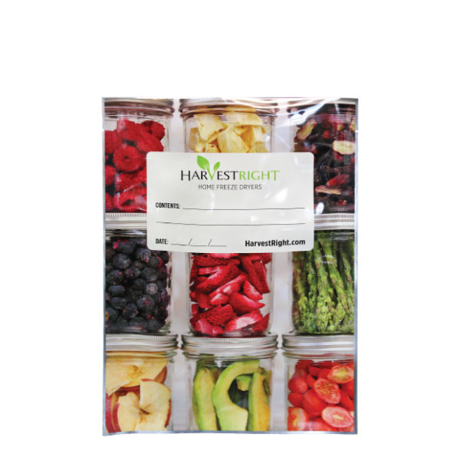
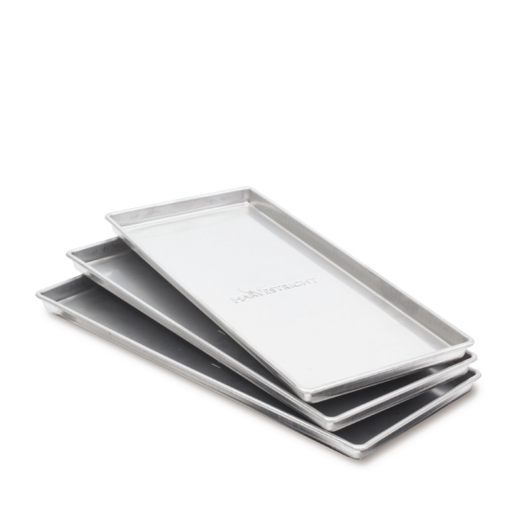
Items included with purchase (cont’d)
Mylar bags starter kit – 50 bags
7 MIL Thickness
Harvest Right Home Freeze Dryer Trays

Slide 16
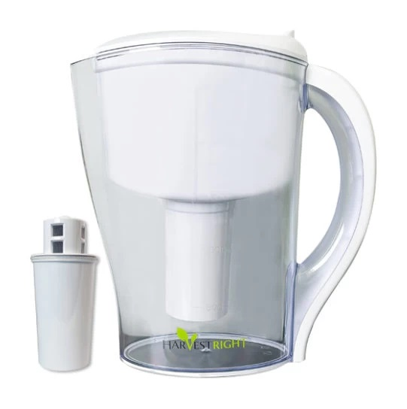
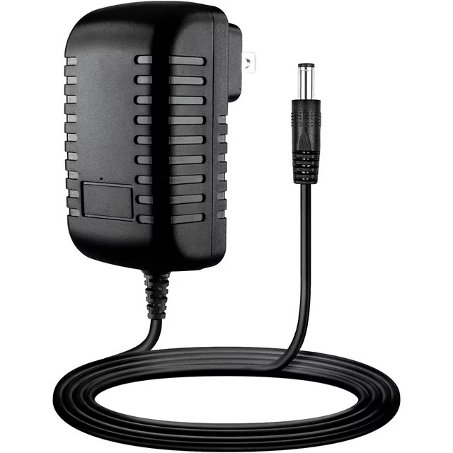
Items included with purchase (cont’d)
Freeze Dryer Oil Filter
100V Power Cord

Slide 17
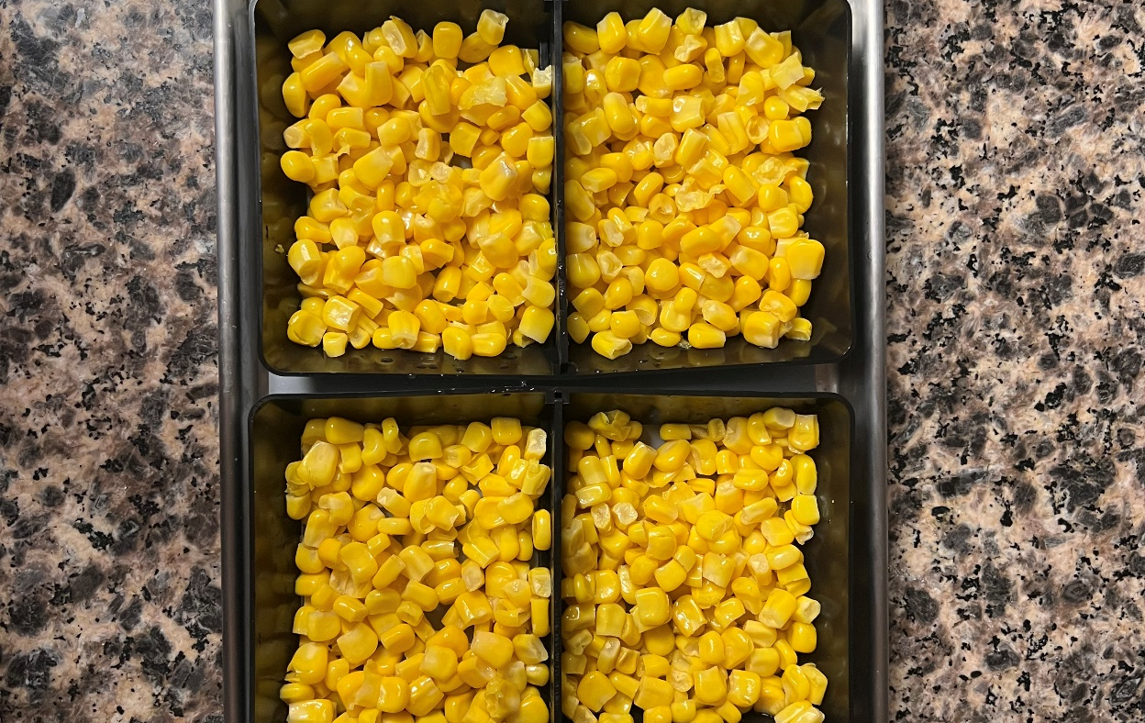
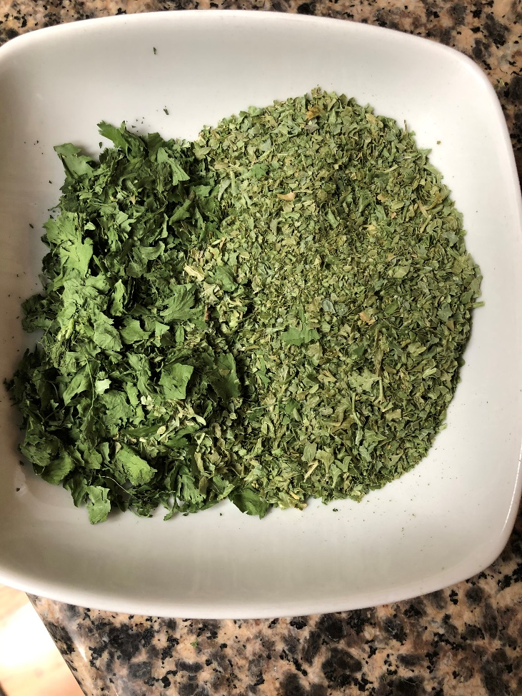
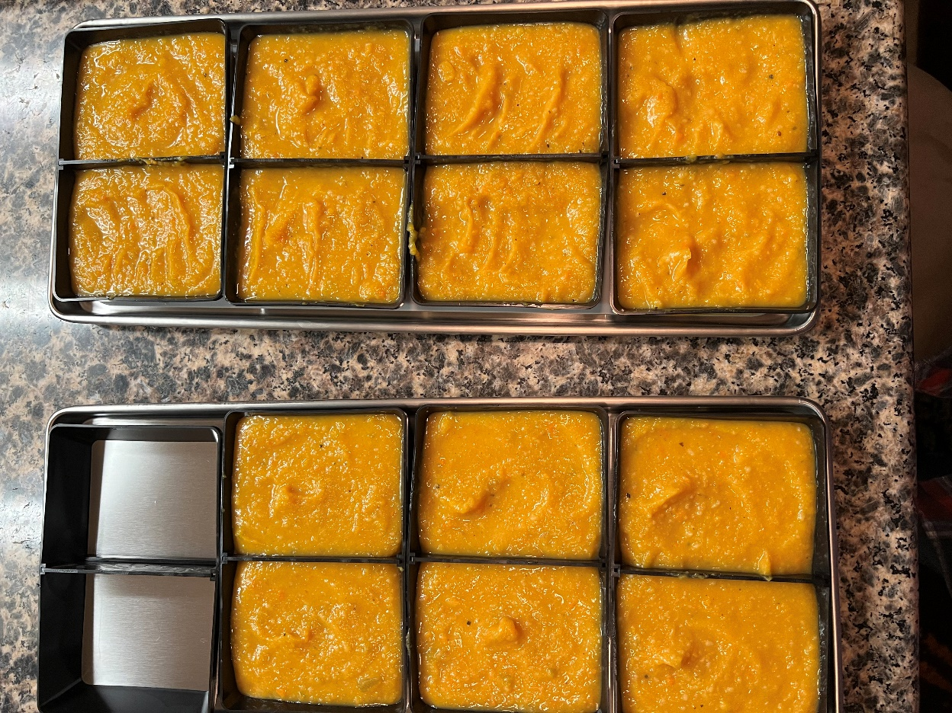
Options: Full Tray
Divide Portions: silicone, molds,
Powder form

Slide 18
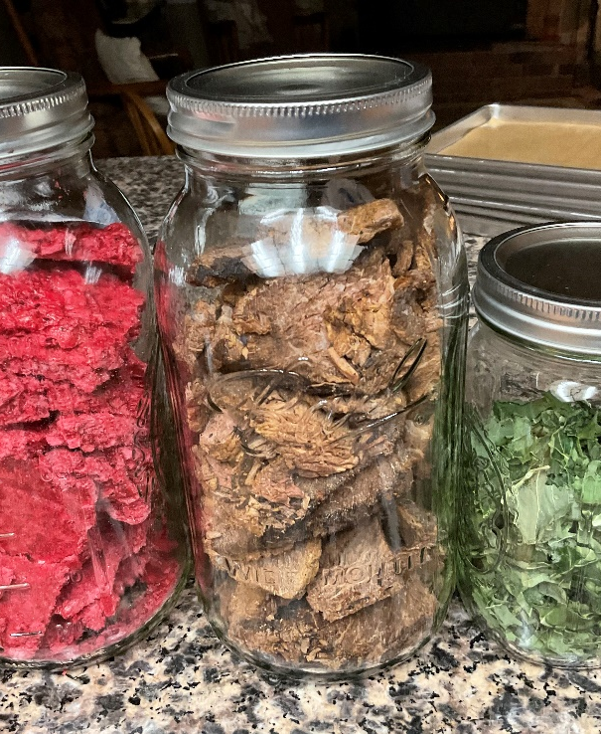
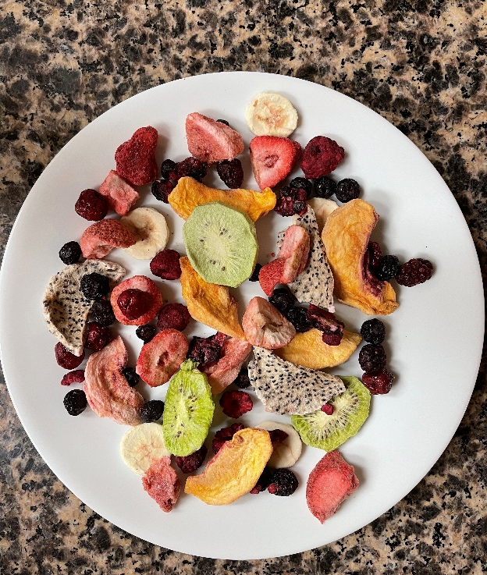
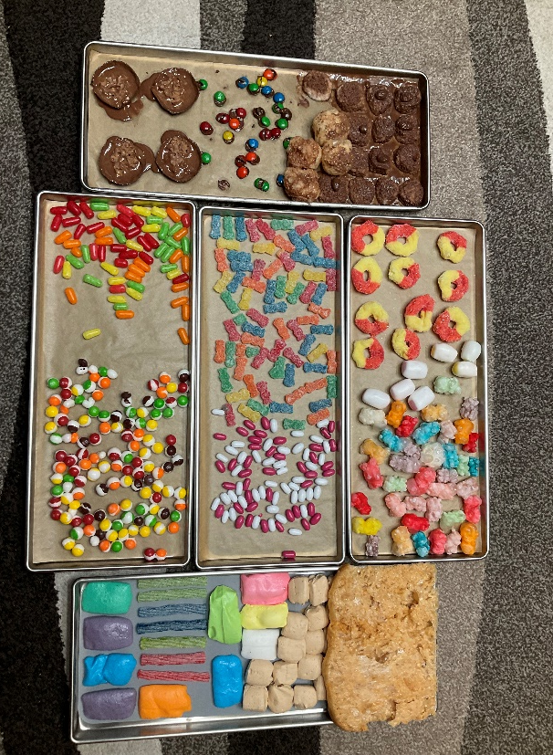
Fruit Meat Soups Candy
Pre freeze products 24 hours
Reduces explosive events
Adjust temperature:
Customize as needed
Yogurt-95-110 degrees F
Candy-more heat
Herbs-less heat

Slide 19
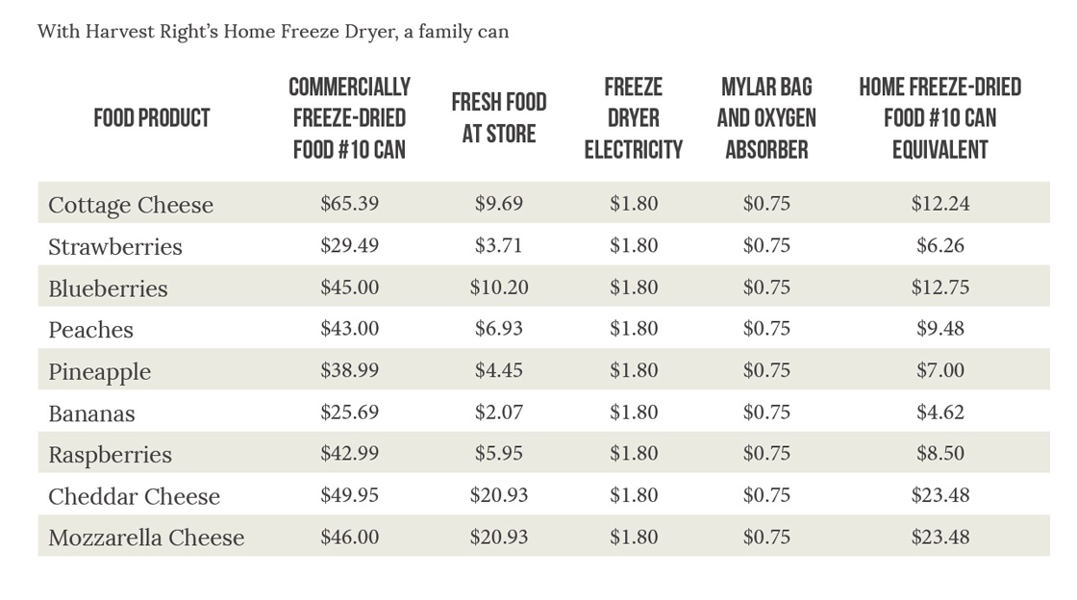
Harvest Right Freeze Dryer Cost Comparison

Slide 20
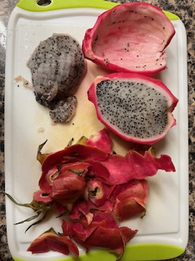
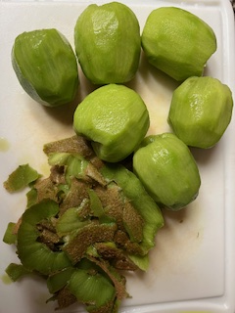
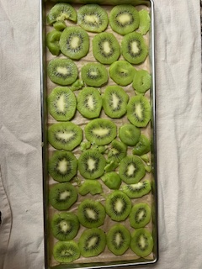
Freeze-Dried Fruits
Name the fruit

Slide 21
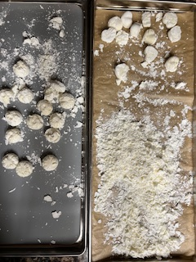
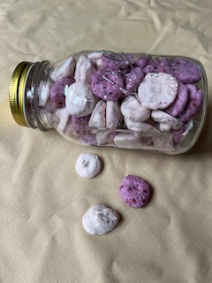
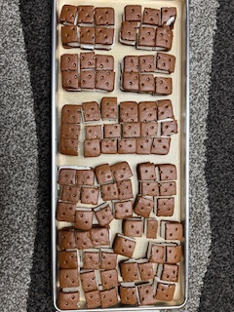
Freeze dried candies
Name the candy

Slide 22
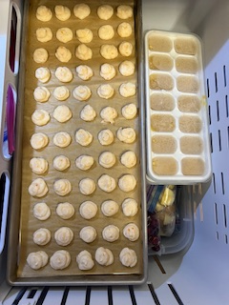
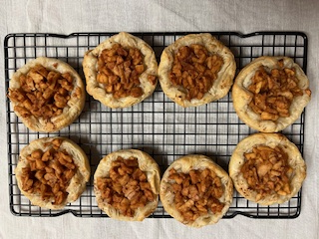
Freeze dried tarts
Name product

Slide 23
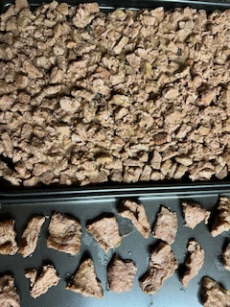
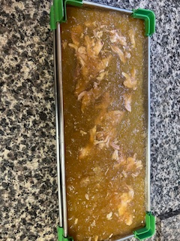
Freeze dried meats
Name product

Slide 24
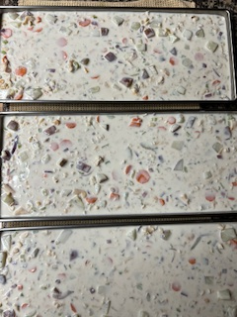
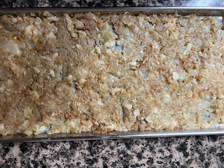
Freeze dried stew ingredients
Name the product

Slide 25
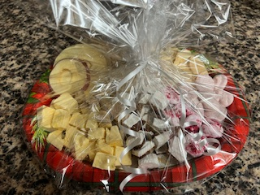
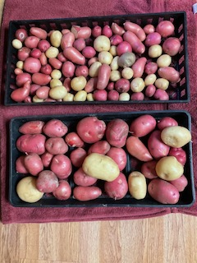
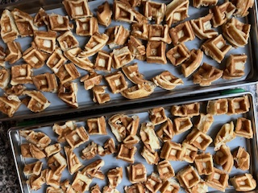
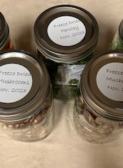
Freeze dried potatoes and veggies
Name the product

Slide 26
Miscellaneous
Name the product

Slide 27
Questions?

