Slide 1
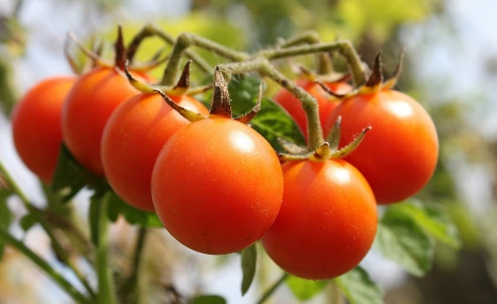
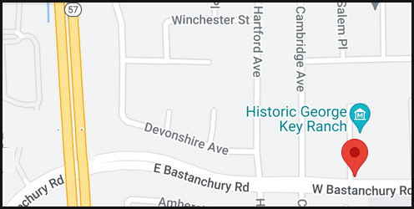
Orange County Master Food Preservers Partnering with Orange County Parks Present:
Tomatoes! Demonstration
At George Key Ranch Historic Park
Saturday, September 21, 2024 (10 AM – 12 Noon)
625 W. Bastanchury Road, Placentia, CA 92870
Historic George Key Ranch is a historic house, museum, garden and orange grove, located in the City of Placentia. Located within the park is the George Key home, built in 1898 and listed on the National Register of Historic Places.
The Master Preservers of Orange County (https://ucanr.edu/sites/MFPOC/) will be demonstrating how to safely preserve tomatoes.
No endorsement of any product/company is intended, nor is criticism implied of similar products/companies that are not included.
It is the policy of the University of California (UC) and the UC Division of Agriculture & Natural Resources not to engage in discrimination against or harassment of any person in any of its programs or activities (Complete nondiscrimination policy statement can be found at http://ucanr.edu/sites/anrstaff/files/215244.pdf).
Inquiries regarding ANR’s nondiscrimination policies may be directed to UCANR, Affirmative Action Compliance & Title IX Officer, University of California, Agriculture and Natural Resources, 2801 Second Street, Davis, CA 95618, (530) 750-1343.

