Slide 1
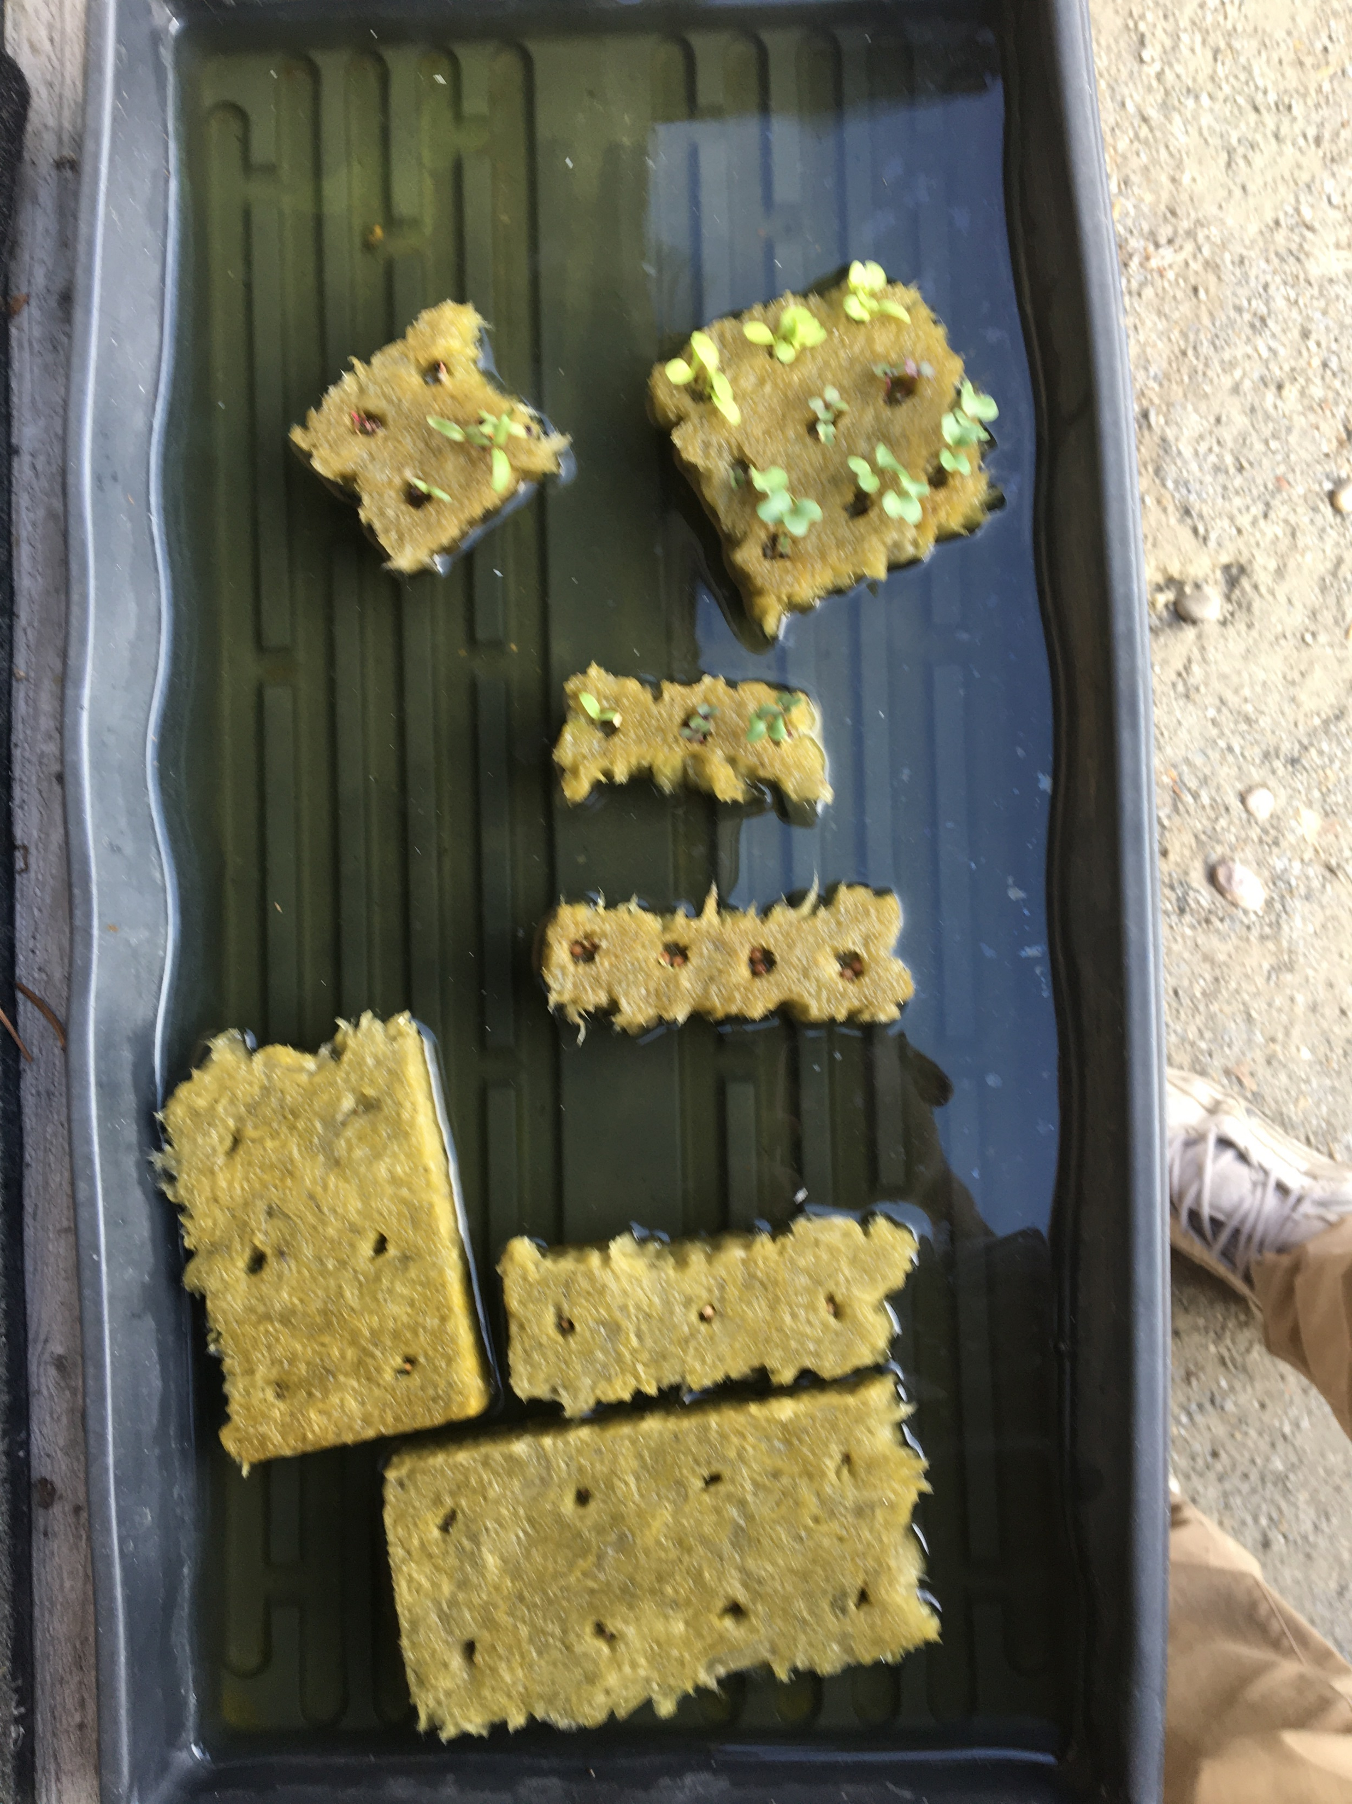
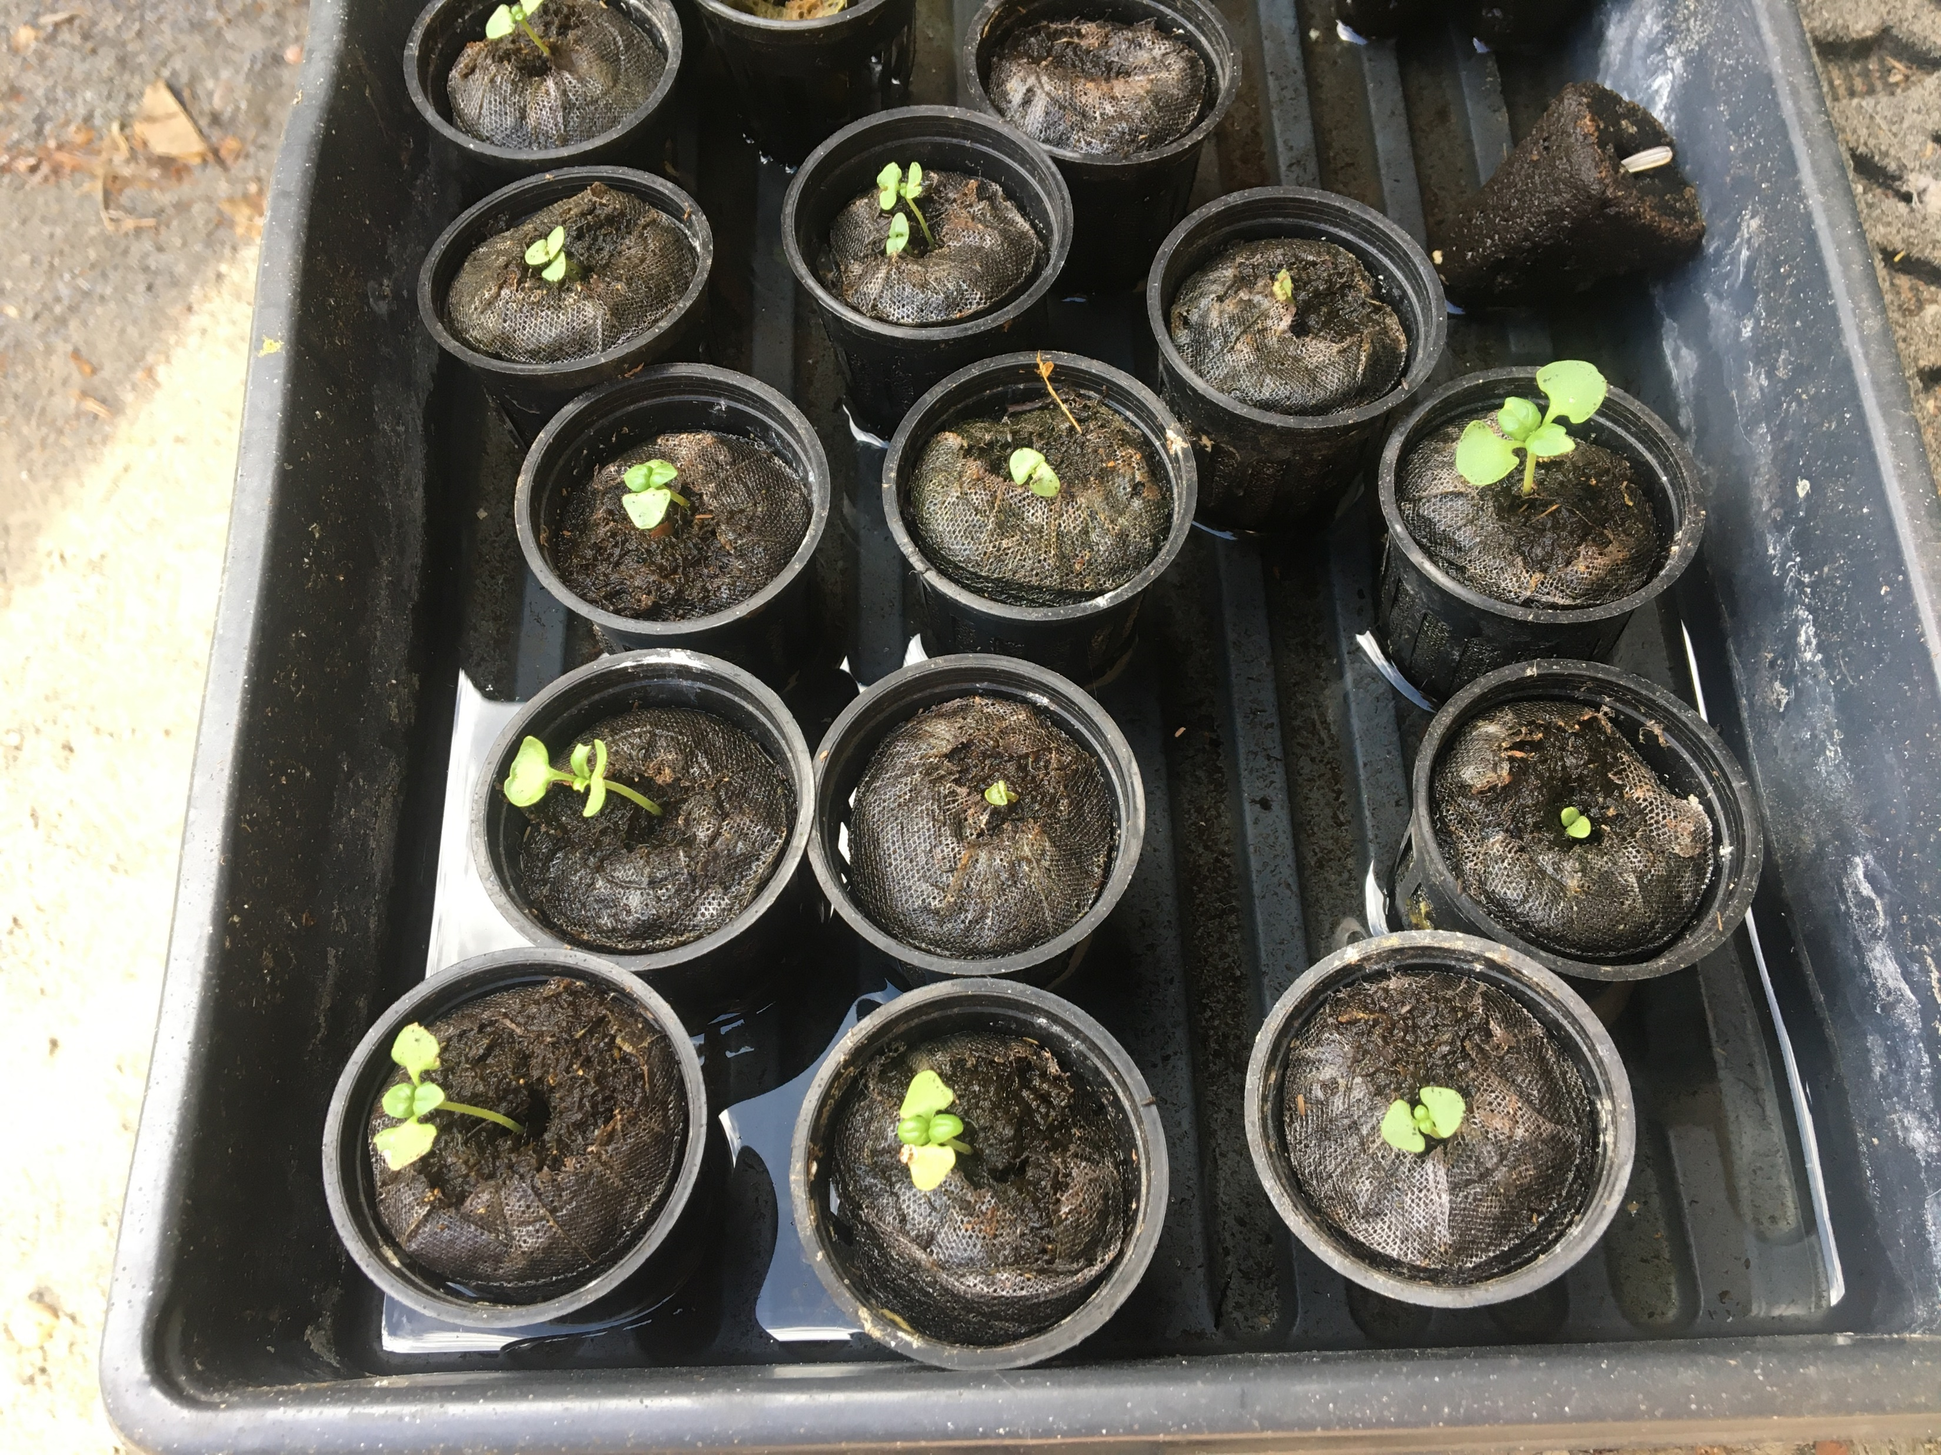
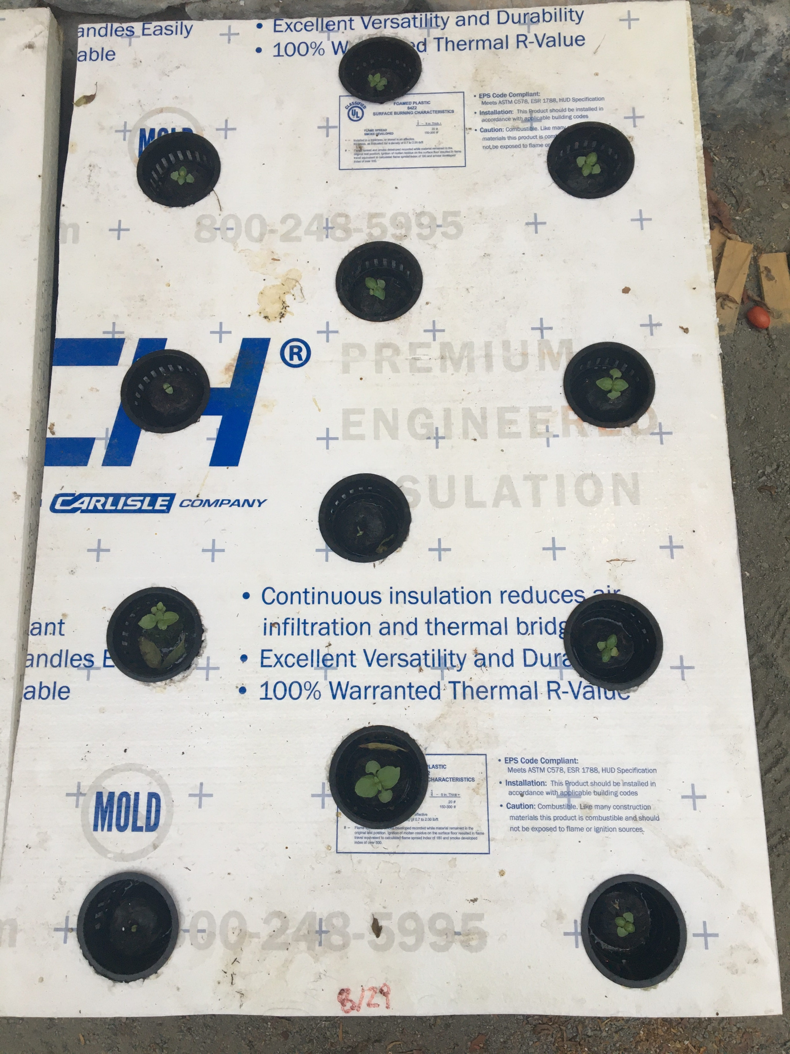
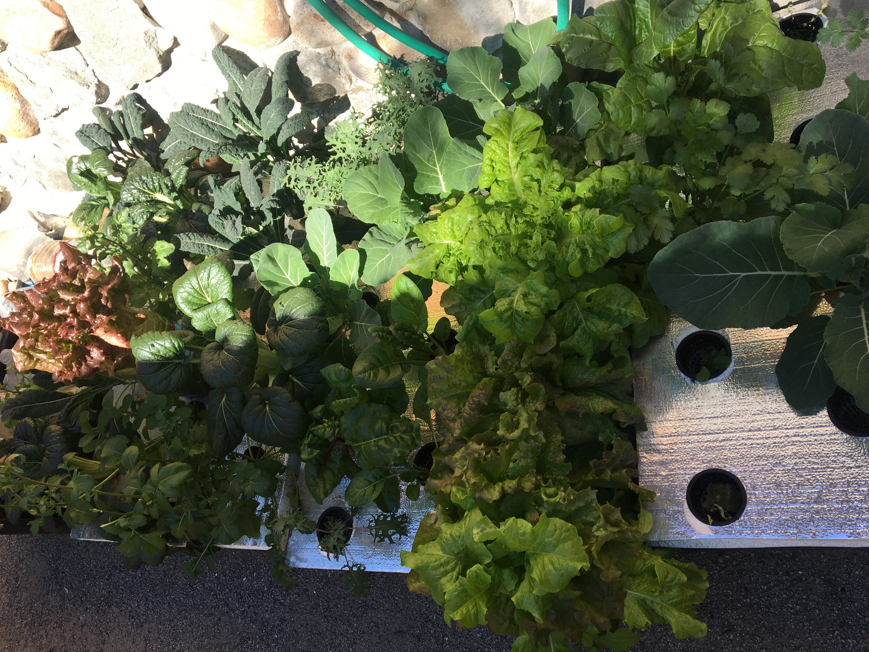
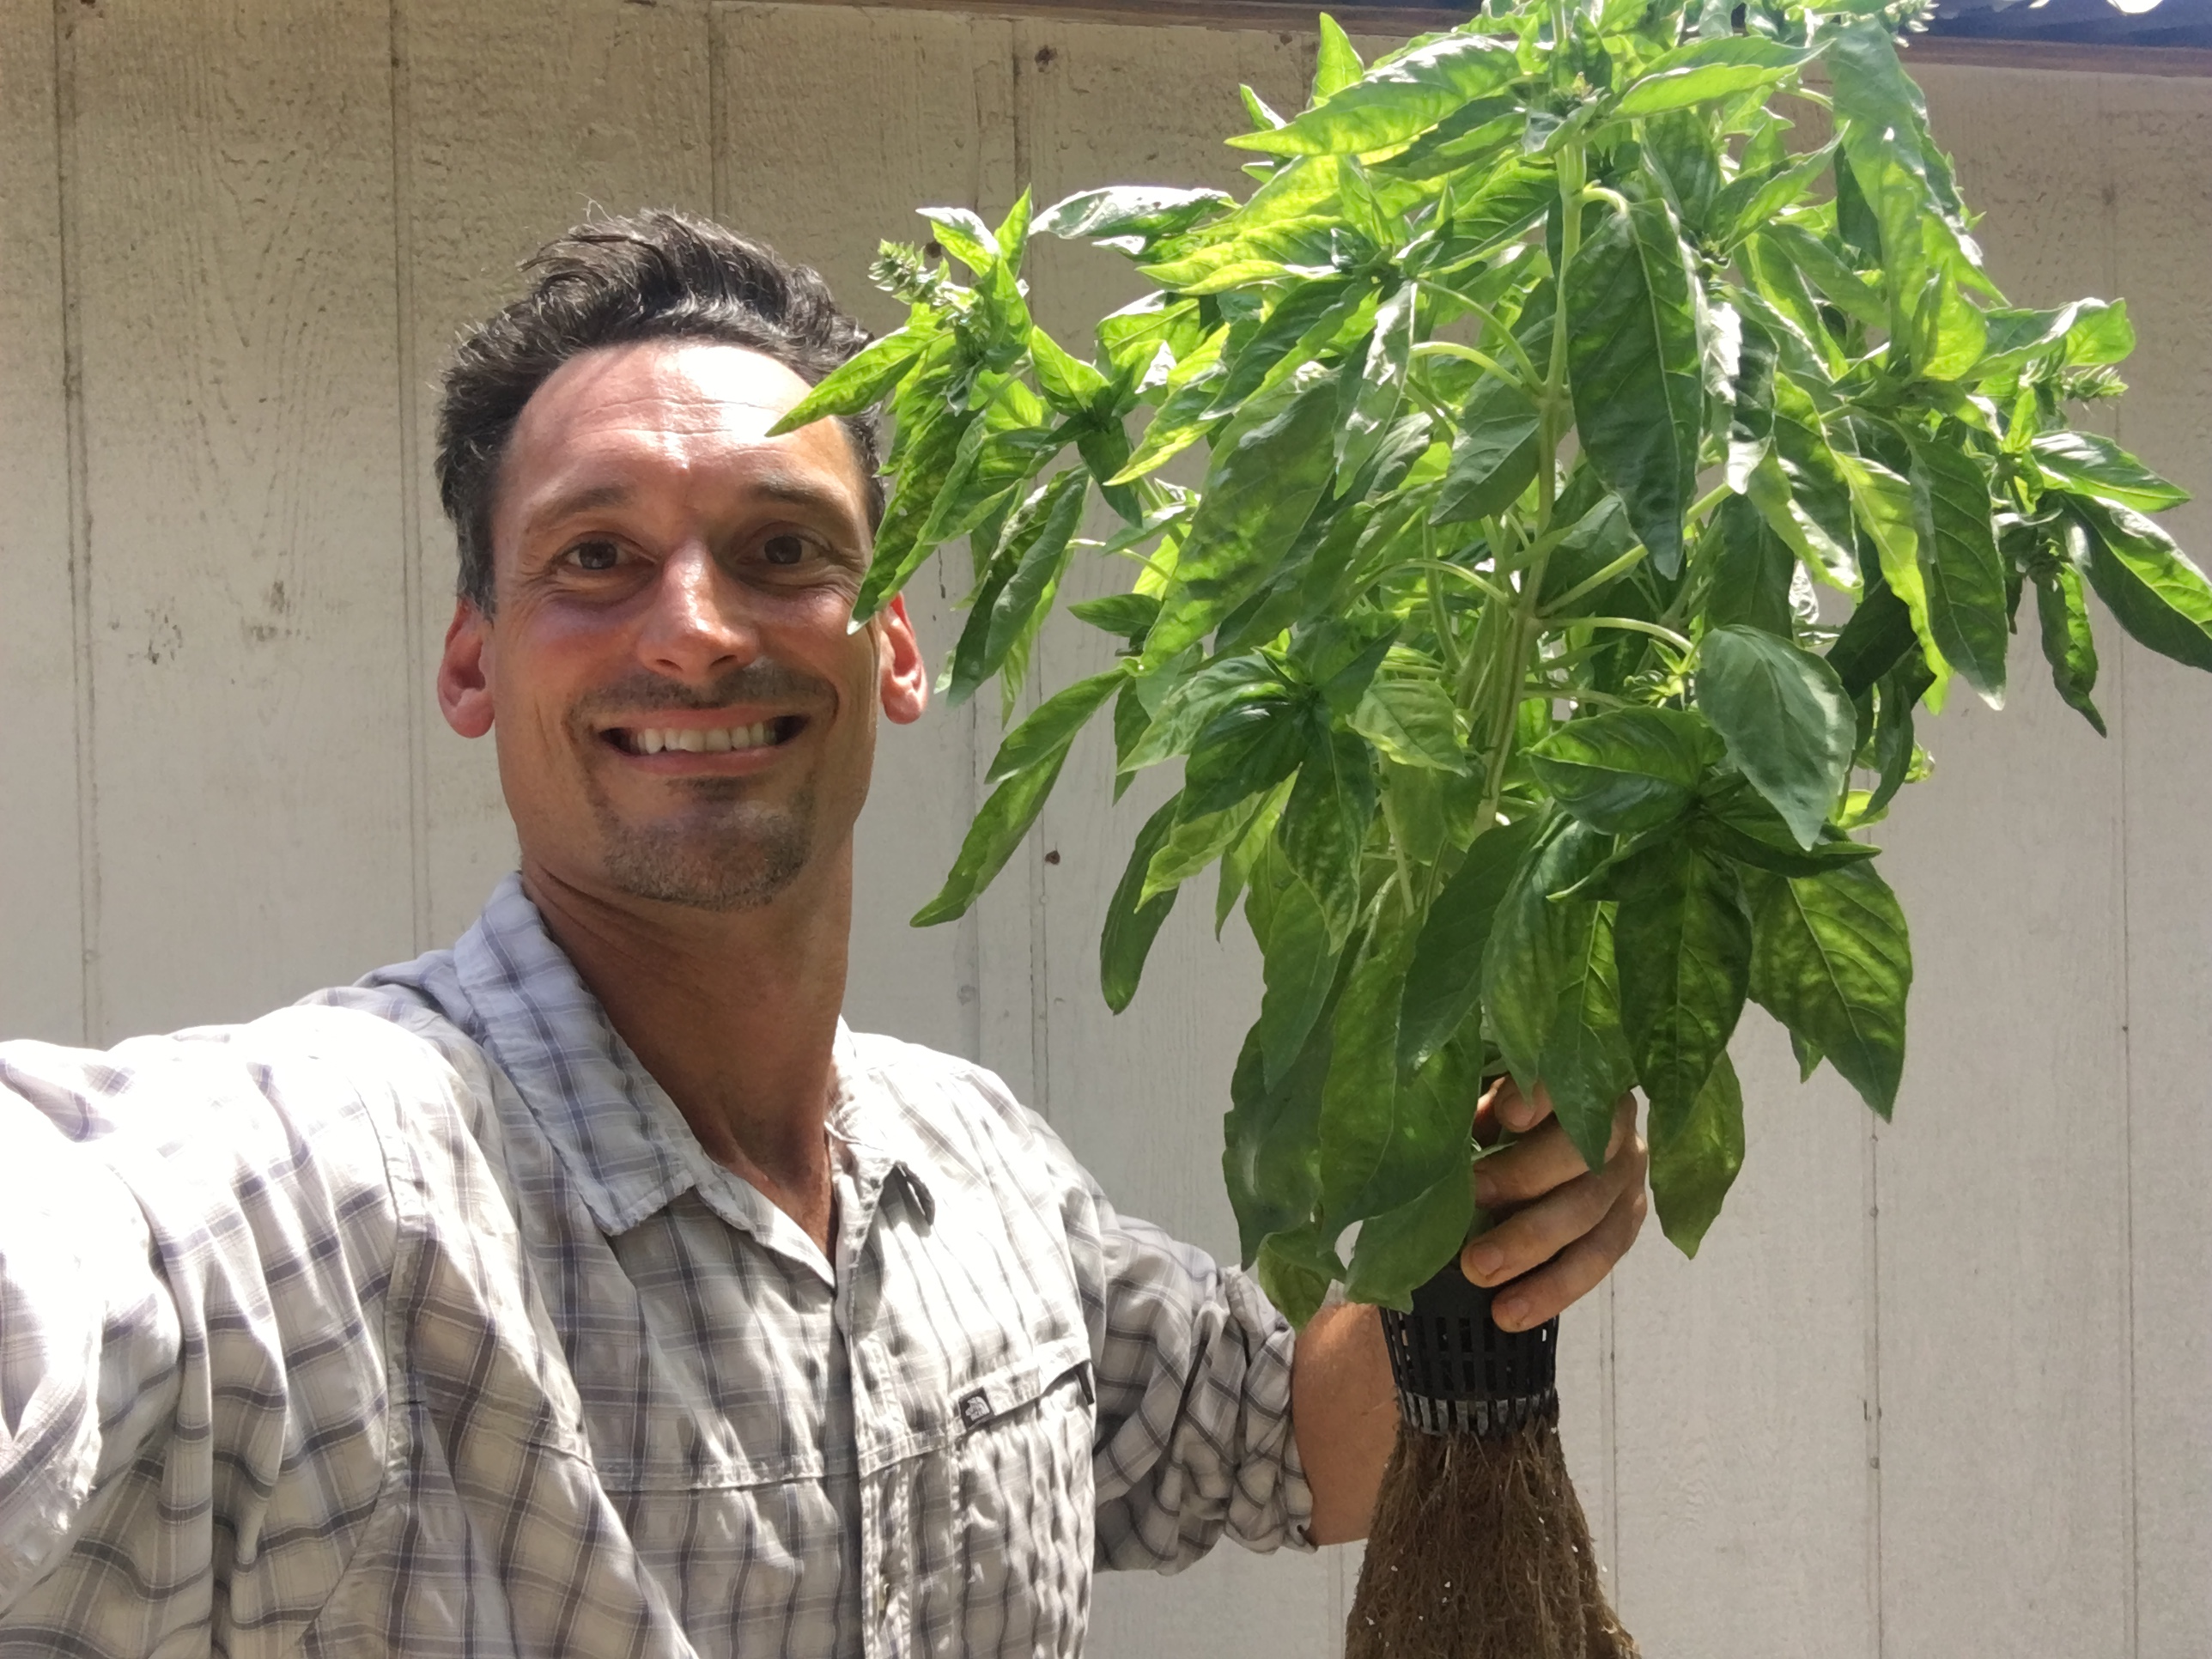
How to grow leafy greens in a 20-gal tub with the Kratky method
YouTube Playlist:
An affordable small-scale method to grow lettuce, spinach, chard, bok choy, kale, basil, mint, cilantro, mustard greens, arugula…
1 – Buy the Tub. Use a Large Concrete Mixing Tub at Home Depot or a Creative Plastic Concepts Large Mixing Tub at Lowe’s. It holds 20 gallons when full. It costs $20.
2 – Make the Cover. Buy a 4ft x 8ft Styrofoam panel ¾ inch or 1 inch thick. You can cut five 2ft x 3ft pieces, each piece fits perfectly over the tub. You can also buy a Twin-wall or corrugated plastic sheet already cut to 2’x 3’. Drill twelve 2-inch holes in the tub, spaced as in the figure below. I indicated the distance between the edge of the cover and the center of the hole. You need a 2” hole saw and a drill.
3 – Buy plugs and seed them. Buy rockwool plugs or pellets. The Grodan 1.5 inch A-OK or the Jiffy 30 mm peat pellets work well. Drop two or three seeds in the center of the plug. Do not broadcast like you would when growing in the soil! Put in a germination tray with water and in full sun.
4 – Buy fertilizer and slit pots. You will need three fertilizers: Calcium Nitrate, Magnesium Sulfate and a Lettuce (or vegetable) formula containing micronutrients. Master Blend is a popular brand that sells small quantities. If you need just a few ounces for a couple of tubs, give me a call.
5 – Put it all together. One of the common mistakes is leaving the plugs in the propagation tray for too long. This will cause plants to stretch and to grow without fertilizer for too long. Lettuce can sprout in 2-3 days and I’ve never had to wait more than a week for other crops like cabbage and basil. Fill the 20-gal tub with water and add 1 oz of Calcium Nitrate, 1 oz of Formula and 0.6 oz of Magnesium Sulfate. Make sure your tub is level. Use a level and wood shims. If the tub is not level, water will pour out from one side before reaching the rim on the other, and plants will die. Make sure you set the tub in full sun! Or in an area exposed to south or southeast. Plants won’t grow in the shade. Find the right spot before filling the tub with water, as it’s too heavy to move once filled. Put the plugs in the slit pots and the pots in the cover holes. Make sure the water with fertilizer touches the bottom of the slit pot.
6 – Optional. If you find mosquito larvae in your tub, you can put a Mosquito Dunk or add some Bt mosquito control liquid. You can grow with organic fertilizer by using 20 fl oz of Hort Americas Pre-Empt liquid fertilizer per 20 gal tub. Yields will be reduced compared to conventional fertilizer. If you set up 6 tubs staggered by one week, you will have a continuous production of leafy greens. Looper and aphids are common pests. I prefer eating them than insecticides.
4 inch
12 inch
20 inch
With the Kratky method you never need to add water or fertilizer to the tub, it’s enough until harvest. This method works well for any leafy greens but does not work for fruiting vegetables (tomatoes, cucumber, pepper etc.). Those need more water and a deeper tub.
2 ¼ inch
Fertilizers for 20-gal tub:
1 oz of Calcium Nitrate,
1 oz of Formula and
0.6 oz of Magnesium Sulfate.
6 ¾ inch
11 ¼ inch
15 ¾ inch
20 ¼ inch
24 ¾ inch
29 ¼ inch
33 ¾ inch
If you are interested in organizing a workshop to show you how to do all this, please contact me. I can share my tools. I will do it if there are at least 10 participants. gspinelli@ucdavis.edu 530-304-3738

