Slide 1
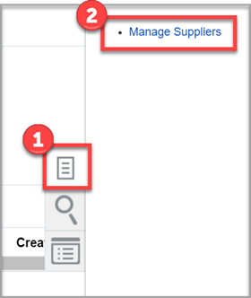
Searching for a Supplier (Vendor)
Navigation Path
Aggie Enterprise > Suppliers > Tasks icon > Manage Suppliers
Aggie Enterprise > Procurement > Purchase Requisitions
Note: For some users, the Manage Suppliers path might be Aggie Enterprise > Procurement > Suppliers > Task icon > Manage Suppliers.

Slide 2
Searching for a Supplier (Vendor)
Search for Existing Suppliers
Log in to Aggie Enterprise.
Click Suppliers, click Tasks, and then click Manage Suppliers. In the Manage Suppliers dialog box, search defaults to the Keywords, but you can click Advanced to view additional ways to search for supplier records.
You can use Keywords, Supplier, or Alternate Supplier Name to locate the supplier by name. This is the recommended and easiest way to search for a supplier.

Slide 3
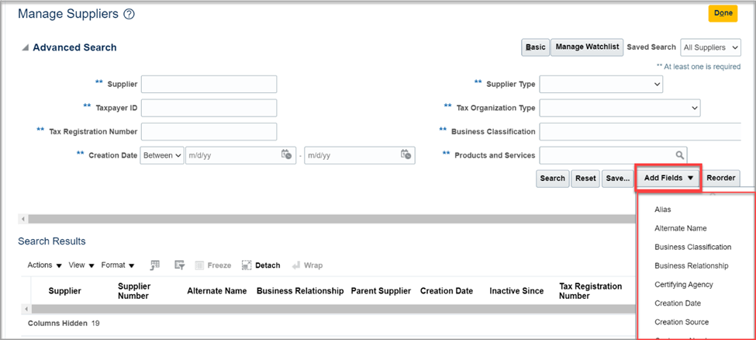
Searching for a Supplier (Vendor)
Click Add Fields to see additional ways to search for suppliers..

Slide 4
Searching for a Supplier (Vendor)
In the search results, click the supplier name to view the supplier details.

Slide 5
Searching for a Supplier (Vendor)
The profile section displays by default, but there are also tabs for viewing the addresses, sites, and contacts for the supplier. The sites identify the various addresses for the supplier record and a supplier site is required on each Requisition.
If no there are no search results, check the spelling to ensure it is correct. Use fewer words in the search to see if this retrieves results. If there are too many search results, enter a more uncommon part of the supplier's name to narrow down the results.

Slide 6
Searching for a Supplier (Vendor)
Search for Existing Vendor in Requisitions
Log in to Aggie Enterprise.
Click Procurement, and then click Purchase Requisitions.
In the Request Forms section, click on the QTY Based or Fixed Price Based Requisition link.

Slide 7
Searching for a Supplier (Vendor)
4. On the Requisition document, click on the lookup icon next to the Supplier field. This will default the search fields Supplier, Supplier Number, and Alternate Name.

Slide 8
Searching for a Supplier (Vendor)
5.Click Advanced to view additional ways to search for supplier records.
The search within the Requisition document provides basic information on a supplier that can be helpful when locating a supplier to cite on a Requisition document.

Slide 9
Creating a New Supplier Recorder (New Vendor)
Overview
Before requesting the creation of a new supplier record, always perform a search first to ensure that the desired supplier record is not already in Aggie Enterprise.
Suppliers can be granted direct access to add a new Supplier record in Aggie Enterprise, or a Department can proxy request on behalf of a supplier. Departments will not have direct access to updating Aggie Enterprise Supplier records, but the completion of the steps below will route the request to the Supplier Services team for review and approval as appropriate.

Slide 10
Creating a New Supplier Recorder (New Vendor)
Register Supplier: Company Information, Address, Contacts
The minimum required fields on the request form are identified with an asterisk and must be completed in order to submit the request. But, there are additional fields that must also be completed before the supplier record can be activated in Aggie Enterprise as indicated below. Always enter as much information as possible to avoid delays for your request.

Slide 11
Creating a New Supplier Recorder (New Vendor)
In the first section of the Company Details screen: Enter the full supplier's name in the Company field.
Select the appropriate Tax Organization Type.
NOTE: The D-U-N-S Number is a unique nine-digit identifier from Dun & Bradstreet for businesses associated with a business’s identity for credit and other business purposes and can be entered if known. This field is not required.
Select the appropriate Tax Country from the drop-down list before entering the Taxpayer ID or foreign Tax Registration Number.
The Note to Approver Box can be used to add a message that will be seen by the Supplier Service Team who are responsible for reviewing and approving each supplier record request.

Slide 12
Creating a New Supplier Recorder (New Vendor)
The Your Contact Information section refers to the contact information for the registration communication. The email address listed in this section will receive an email notification when the record is activated in Aggie Enterprise.
Click the Next button in the upper right corner to proceed to the supplier Contacts section.
The Contacts section will display the contact person/email address entered in the Company Details screen.
Edit this information to be the supplier contact name and email address. The supplier will receive notification once the record has been approved, along with instructions to create an account for future updates.

Slide 13
Creating a New Supplier Recorder (New Vendor)
Whenever possible, entering a group email address for the supplier is preferable to entering an individual's email address.
Additional contact(s) may be added by clicking on the Actions menu, and selecting Create.
Click on the Next button to proceed to the Addresses section.
In the Addresses section, at least one address is required.
Click Actions and choose Create to add an address to the supplier record.
On the Create Address screen, the Address Name can be used to enter "Address 1","Address, 2," etc. This field will be updated by the Supplier Services team to ensure consistency with addressing conventions in Aggie Enterprise.

Slide 14
Creating a New Supplier Recorder (New Vendor)
Select the appropriate Country from the dropdown list before entering the address details.
The Payee Name field is the name for which payments are to be made to the supplier/payee.
The Postal Code field is used to enter the zip code for US addresses. NOTE: This field currently cannot accommodate 4-digit zip code extensions/suffixes. If a 4-digit zip code suffix is entered, a "not valid" error message will display.
The Address Purpose field identifies how the supplier uses that address.
Check both Ordering and Remit to boxes.
Leave the RFQ or Bidding box unchecked.

Slide 15
Creating a New Supplier Recorder (New Vendor)
In the Address Contacts section, click on the Actions menu, and then Select and Add to assign the previously-created contact to the address.
If more than one address is to be entered, click on the Create Another button. If no additional addresses are required, click the OK button.
Click Next in the upper right corner of the screen to proceed to the supplier questionnaire.

Slide 16
Creating a New Supplier Recorder (New Vendor)
Register Supplier: Supplier Questionnaire
Complete the supplier questionnaire, which includes several tax and business certification questions.
After you complete the questionnaire, click Next in the upper-right corner to proceed to the Review section.
Make sure that all displayed data is correct in the Review section, and then click Register to complete the request process. A confirmation screen confirms that the request has been submitted.
All supplier record requests are reviewed by the UC Davis Supplier Services team before the supplier record is activated in Aggie Enterprise. An email will be sent to the email address listed in the Your Contact Information section of the Company Details screen AND to the supplier contact(s) listed in the Supplier Contact section once the supplier record has been activated.

Slide 17
Creating a New Supplier Recorder (New Vendor)
Notes
The Save for Later button allows a user to save the progress on their request and return to it later. All required fields must be completed on the current screen before the Save for Later button can be clicked. Clicking the button will generate an email to the email address listed in the Your Contact Information section of the Company Details screen with a direct link to finish the request later.
Most delays to processing of the supplier request form are due to a lack of information, not too much information.
Once a supplier record is activated, it can be edited as needed for future transactions, such as adding new addresses, updating insurance, information, certifications, etc.
.

Slide 18
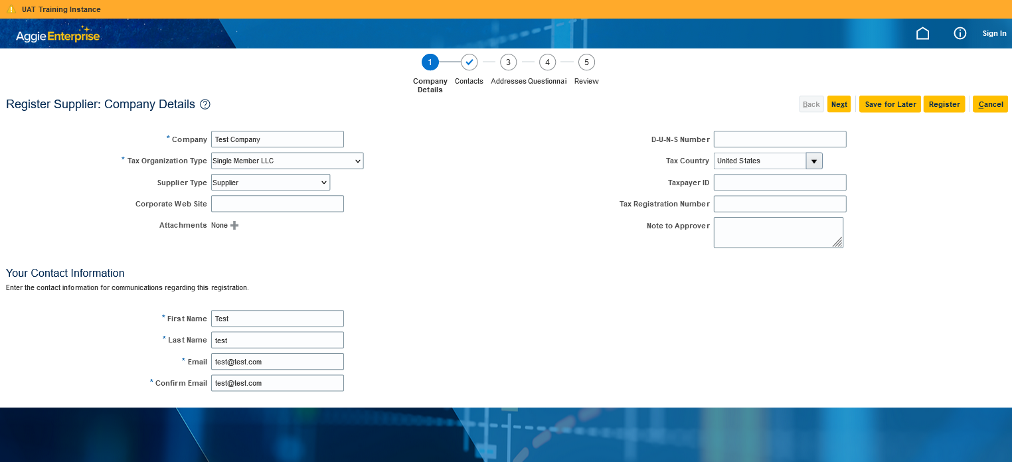
Creating a New Supplier Recorder (New Vendor)

Slide 19
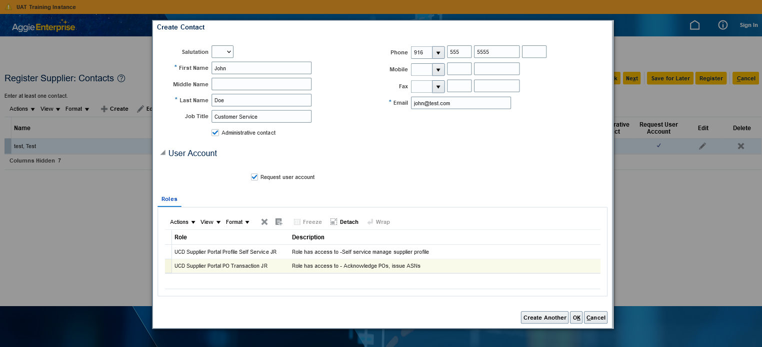
Creating a New Supplier Recorder (New Vendor)

Slide 20
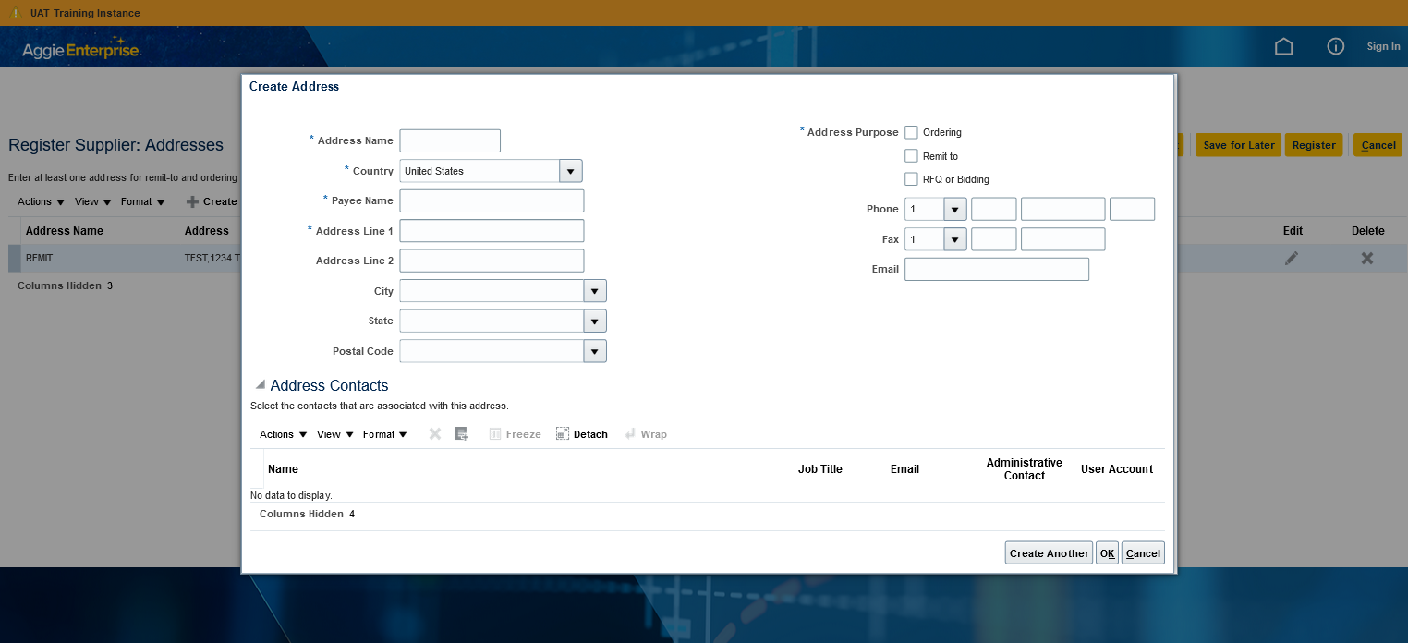
Creating a New Supplier Recorder (New Vendor)

Slide 21
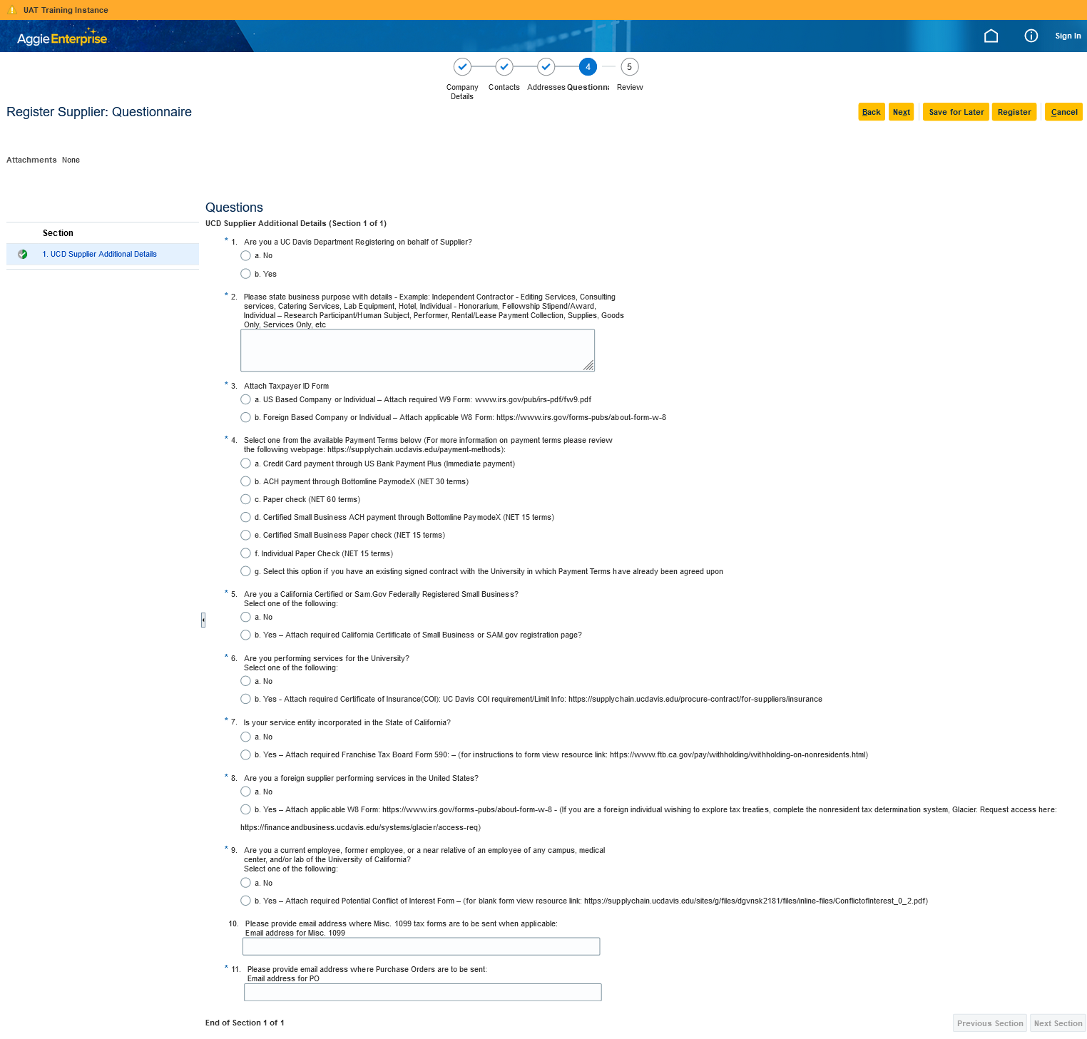
Creating a New Supplier Recorder (New Vendor)

