Slide 1
Preserving Meat
March 18, 2023
Penni, Frances, Bette, Sue, Fran, Steve

Slide 2
Agenda
Food Safety
Canning Meat and Meat Products
Break
Freezing Meat
Drying Meat

Slide 3


Food Safety Basics
Do not rinse meat or poultry
Clean then sanitize work area and tools
Hair back/covered
Clean apron
Wash hands frequently
Food preservation’s goal: keep foodborne
microorganisms from growing in our food
  Destroy or inhibit growth
  Microbial growth danger zone: 40 – 140°F
Notes:
Note: some slides have animation on it; watch it first in slide show mode.
Let’s go over some food safety information to make sure we’re all on the same page.
<click> Don’t worry about washing produce until you’re ready to use it. Then, just rinse it under cool water and use your hands or a scrub brush to clean.
<click> One benefit of the pandemic is we’ve learned how to sanitize our kitchen work areas, right? The first step is to clean. Use a damp cloth to remove crumbs, globs of jam, and anything else that ended up on your counter. Then sanitize to get rid of the majority of germs. Let your cleaning solution sit on the surface long enough to do its job – at least 10 seconds; it’s not a magic wand that works immediately.
<click> Don’t forget to prep yourself, too. Pull your hair back. This obviously helps keep hair from ending up in your food, but also keeps you from repeatedly touching your hair to get it out of your eyes. Your hair collects lots of microscopic organisms from the air. Keep your clean hands away from your hair. 50% of p
<click> Wear a clean apron. Yes, it protects your clothes from getting dirty, but more importantly, it protects your food from what is on your clothes. If you snuggle pets during the day or if carry things from outside against your chest, you’re clothes aren’t food-safety-clean.
<click> And if you use your cell phone for the recipe or as a timer, sanitize it, too.
<click> Wash your hands frequently. They touch a lot of surfaces while you cook that you may not have sanitized. Think cupboard door handles, the garbage can, refrigerator door handle, the phone, garbage disposal switch, and more.
<click> All these preventative measures are part of food preservation’s overall goal: to keep foodborne pathogens from growing in food.
Let’s take a look at the three main food preservation methods.

Slide 4
Long-Term Preservation Methods
Freezing
  Prevents microorganisms from growing (hibernation)
Dehydrating
  Removes moisture needed by microorganisms to grow
Canning
  Destroys molds, bacteria and yeasts
  Creates sealed, pasteurized, shelf-stable product
Notes:
When we preserve food, we either destroy pathogens or prevent them from growing.
<click> Freezing essentially puts foodborne microorganisms into an extreme state of hibernation. Freezing doesn’t kill microorganisms, but it does prevent them from growing.
<click> Dehydrating removes moisture from food. Microorganisms need moisture to grow. No moisture, no growth. When properly stored, dried microorganisms don’t grow. They do, however, survive dry conditions very well. So keep dried foods dry during storage so they don’t start to rehydrate, giving the microorganisms a good growth environment.
<click> Canning uses heat to destroy pathogens so they can’t grow in the sealed jars, creating a shelf-stable, pasteurized product.

Slide 5
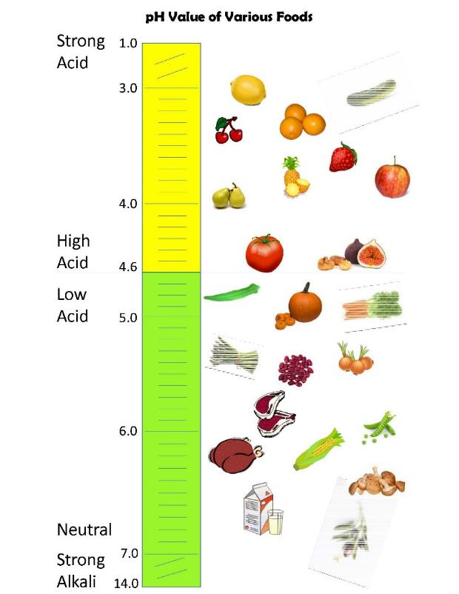
Canning Methods
Acidity determines method
High acid foods:
boiling water canner or atmospheric steam canner
Low acid foods: pressure canner
Notes:
Use either boiling water or pressure to can food. The deciding factor on which method is the acidity level of the food you’re canning.
Most fruits are a high acid food. You can them with a boiling water or steam canner.
<click> Citrus is very acidic; it’s very high on the chart.
Most vegetables are low acid foods. You can them with a pressure canner. Beans, meats, fish and seafood are also low acid foods. We aren’t going to cover pressure canning today, but there are several videos in the statewide UC Master Food Preserver Video library that demonstrate how to use a pressure canner. At the end of the presentation I’ll share the video library link.
Some fruits are borderline acidic and we add commercial lemon juice or vinegar to increase their acidity to make them safe to can in a boiling water or steam canner. Tomatoes, figs and Asian pears fall into this category.
When you pickle a vegetable - and you can pickle just about ANY vegetable - you increase the acidity so it becomes a high acid product. This is why you can process pickled vegetables in a boiling water or steam canner.

Slide 6
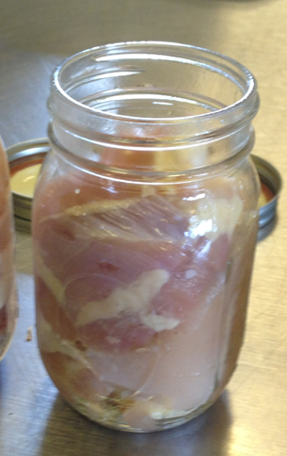
Why 2 Canning Methods?
Concern over Clostridium botulinum bacteria
  Grows: low acid food, moist, anaerobic, room temp
    Creates toxin that causes botulism
  Doesn’t grow: high acid foods, dry, aerobic, cold temp
Inhospitable environment? Protective spore
  240°F to kill spore, then bacteria
  Need pressure to reach 240°F
Assume present; no uniform distribution
Notes:
Why are there 2 canning methods?
Well, most bacteria, molds and yeast are killed at boiling water temperature. The one that isn’t, the one we worry about,
<click> is Clostridium botulinum, which causes botulism. This pathogen is often in and on soil, which means it ends up on fresh fruits and vegetables, which we eat. It only grows when there’s low-acid environment, moisture, no oxygen, and it’s at room temperature. If we eat the bacteria, it won’t grow and get us sick because our stomach is highly acidic and it passes through our system. If it’s in a jar of jelly, fruit or pickled vegetable, it won’t grow because of the high acidity. If we dehydrate it, we remove the moisture it needs and it won’t grow. When it’s out in the open, it won’t grow because it’s surrounded by oxygen. If we freeze it, it won’t grow – it’s too cold.
<click> When Clostridium botulinum can’t grow, it creates a protective spore around itself and waits patiently for the ideal environment. This is only a concern when canning low-acid foods. The spore is a tough bugger. It takes a temperature of 240 degrees to destroy. No matter how hard you boil water, it’ll never get above 212. So we have to use a pressure canner to reach 240 degrees, then keep the temperature that high long enough to kill any Clostridum botulium bacteria in the food. If you don’t kill it in the canned low acid food, it grows and creates a toxin. If we eat that toxin, we get the disease called botulism, which can be deadly. So we make sure that we destroy the pathogen so it doesn’t grow.
<click> There’s no uniform distribution of pathogens, so you can never tell if Clostridium botulinum is in your low-acid canned goods. Assume it is, pressure can the jars, and then you don’t need to worry.
<click> Remember, there’s no danger of getting botulism from canned jams & jellies, pickles and fruit because they’re high acid foods. This includes canned citrus products.

Slide 7
Agenda
Food Safety
Canning Meat and Meat Products
Break
Freezing Meat
Drying Meat

Slide 8
Canning Meat and Meat Products
Canning Demo: Broth
Process steps, page 2
Handout, page 4
Prep Food & Fill Jars
Raw-pack vs. Hot-pack
Jars, lids & rings
  Only need to wash lids and rings, then set aside – no pre-heating!
Headspace
Strong finger tight ring placement

Slide 9
Using a Pressure Canner
Check canner parts (Today’s Demo Canner: Presto)
Canner rack & water depth
Jars in canner
Lid safety features
  Lock
  Pressure release safety plug
  Vent Port
  Pressure lock

Slide 10
Using a Pressure Canner: Venting
High heat
  Force out all air in canner
  Want a pure steam environment in canner
  Look for steady stream of steam
Show and Tell: Canned Ground Beef
  Recipe, page 4

Slide 11
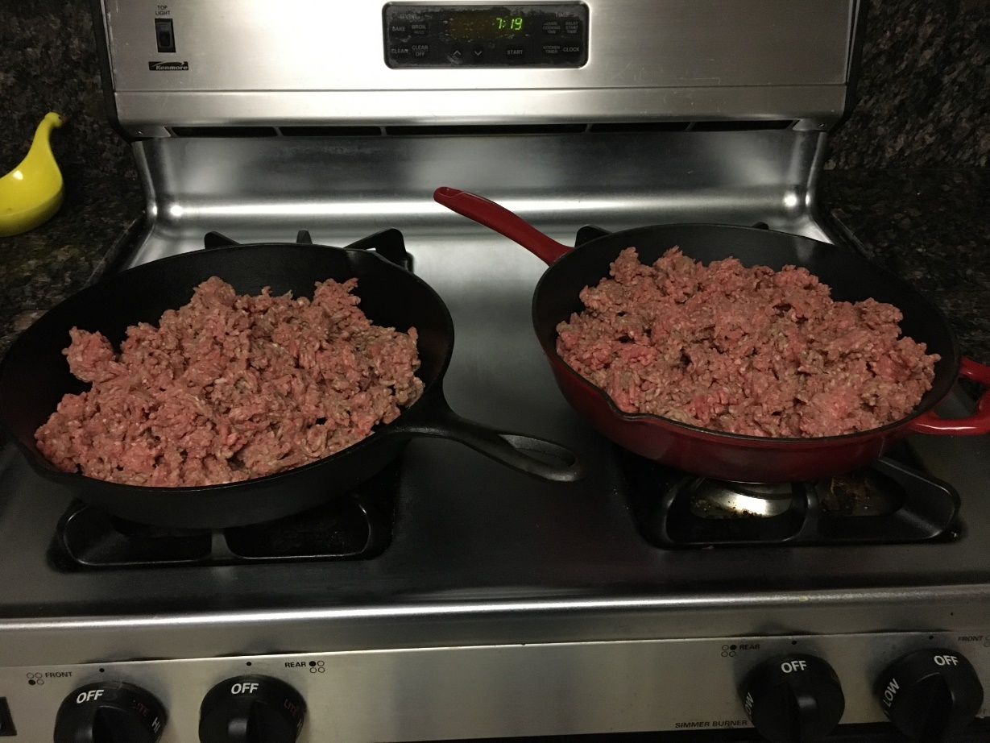
Show & Tell: Canned Ground Beef
Cook until lightly browned
Notes:
Last fall I found an awesome sale on ground beef and stocked up. Our freezer was full, so I decided to can ground beef for the first time. This way I can have tacos at a moment’s notice without having to thaw and cook the beef. Or I can add it to my homemade tomato sauce without dirtying another pan.
Here’s what I did.
<click> First, I cooked the meat
<click> until it was lightly browned. Next, I drained the excess fat. I put a cookie sheet on the counter bumping up to the skillet so I wouldn’t drip on the counter or stove – or the crack in between. I put the meat into a mesh strainer and let it drip. Next time I will take the extra step of putting it on some paper towels to absorb more of the fat.
<click> Then I put the drained ground been in canning jars, added boiling water over it, and canned it. This is what it looked like when I took it out. It is unseasoned. I’ll season it when I use it.
I’ll show you a picture of what it looks like now. When I took it out of the canner it was hot and any fat in the jars was melted.
<click> It’s cooler now and the fat floated to the top and solidified. Luckily it’s at the top of the jar so it’s easy to remove. The lighting makes it look redder than it is; the color hasn’t changed from when it came out of the canner.
This works great and I’ll do it again. And I’ll ignore the comments from my family when they look at the pantry – ewww, what’s this supposed to be?!

Slide 12
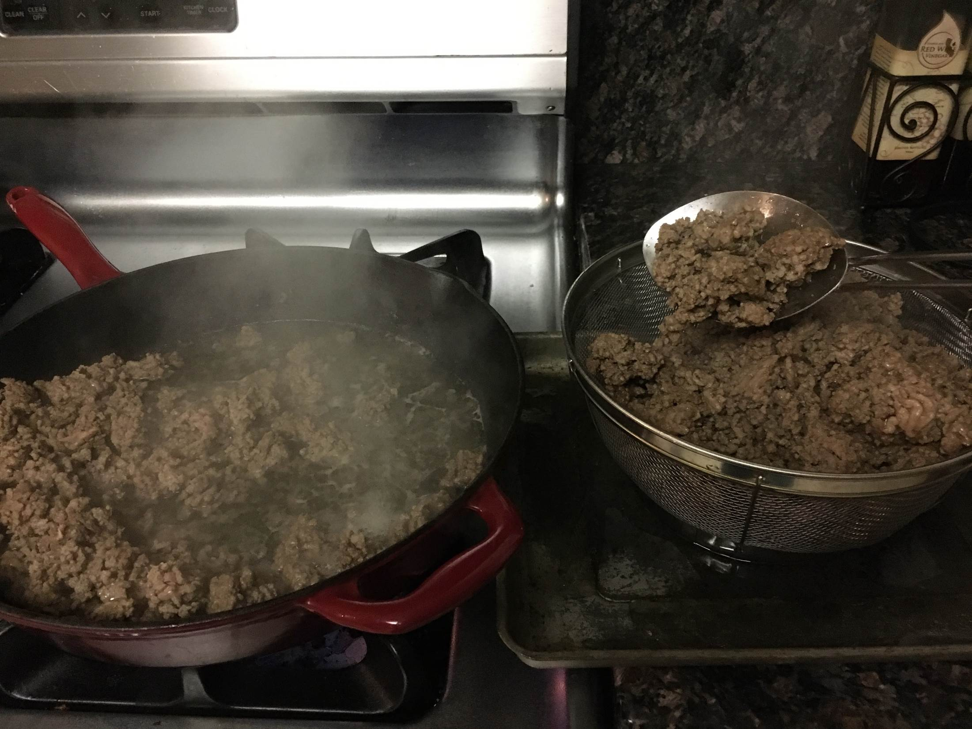
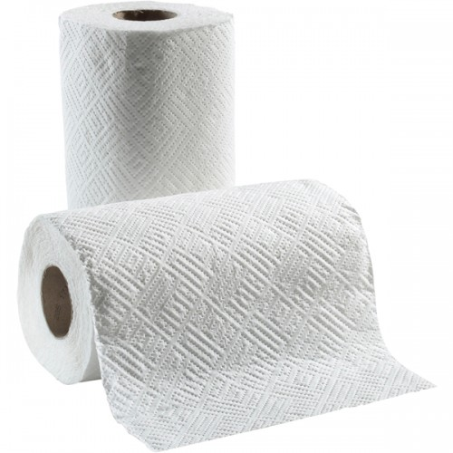
Show & Tell: Canned Ground Beef
Drain excess fat
Pat dry with paper towels
Notes:
Next, I drained the excess fat. I put a cookie sheet on the counter bumping up to the skillet so I wouldn’t drip on the counter or stove – or the crack in between. I put the meat into a mesh strainer and let it drip. Next time I will take the extra step of putting it on some paper towels to absorb more of the fat.

Slide 13
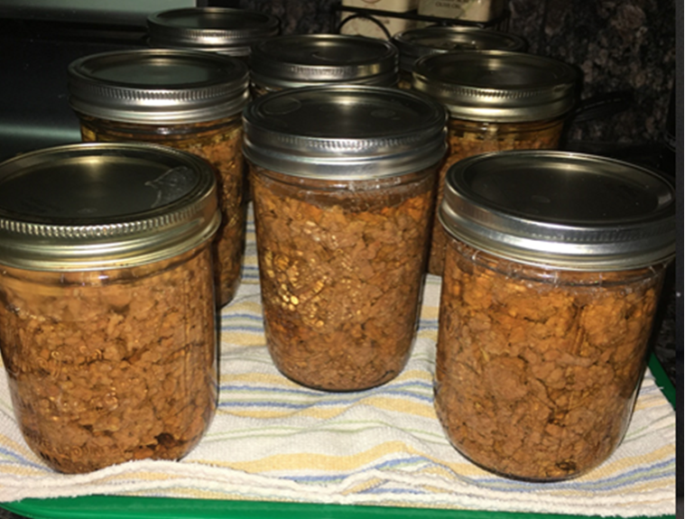
Show & Tell: Canned Ground Beef
Put drained ground beef in jars
Cover with boiling water
Process it (pg 4)
Notes:
Last fall I found an awesome sale on ground beef and stocked up. Our freezer was full, so I decided to can ground beef for the first time. This way I can have tacos at a moment’s notice without having to thaw and cook the beef. Or I can add it to my homemade tomato sauce without dirtying another pan.
Here’s what I did.
<click> First, I cooked the meat
<click> until it was lightly browned. Next, I drained the excess fat. I put a cookie sheet on the counter bumping up to the skillet so I wouldn’t drip on the counter or stove – or the crack in between. I put the meat into a mesh strainer and let it drip. Next time I will take the extra step of putting it on some paper towels to absorb more of the fat.
<click> Then I put the drained ground been in canning jars, added boiling water over it, and canned it. This is what it looked like when I took it out. It is unseasoned. I’ll season it when I use it.
I’ll show you a picture of what it looks like now. When I took it out of the canner it was hot and any fat in the jars was melted.
<click> It’s cooler now and the fat floated to the top and solidified. Luckily it’s at the top of the jar so it’s easy to remove. The lighting makes it look redder than it is; the color hasn’t changed from when it came out of the canner.
This works great and I’ll do it again. And I’ll ignore the comments from my family when they look at the pantry – ewww, what’s this supposed to be?!

Slide 14
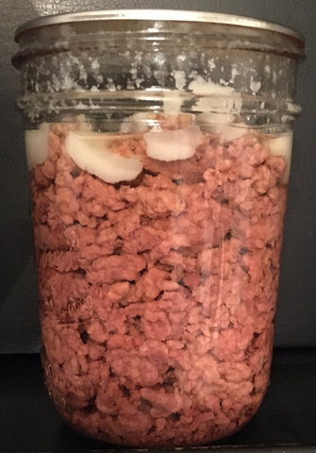
Show & Tell: Canned Ground Beef
Finished product:
Solidified fat removes easily
Notes:
Last fall I found an awesome sale on ground beef and stocked up. Our freezer was full, so I decided to can ground beef for the first time. This way I can have tacos at a moment’s notice without having to thaw and cook the beef. Or I can add it to my homemade tomato sauce without dirtying another pan.
Here’s what I did.
<click> First, I cooked the meat
<click> until it was lightly browned. Next, I drained the excess fat. I put a cookie sheet on the counter bumping up to the skillet so I wouldn’t drip on the counter or stove – or the crack in between. I put the meat into a mesh strainer and let it drip. Next time I will take the extra step of putting it on some paper towels to absorb more of the fat.
<click> Then I put the drained ground been in canning jars, added boiling water over it, and canned it. This is what it looked like when I took it out. It is unseasoned. I’ll season it when I use it.
I’ll show you a picture of what it looks like now. When I took it out of the canner it was hot and any fat in the jars was melted.
<click> It’s cooler now and the fat floated to the top and solidified. Luckily it’s at the top of the jar so it’s easy to remove. The lighting makes it look redder than it is; the color hasn’t changed from when it came out of the canner.
This works great and I’ll do it again. And I’ll ignore the comments from my family when they look at the pantry – ewww, what’s this supposed to be?!

Slide 15
Using a Pressure Canner: Venting
High heat
  Force out all air in canner
  Want a pure steam environment in canner
  Look for steady stream of steam
  Start timing: vent for 10 minutes
Show and Tell: Mincemeat Pie Filling
  Recipe, page 4

Slide 16
Using a Pressure Canner: Building Pressure
Weight on vent port
Start timing when at pressure
  Adjust for elevation: increase pressure to increase temperature
  What temp needed to destroy C bot spores?
  Dial gauge: dial at correct pressure
  Weighted gauge: pressure regulator starts to release pressure
Show and Tell: Chili Con Carne
  Recipe, page 5

Slide 17
Using a Pressure Canner: Process
Adjust heat to control pressure
  Broth: Process for 20 minutes
  Pressure drops? Return to pressure and restart timing
    Pay attention!
Show and Tell: Chicken
  Recipe, page 5

Slide 18
Show and Tell: Canned Chicken
Remove excess fat
Raw pack
  Raw chicken in hot jar, loosely packed, 1.25” headspace
  No added liquid; liquid pulled from chicken as it cooks
  Canner water at 140°F
Hot pack
  Cook chicken to 110°F
  Pack in hot jar, add cooking liquid, debubble, 1.25” headspace
  Canner water at 180°F
Process in pressure canner
Show and tell: finished raw-pack chicken breast

Slide 19
Using a Pressure Canner: Depressurize
Ding! Processing time complete
  Turn off heat & walk away
  Cool down to depressurize naturally
  Pints – about 30 minutes
  Quarts – about 45 minutes
Show and tell: other pressure canner models
Like a rental car; different models, same usage process

Slide 20
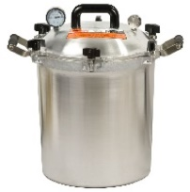
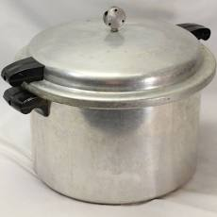
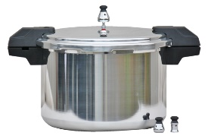
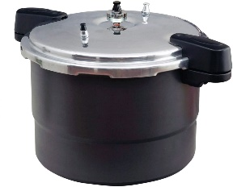
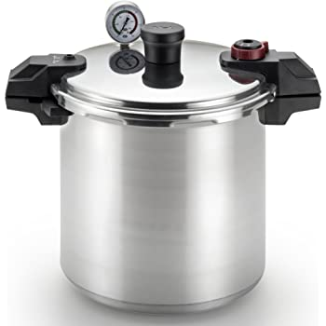
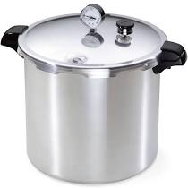
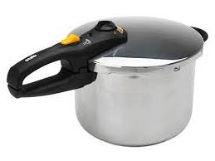
So Many Options!
Mirro
Old style Current style
All American
Granite ware
Presto
(induction compatible model available)
T-Fal
Fagor / Zavor
Notes:
So let’s put a brand name to each of the canners shown earlier. I’ll have the real ones available at our Friday class for show and tell.
<click> to bring up each brand name.
Granite ware has a non-stick interior and comes with a steaming rack for cooking.
T-fal’s over pressure plug is in the top handle; less mess if it is forced out.
Note that Fagor isn’t sold or supported in the US anymore and can only be canned at the highest pressure setting. More on that in another module. There’s a similar model available called a Zavor. Both can work on induction burners. And both have a spring loaded pressure adjuster, so you need to be careful with storage so you don’t bang it around and impact the accuracy.
Remember, these canners look different from each other, but they have the same core components, they’re just different models.

Slide 21
Using a Pressure Canner: Post Processing
Depressurized?
  Dial gauge canner: pressure indicator button down, gauge at 0
  Weighted gauge canner: gauge at 0 and/or regulator spins without hissing
  Remove weight from vent pipe
  Wait 10 minutes
Break

Slide 22
Using a Pressure Canner: Cool Down
Jars out onto protected surface
Leave jars & rings alone!
  Cool 12-24 hours
  Lid gasket cools and seals around jar rim
  Check for sealed jar; refrigerate unsealed jars
Dry canner & parts; store per manufacturer’s recommendation

Slide 23
Agenda
Food Safety
Canning Meat and Meat Products
Break
Freezing Meat
Drying Meat

Slide 24
Freezing Meat
Avoid mushy texture
Avoid freezer burn

Slide 25

Frozen Meat Texture
Natural water freezes and expands
  Ice crystals rupture cell walls of
  meat products
  Beginning of mushiness
Thawed foods spoil faster than fresh food
  Get small ice crystals: freeze fast!
Notes:
The fourth factor to control when freezing food is water.
Food contains water. When the food freezes, so does the water inside it, forming ice crystals, which rupture the cell walls of your food.
This will always happen because there’s water in our food. To maintain the best texture, you want to minimize the size of those ice crystals. Large ice crystals do more damage to food cells and cause softer, mushier textures.
Water and foods freeze differently. When water freezes and ice crystals form, there is actually a small amount of heat produced. The temperature of the water remains at 32°F as the ice crystals grow, and then a rapid temperature drop occurs as the ice crystals cool.
Because foods are a complex mixture of many substances, their freezing point is below the freezing point of water. A slow temperature drop occurs as ice crystals form within the food. The temperature then drops more quickly as the crystals cool inside the food. Each food will freeze differently based on things like the amount of water, sugar, muscle tissue or air in the food.
Foods that don’t freeze well (and the effects of freezing on their texture) are summarized on the NCHFP at:
http://www.uga.edu/nchfp/how/freeze/dont_freeze_foods.html. A copy of the list is in your Resources section.

Slide 26
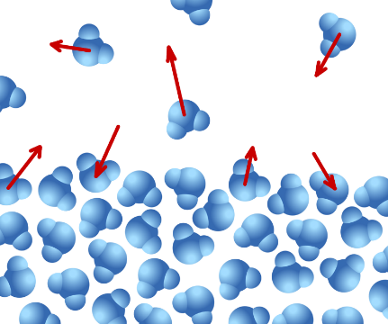
Frozen Meat Texture
Natural water freezes and expands
  Ice crystals rupture cell walls of
  meat products
  Beginning of mushiness
  Get small ice crystals: freeze fast!
Freezer temp: 0° or lower
-10° for large quantities
Consistent temperature
Notes:
The fourth factor to control when freezing food is water.
Food contains water. When the food freezes, so does the water inside it, forming ice crystals, which rupture the cell walls of your food.
This will always happen because there’s water in our food. To maintain the best texture, you want to minimize the size of those ice crystals. Large ice crystals do more damage to food cells and cause softer, mushier textures.
Water and foods freeze differently. When water freezes and ice crystals form, there is actually a small amount of heat produced. The temperature of the water remains at 32°F as the ice crystals grow, and then a rapid temperature drop occurs as the ice crystals cool.
Because foods are a complex mixture of many substances, their freezing point is below the freezing point of water. A slow temperature drop occurs as ice crystals form within the food. The temperature then drops more quickly as the crystals cool inside the food. Each food will freeze differently based on things like the amount of water, sugar, muscle tissue or air in the food.
Foods that don’t freeze well (and the effects of freezing on their texture) are summarized on the NCHFP at:
http://www.uga.edu/nchfp/how/freeze/dont_freeze_foods.html. A copy of the list is in your Resources section.

Slide 27
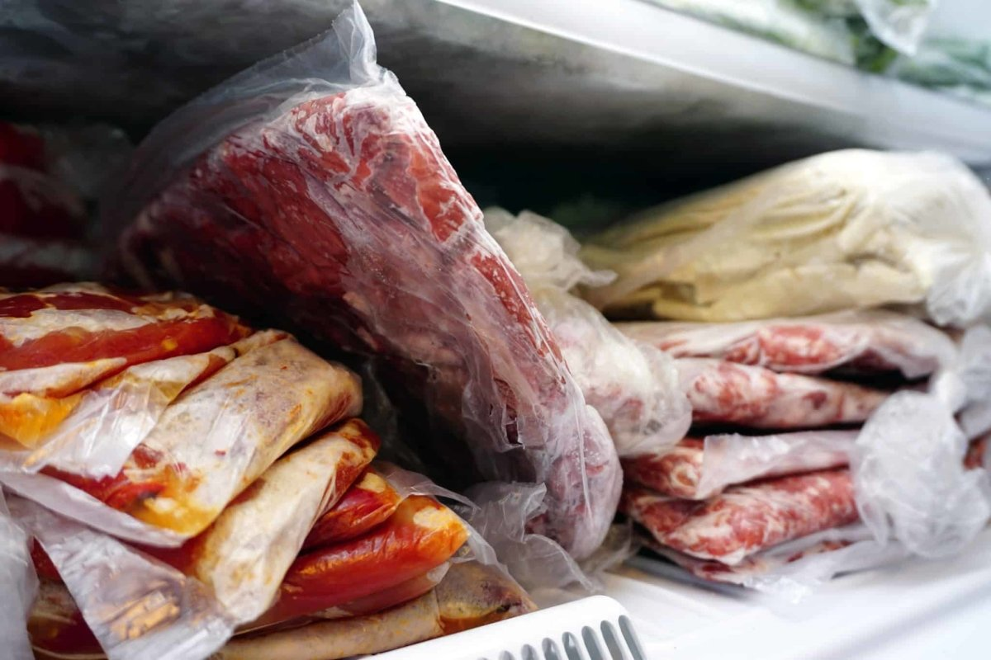
Frozen Meat Texture
Freeze foods fast!
Air circulation
Notes:
<click> Many commercial food manufacturers use blast freezers operated at temperatures in the range of -30 to -60 degrees F, with very fast airflow. This freezes food very, very fast with the formation of very small ice crystals, to maximize quality.
While you may not have a fan circulating freezing cold air in your freezer, if you leave space around the containers when they are initially freezing, the cold air can circulate around the containers to speed up the freezing process.
It’s a similar concept to a boiling water canner when you want the boiling water beneath, around, and above the jars for even heat penetration. In the same manner we want the container to have as much cold air as possible around it on as many sides as possible to promote a fast freeze.

Slide 28
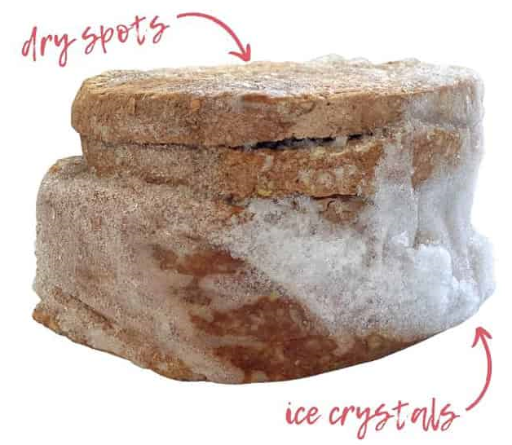
Preventing Freezer Burn
Dried out food = freezer burn
  Quality issue; safe to eat
Prevention:
  Remove air; keep it out
  Package properly
  Remove surface moisture
  Keep it frozen (“What’s in here?”)
Notes:
Let’s move on to the fifth factor you need to control when freezing food: moisture evaporation.
The air in a freezer is very dry. If foods are improperly packaged and exposed to the dry air in the freezer, or if moisture is pulled through the packaging material from inside to outside the package, the moisture evaporates and the food dries out.
<click> Freezer burn is dried out frozen food. It is a quality issue, not a food safety issue.
<click> If the temperature in the freezer warms up enough for moisture to evaporate from the food and then refreeze, it creates exterior ice crystals and dries out the food. In its simplest form, freezer burn is a food flavored ice blob.
<click> Moisture loss leaves the food exposed to oxygen, which accelerates loss of color, flavor, and texture, resulting in what is known as freezer burn
Freezer burn often looks like a grainy, brownish or whitish spot on the surface of food, where the tissues become dry and tough. This dried surface area is very likely to develop off-flavors, but it will not cause illness. Again, it’s a quality issue, not a food safety issue.
<click> Opening/closing the freezer door allows room temperature heat to enter the freezer, causing foods foods to warm up and their water starts to evaporate. I recommend putting frozen liquids in the door storage since their quality won’t degrade if they warm up; they’re already a liquid. In the heat of the summer it may feel great to stand in the open door of a freezer, but you aren’t doing your food any favors.
<click> How do you prevent freezer burn? Get rid of the moisture and air in the package, and keep it out.
If you are repackaging meat and freezing it, take paper towels and remove as much surface moisture as possible. Make sure your fresh fruits and vegetables are also dry before putting them in the freezer.
Use freezer safe containers and remove as much air as possible from the package. More on that in Module 4.

Slide 29
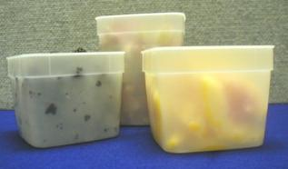

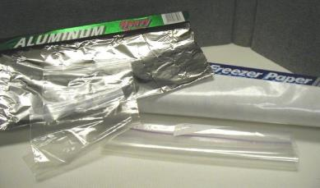
Freezer Packaging
Designed for freezing
Moisture-vapor resistant
  Prevents transfer of moisture and air in and out of package
Notes:
<click> Canning jars are designed for hot and cold temperatures; non-canning jars break too easily in the freezer. Be sure to allow enough space for expansion, and inch and a half with liquids.
<click> When freezing liquids, only use straight-sided jars. Jar shoulders can crack because freezing liquids do not conform to the shape of their container. Frozen food is like a glacier – it forces it’s way up the jar. I have a MFP friend who froze a bunch of tomato sauce in jars and didn’t even think about the shape and put them in shouldered quart jars. They all cracked at the shoulder. She ended up tossing them because she didn’t know if there were bits of glass in the sauce. So sad. And she was so mad at herself because she knew the right way to do it!

Slide 30
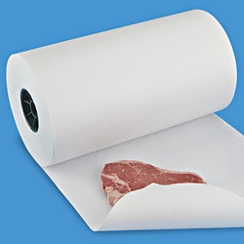
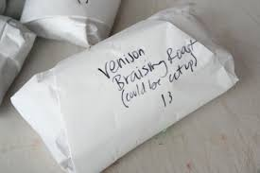
Freezing Meat
Vacuum sealer
Freezer paper
  Freezing section, page 2
  Drugstore wrap
  Butcher wrap
Storage times (best quality)
  Freezing section, page 4
Cured meats: 1-3 months
Salt hastens rancidity
Notes:
Reference Handout: Methods of wrapping.
When freezing meat, remove as much excess fat as possible just as you would before cooking. Before you wrap it, pat it dry with paper towels.
If you have a vacuum sealer, it’s a great way to remove the air.
<click> If you use freezer paper – it’s still sold - there are several types of wrap methods you can use.
<click> In the Resource section is a handout from North Dakota State Extension explaining wrapping meat. We had a trainee in Amador a while back whose father was a butcher, and taught her how to wrap meat with freezer paper. She stressed that the most important part of wrapping meat is to press firmly after each fold to get the air out. Her packages were air tight.
I bought fake meat that I use in training labs to teach how to wrap meat using freezer paper. We use them in public classes when we’re demonstrating how to package meat for the freezer.

Slide 31
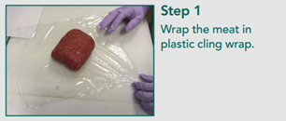
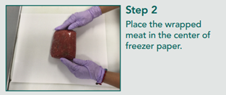
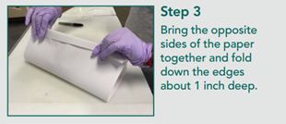
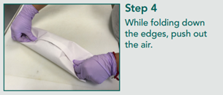
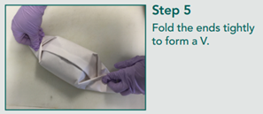
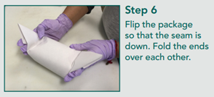
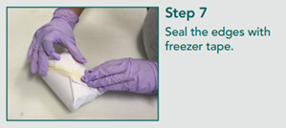
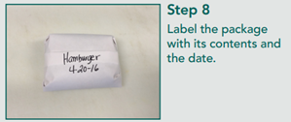
Packaging & Storing Meat & Wild Game
Texas A&M Agrilife Extension
Notes:
Let’s step through the process of wrapping ground beef.
<Press click to bring up each step.>

Slide 32
Agenda
Food Safety
Canning Meat and Meat Products
Break
Freezing Meat
Drying Meat

Slide 33
Drying Meat
Remove moisture needed by foodborne microorganisms
Most effective: low humidity & air current
  Speeds up drying, removes air around food
  Air must penetrate whole food piece
Optimum temperature: 140˚F or less
  Higher temps cook food instead of drying
Notes:
<click> The purpose of drying food is to remove enough moisture so foodborne pathogens can’t grow.
<click> We are fortunate that in California most places have relatively low humidity, which speeds up the dehydration process.
You also need heat to force evaporation
and an air current to pull the moisture away from the food as it evaporates.
The air and heat combination needs access to the whole piece of food, so leave space between the pieces of food.
<click> In general, you want a maximum of 140 degrees to dry fruits and vegetables. Anything higher cooks the food.
On the UC Master Food Preserver statewide website, the publications library has several documents that list drying and rehydrating temperature and times for specific fruits and vegetables. You can also use reputable dehydration books and the manufacturer’s recipes for drying times.

Slide 34
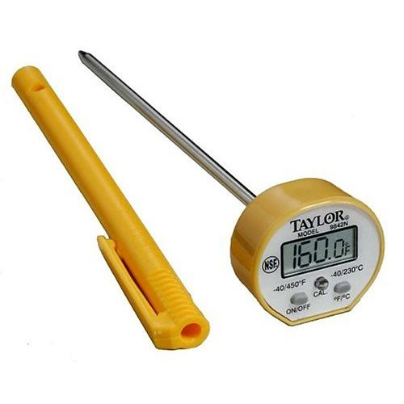
Drying Meat: Food Safety
Dry cooked meat only
  Raw meat = microorganisms
  Moist, high protein food
  Sanitize after handling raw meat
Cook to 160°F
  Color check?
Notes:
Let’s start with some food safety.
<click> Raw meats can be contaminated with microorganisms that cause disease. These harmful bacteria can easily multiply on moist, high protein foods like meat and poultry and can cause illness if the products are not handled correctly.
As you know, wash your hands and sanitize your workspace after handling raw meat.
<check> At some stage in the drying process we’re going to heat the meat to 160 degrees.
Color is not a reliable indicator if cooked meat is done.
<check> Use your thermometer.

Slide 35
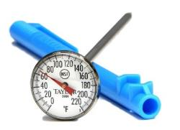
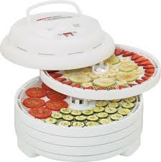
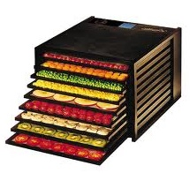
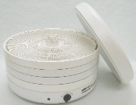
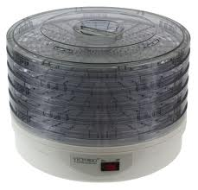
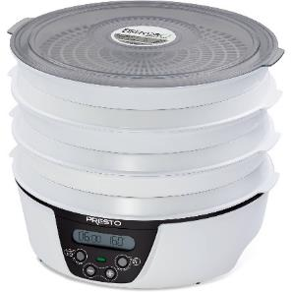
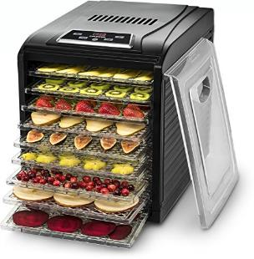
Electric Dehydrators
Temperature control, heat source, fan
Uniform sized slices dry more evenly
Space out pieces for air circulation
Notes:
Electric dehydrators need to have a way to control the temperature, a heat source to force evaporation, and a fan to blow away the evaporated moisture. There are multiple styles available, with either manual or digital temperature controllers.
<click> This style has the heat source and fan at the back of the machine and has a finite set of trays. The lid sits loosely on the front. As an FYI, you can use this style to incubate yogurt. As another FYI, since this is an internal class, the Excalibur company that makes the top model is based in Sacramento and gives a discount to Master Food Preserver volunteers.
<click> This style has the heat source on the bottom. The food closest to the heat source will dry faster than those at the top, so you need to rotate the trays throughout the drying process. You can purchase additional trays.
<click> This style has the heat source on the top. Again, you need to rotate the trays and you can buy more trays.
<click> This last one is an old style dehydrator that only has an on/off switch instead of a temperature controller. To find out what temperature it reaches,
<click> lay a kitchen thermometer on the rack and turn the machine on. You should do this with all dehydrators to see how accurate they are.
All electric dehydrators have tray inserts to make leathers out of pureed food, or to dry tiny pieces of food.
<click. A couple of tips: make sure you cut the produce into the same sized pieces. Otherwise, the thinner and smaller pieces will dry faster, and you’ll end up sorting through the trays to pull out the dry pieces. Or you can put all the small pieces on one tray. And make sure you leave space between pieces for better air circulation; this helps speed up drying time, too.
If you have mesh tray liners and are working with small pieces, you can lay a mesh liner on top of the food pieces to keep them from blowing around in the dehydrator.

Slide 36
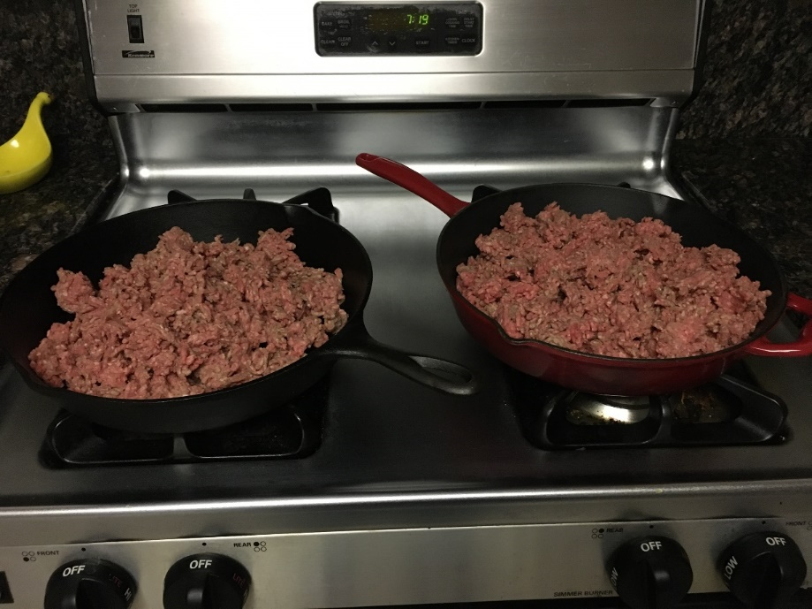
Dried Ground Beef (page 6)
Cook until 160°F
Notes:
Let’s start with the easiest thing to do – dry ground beef.
<click> Start with your raw meat. Leave it in big clumps so you can measure the temperature later. If you start with a fine crumble, you’ll need a needle point tipped thermometer. Aim for mini-meatball size clumps. When you reach 160 degrees, you can stop cooking.
<click> Depending on the fat content, you may still have liquid in the pan. I put a metal strainer on a cookie sheet to drain out the initial drippings. Then I put the meat on several layers of paper towels with several more layers on top to blot out as much moisture as possible.
<click> Spread the cooked ground beef on your dehydrator trays using the inserts to make leathers. Now is when you break up the clumps of meat into crumbles. Spread out the crumbled meat on the tray so there will be room for plenty of air circulation.
Set the temperature to 155 degrees on your dehydrator and dry for 6 to 8 hours. The final product should be very firm and dry throughout. As an FYI, this isn’t that final quantity of the two pans of meat – it’s just one tray. A pound of ground beef makes about 4 ounces of dried ground beef.
Let it cool completely before putting it into an air tight container.
<click> To rehydrate, cover the dried ground beef with water and let it sit for 15 minutes. Bring it to a boil, then simmer for about 10 minutes until beef is tender.

Slide 37
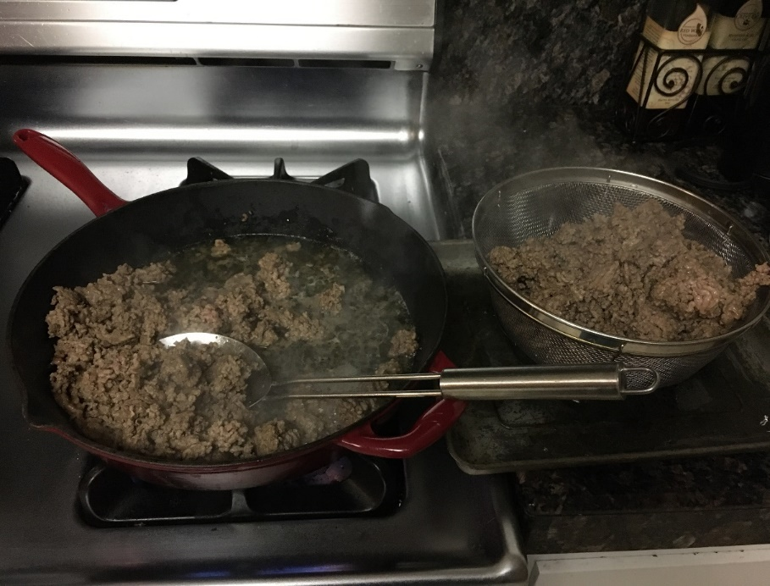
Dried Ground Beef
Drain & blot
to remove moisture
Notes:
Let’s start with the easiest thing to do – dry ground beef.
<click> Start with your raw meat. Leave it in big clumps so you can measure the temperature later. If you start with a fine crumble, you’ll need a needle point tipped thermometer. Aim for mini-meatball size clumps. When you reach 160 degrees, you can stop cooking.
<click> Depending on the fat content, you may still have liquid in the pan. I put a metal strainer on a cookie sheet to drain out the initial drippings. Then I put the meat on several layers of paper towels with several more layers on top to blot out as much moisture as possible.
<click> Spread the cooked ground beef on your dehydrator trays using the inserts to make leathers. Now is when you break up the clumps of meat into crumbles. Spread out the crumbled meat on the tray so there will be room for plenty of air circulation.
Set the temperature to 155 degrees on your dehydrator and dry for 6 to 8 hours. The final product should be very firm and dry throughout. As an FYI, this isn’t that final quantity of the two pans of meat – it’s just one tray. A pound of ground beef makes about 4 ounces of dried ground beef.
Let it cool completely before putting it into an air tight container.
<click> To rehydrate, cover the dried ground beef with water and let it sit for 15 minutes. Bring it to a boil, then simmer for about 10 minutes until beef is tender.

Slide 38
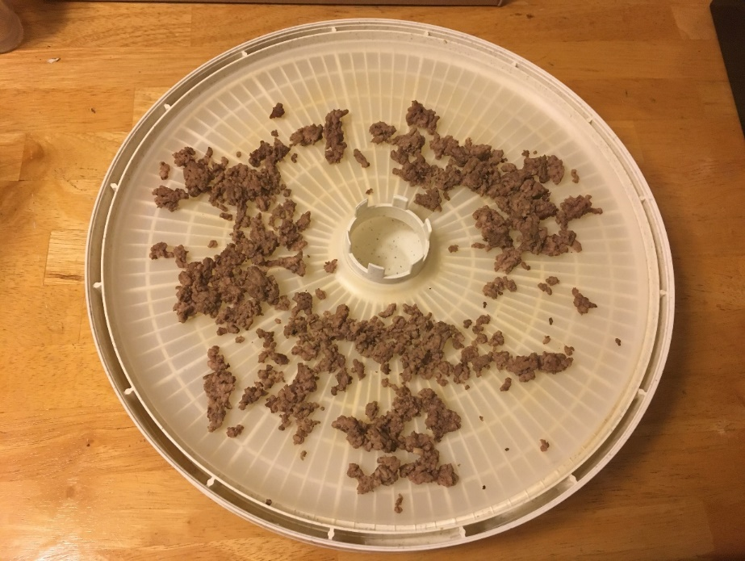
Dried Ground Beef
Place on fruit leather tray
Dry at 155°F 6-8 hours
Cool completely
Rehydrate:
Soak 15 minutes
Boil & simmer 10 minutes
Notes:
Let’s start with the easiest thing to do – dry ground beef.
<click> Start with your raw meat. Leave it in big clumps so you can measure the temperature later. If you start with a fine crumble, you’ll need a needle point tipped thermometer. Aim for mini-meatball size clumps. When you reach 160 degrees, you can stop cooking.
<click> Depending on the fat content, you may still have liquid in the pan. I put a metal strainer on a cookie sheet to drain out the initial drippings. Then I put the meat on several layers of paper towels with several more layers on top to blot out as much moisture as possible.
<click> Spread the cooked ground beef on your dehydrator trays using the inserts to make leathers. Now is when you break up the clumps of meat into crumbles. Spread out the crumbled meat on the tray so there will be room for plenty of air circulation.
Set the temperature to 155 degrees on your dehydrator and dry for 6 to 8 hours. The final product should be very firm and dry throughout. As an FYI, this isn’t that final quantity of the two pans of meat – it’s just one tray. A pound of ground beef makes about 4 ounces of dried ground beef.
Let it cool completely before putting it into an air tight container.
<click> To rehydrate, cover the dried ground beef with water and let it sit for 15 minutes. Bring it to a boil, then simmer for about 10 minutes until beef is tender.

Slide 39
Dried Ground Beef
Show me!

Slide 40
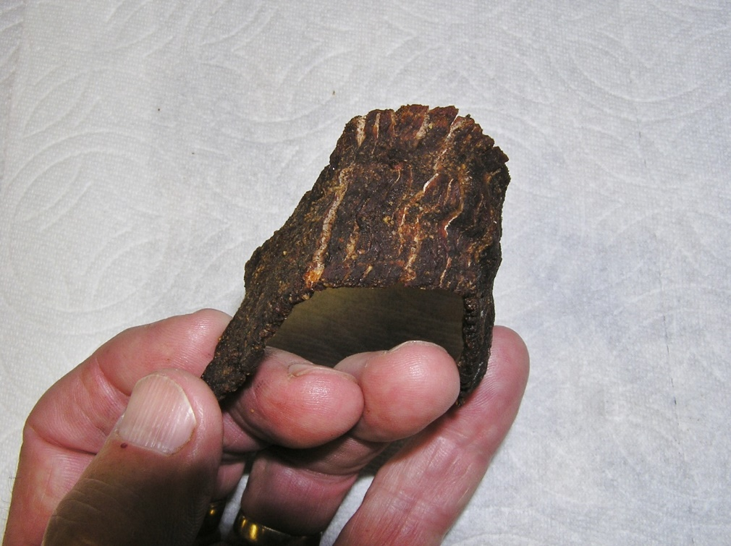
Jerky (K-State pub)
Sanitize workspace
Cook to 160°F before or after drying
Notes:
Now let’s explore the most popular and tasty dried meat, jerky.
When we dry jerky at home, we don’t have the control checkpoints that commercial producers have, so we need to make sure we reduce the risk of foodborne illness from home-dried jerky. We do this by allowing the internal temperature of the meat to reach 160ºF, but in such a way as to prevent case hardening. I’ll explain the two methods: heating meat strips in the marinade before drying or heating the dried jerky strips in an oven after drying.
If you heat the strip in the marinade before drying, the drying times are reduced. The color and texture will differ from traditional jerky, but it still tastes delicious.
Since we’re working with raw meat, sanitize your workspace and tools before you start and after you finish.

Slide 41
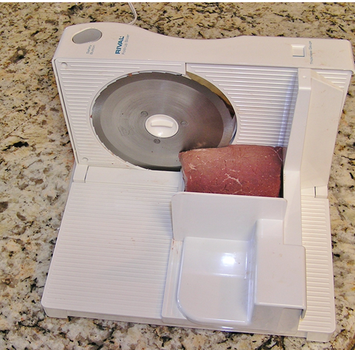
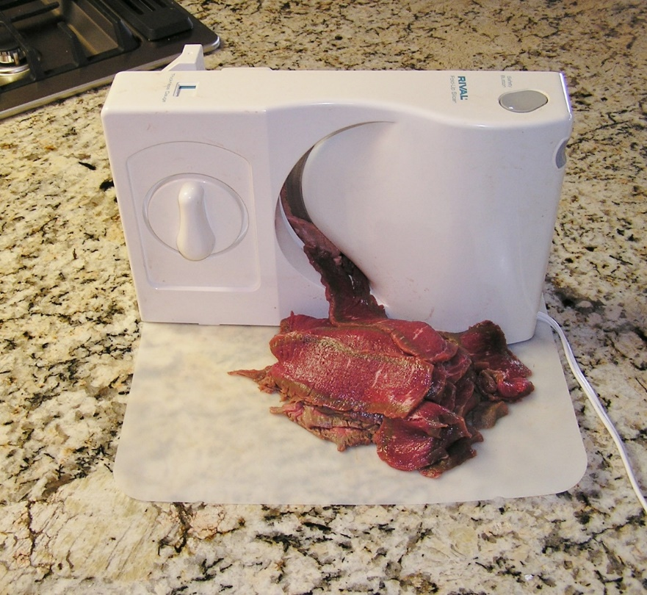
Jerky
You cut:
Partially frozen meat
Remove fat
1/4-inch thick
  Chewy jerky? Slice w/grain
  Tender/brittle jerky? Across grain
Store cut
Butcher or Carne asada meat
Notes:
Jerky is made from sliced meat.
<click> If you want to cut it yourself,
<click> start with partially frozen meat to make slicing easier.
<click> Trim and discard all fat from meat because it becomes rancid quickly.
<click> The thickness of the meat strips will make a difference in the safety of the final product. Slice the meat no thicker than ¼ inch.
<click> If you like your jerky chewy, slice with the grain of the meat.
<click> <click> If you like a more tender, brittle jerky, slice across the grain.
<click> If you want pre-cut meat,
You can ask the butcher at the grocery store to slice the meat for your. Or look for a package of carne asada pre-sliced meat.

Slide 42
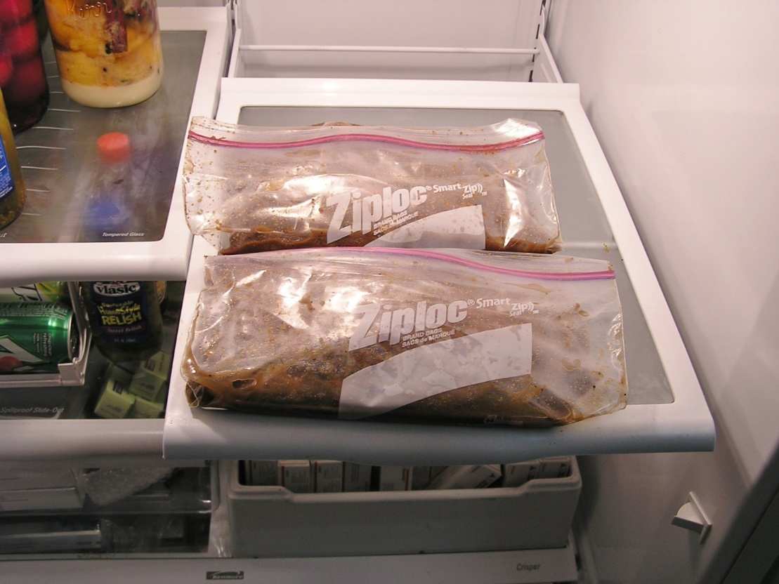
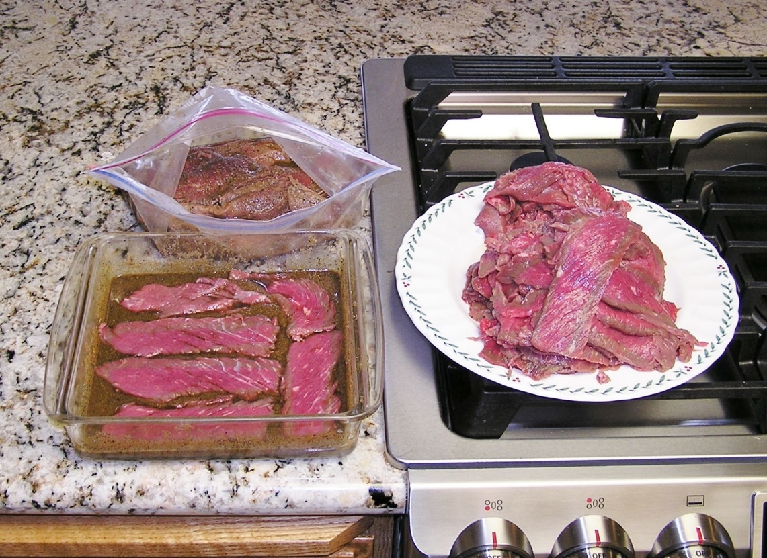
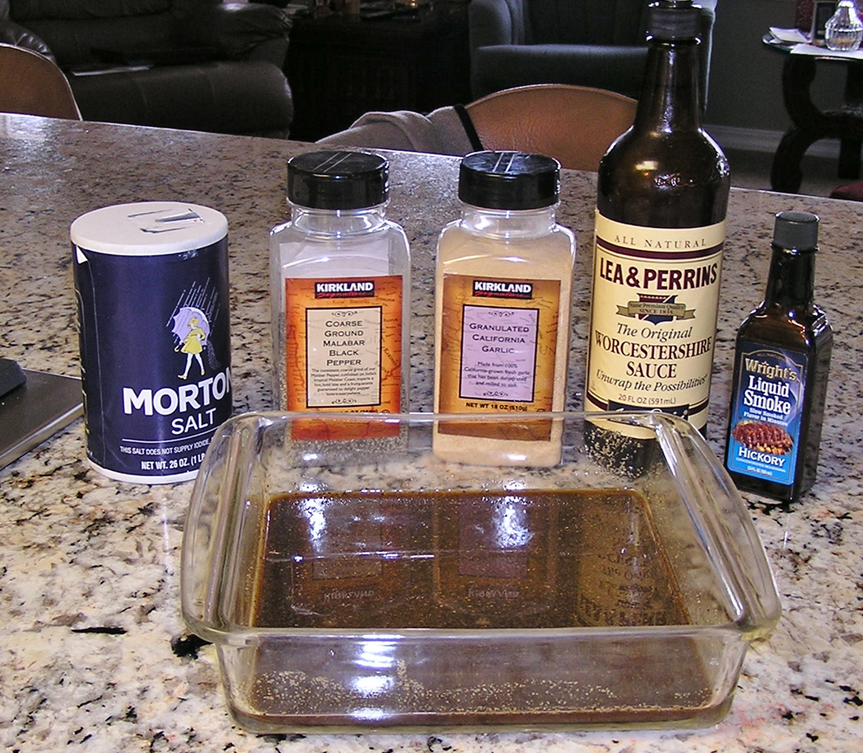
Jerky
Marinade
  For flavor and tenderness
  1-2 hours or overnight
Pre-drying heating option
  Boil 5 min in marinade
  Check temp: 160°F
Drain and pat dry
Notes:
The National Center for Home Food Preservation has a marinade recipe that produces a tasty product. You can find lots of marinade recipes online. They will commonly use an oil, spices and an acid, such as vinegar, lemon juice, teriyaki, soy sauce or wine. In addition to flavoring the meat, the marinade also makes the meat more tender.
<click> Put the strips of meat in a shallow pan and cover with the marinade. Cover and refrigerate 1-2 hours or overnight.
<click> You can also put the meat with the marinade in plastic bags. The longer you let it marinate, the stronger the flavor.
Remember I said you need to heat the meat before or after you dry it to decrease the risk of foodborne illness?
<click> If you choose to heat the meat before drying, start after you marinate. Dump all of the contents of your marinating meat pan or bag into a pot, bring it to a boil and boil for 5 minutes. The drain the marinade (don’t reuse it) and pat the slices dry with paper towels.

Slide 43
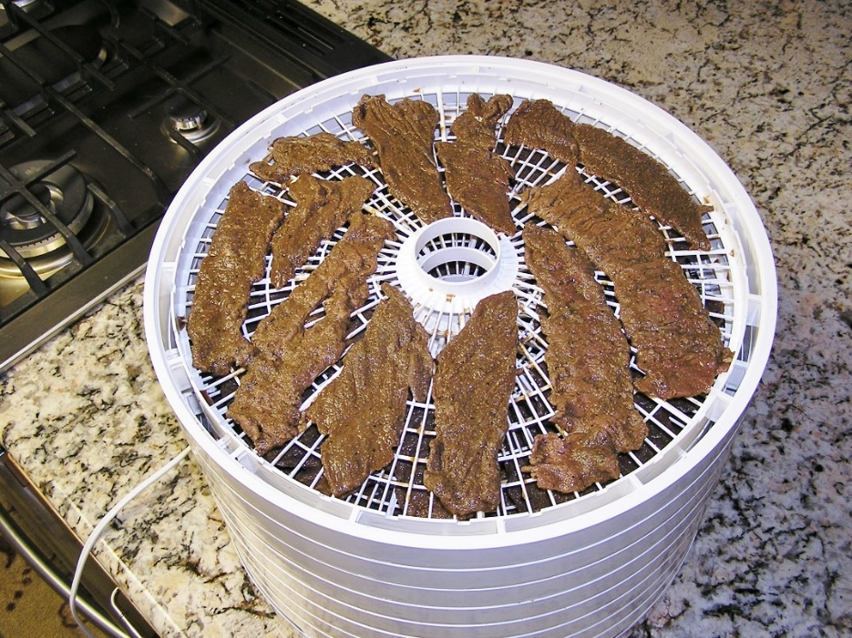
Jerky
Place on dehydrator trays; 140˚F
Test: cracks but not break
Pat dry, cool, store or
Post-drying heating option
  Pre-heated oven at 275˚F
  10 minutes; Test for 160˚F
Sealed container 2 weeks
  Freeze for longer storage
Notes:
<click> Arrange the strips on the dehydrator trays or on baking sheets for oven drying.
Place the slices close together, but not touching or overlapping. Dry at 140ºF in either a dehydrator or a preheated oven.
<click> Dry until a test piece cracks but doesn’t break when you bend it.
If you pre-heated the meat, start checking after 3 hours.
If you didn’t pre-heat the meat, it may take 10 to 24 hours to dry.
<click> Use paper towels to pat off any beads of oil. Cool the meat then package in glass jars or heavy plastic food storage bags. Vacuum sealing is also a good option.
<click> If you didn’t heat the meat in the marinade before drying, you can heat them in an oven now as an added safety measure. Put the dried jerky on a baking sheet, close together, but not touching or overlapping. Heat 10 minutes in an oven preheated to 275ºF. Use a thermometer to test that the meat temperature reaches 160ºF.
<click> The recommended storage time in an airtight container in the cupboard is 2 weeks. Freeze it to keep it around longer. It won’t take long to thaw so you can enjoy it.
It’s actually a pretty easy process and results in delicious jerky.

Slide 44
Agenda
Food Safety
Canning Meat and Meat Products
Break
Freezing Meat
Drying Meat

Slide 45
Final Questions?
UC Master Food Preserver Libraries
  http://mfp.ucanr.edu
  Publications
  Videos
  Recipes

