Slide 1
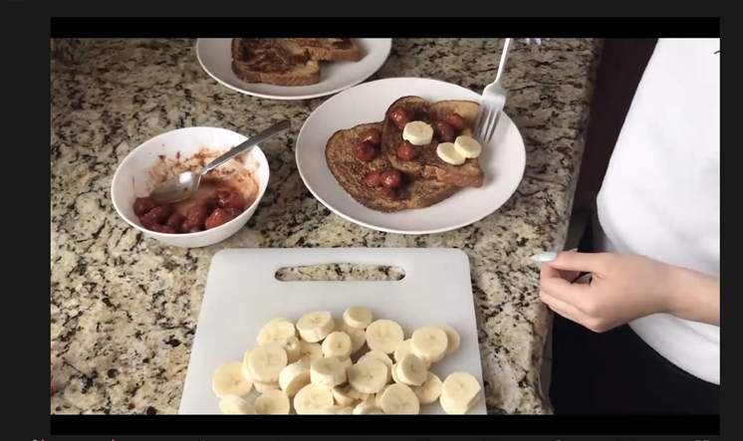
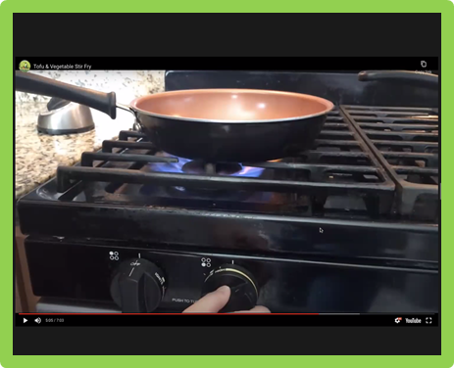
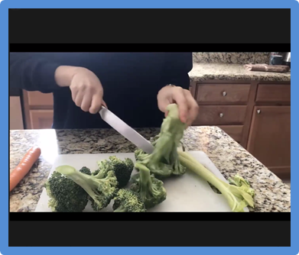
Reaching New Audiences (Despite the Pandemic!)
4-H Virtual Cooking Academy in Sacramento County
Alicia
Beryl
Linda
Marianne
Svetlana

Slide 2
Why this? Why now?
We had teenagers to place!
Cooking Academy curriculum a great fit! (thanks, Marcel!)
EFNEP staff looking for ways to connect with the community.
Students at EGUSD “Day Camps” would benefit.
Teens seeking meaningful activities.
Notes:
Background (Marianne) 1 min.
Why did we chose to do Cooking Academy? Especially last year?!
The Virtual Cooking Academy was born of two problems: The coronavirus pandemic, and a group of 16 teenagers who were looking to 4-H for a community service opportunity. We had trained the teens in the 4-H Youth Experiences in Science curriculum in February 2020, and as we were placing them into afterschool programs to deliver the YES curriculum, COVID-19 shut everything down. We needed a teen-friendly curriculum that could be delivered virtually, and the Cooking Academy—Marcel and Angela’s brainchild—was perfect.
It turned out to be a real gift that met several needs:
EFNEP staff needed to find ways to keep engaging the community despite the pandemic. When Beryl and I presented the Cooking Academy opportunity, they jumped on it!
The Elk Grove School District “day camp” sites where we presented the program focused on kids who needed additional support to learn during COVID. They were a perfect audience for the program.
During the pandemic, teens yearned for meaningful activities, and their role as Cooking Academy teachers met that need.

Slide 3
4-H Virtual Cooking Academy Program Goals
Program Outcomes
Youth Chefs prepare and try new foods in delicious ways (attitudes)
Youth Chefs learn the skills needed to prepare fruits, vegetables, and other healthy items (skills)
Youth Chefs increase food literacy around recipe reading and food preparation concepts (knowledge)
Youth Chefs shape their eating behaviors by creating a healthy food environment at home with their family.
Notes:
Description of Project: Program Goals (Alicia) Slide 3 & 4 – 2 min

Slide 4
4-H Virtual Cooking Academy Program Delivery
Program Delivery
Six healthy living lessons delivered
bi-weekly in after school programs to
youth in 4th-6th grades
Teen taught, supported by adult coaches
16 teen teacher delivered to program to 64 youth attending Day Camps
Notes:
Description of Project (Alicia)

Slide 5
4-H Virtual Cooking Academy Partnerships
Elk Grove Unified
Sacramento City Unified
Robla Unified
Granite Bay High School
City of Sacramento
Sacramento EFNEP Team
Notes:
Partnerships: (Beryl) 3 min. for Slides 5, 6, 7
In the community: Expanded Learning Programs; School Districts;
Share which Expanded Learning Programs (after school programs) we worked with.
Share why these programs are critical to our mission to reach diverse youth in our communities
Within our organization: EFNEP and 4-H
Describe 4-H’s role
Describe EFNEP’s role

Slide 6
Teen-Teachers, Schools and Adult-Coaches
Sac City
High Schools Represented
Valley
Monterey Trail
Laguna
West Campus
Granite Bay
Cosumnes Oaks
Pleasant Grove
Visions In Education
Laurel Springs Middle
NP3Natomas Middle
Teen Teachers
Alex Yamine
Trevor Thai
Aniruddha Joshi
Elk Grove
Teen Teachers
Jessica Gonzalez
Triana Lee
Shireen Caul
Triana Lee
Joyce Cui
Aashvi Sharma
Jyoti Maharjanr
Rania Alnamrouti
Huma Shalid
Tiffany Dip
Robla
Teen Teachers
Isabella Patterson
Granite Bay
Teen Teachers
Evan Wu
Vaaris Gill
Adult Coaches
Alicia Fraticelli
Svetlana Kolesnikova
Beryl Johnson
Notes:
Partnerships with Teens (Beryl)
Teens
How Many: Share how many teens served, where they came from.
Importance of Teens: Briefly share why teens were so important to this project. What did they bring or do to make it successful?

Slide 7
VCA Training & Development
Six hours Cooking Academy weekend training
Peer-to-Peer Practice sessions
Planning, designing and developing
bi-weekly, hourly lessons
Delivers one hour Zoom session
Session delivery assessment, evaluation and enhancement
Notes:
Partnerships: Teen Training (Beryl)
Teens Preparation
Briefly describe training teens received
Describe what they did in their job as teen teachers
Describe how things were different in teaching virtually: use of videos, having to work though teachers who were on-site with the kids, inability to see final produce sometimes.

Slide 8
From Teen Teacher to Teen Chef
Florin Elementary (Monday)
Jessica-Chef Jessie
Jyoti- Chef J.
Aashvi-Chef A.
Tiffany-Chef Tiff
Franklin Elementary (Thursday)
Rania-Chef Rania
Shireen-Chef Shireen
Huma- Chef Huma
David Reese Elementary (Wednesday)
Alex-Chef Avocado
Trevor- Chef Thai Tea
Varris-Chef Green Beans
Union House Elementary (FRIDAY)
Isabella-Pastry Chef
Triana-Tangy Chef
Joyce-Spicy Chef
Herman Leimbach Elementary (Tuesday)
Aniruddha-Chef A
Evan- Chef Vareem
Varris-Chef Eveem
Notes:
Teens in Action (Alicia) 2 min slides 8 & 9
They brought a different type of energy to the project—the kids responded to the teens differently than an adult.
They chose a program name or alias for their online presence
Had to work as a team to build out their lesson

Slide 9
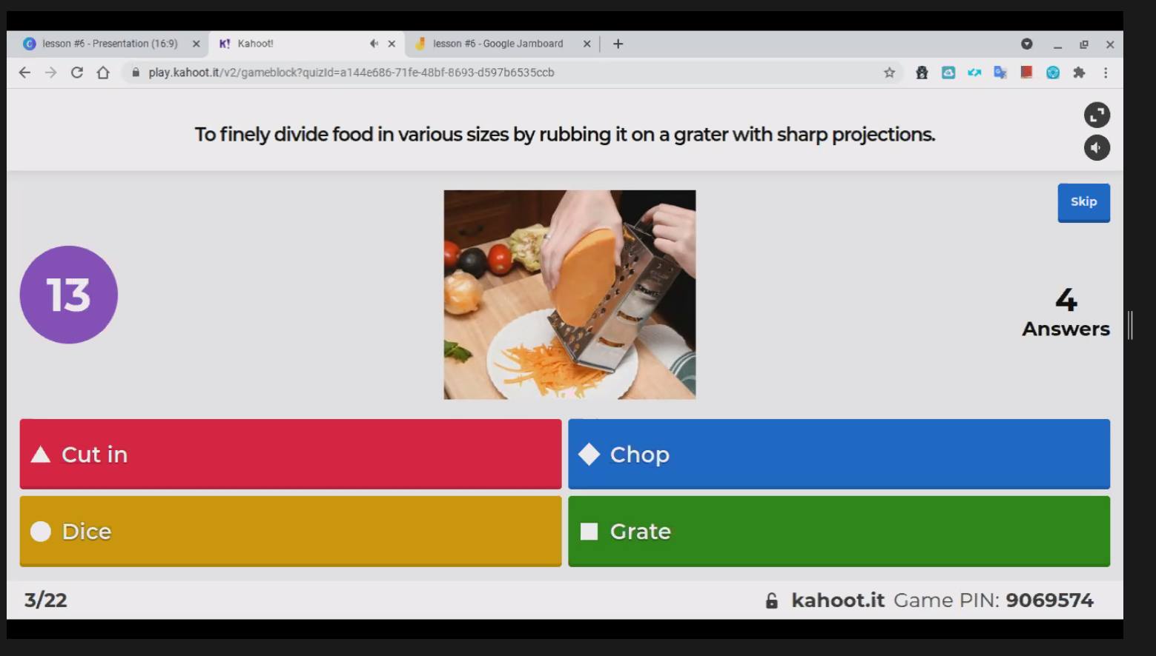
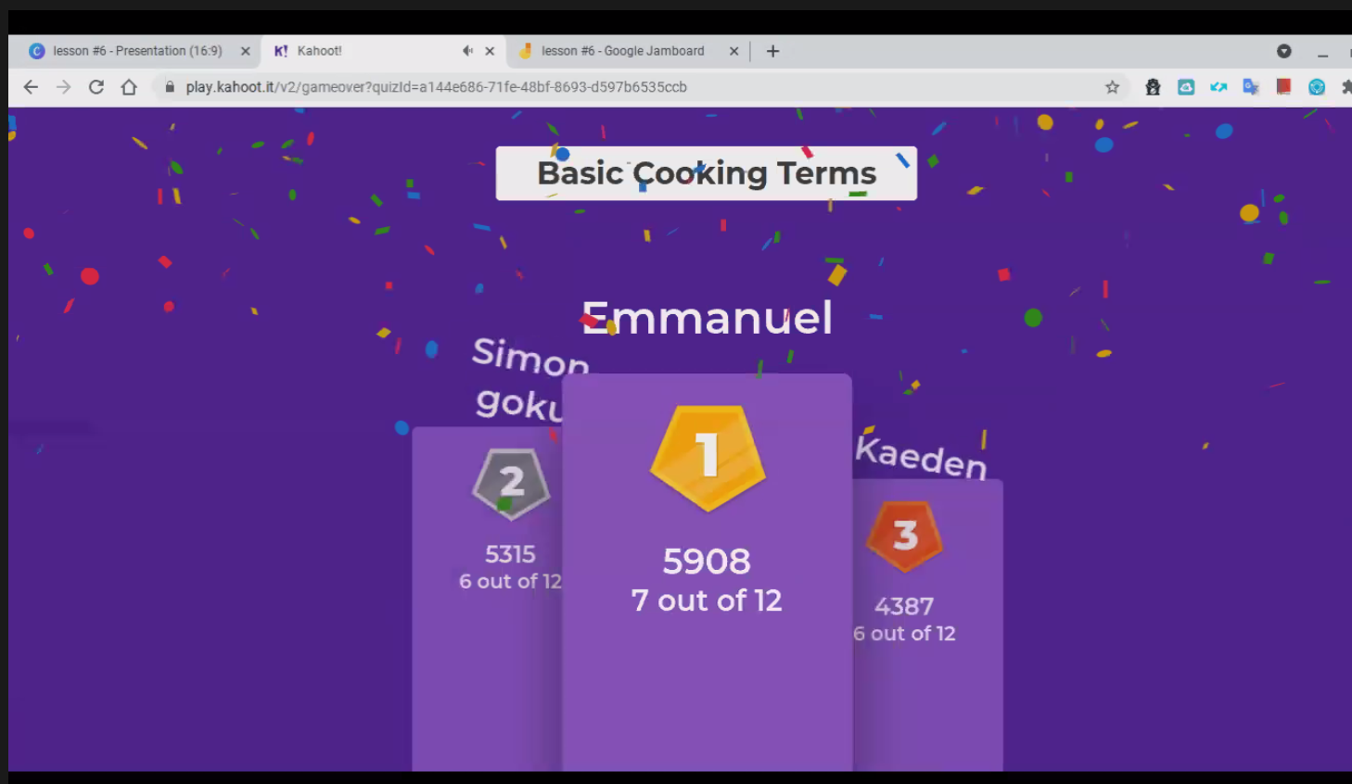
Cooking Academy
Kahoot!
Notes:
Maybe include as Teen Teacher strategy for exciting lessons (Alicia)
Creative use of videos and online tools: Kahoots
They were patient.

Slide 10
4-H Virtual Cooking Academy Demographics
 |  | Youth Chefs (students) | Teen Teachers | Adult Coaches (4-H, EFNEP) | Total youth | Percent
Ethnicity | Hispanic/Latino | 30 | 5 | 1 | 35 | 44%
 | Non-Hispanic/Latino | 34 | 11 | 2 | 45 | 56%
Totals |  | 64 | 16 | 3 | 80 | 100%
Race | Am. Indian/AK Native | 0 | 4 | 0 | 4 | 5%
 | Asian | 17 | 5 | 1 | 22 | 27%
 | Black or African Am. | 16 | 0 | 1 | 16 | 20%
 | Asian Pacific Islander | 0 | 2 | 0 | 2 | 3%
 | White | 14 | 5 | 1 | 19 | 24%
 | Hispanic Only | 17 | 0 | 0 | 17 | 21%
Totals |  | 64 | 16 | 3 | 80 | 100%
Notes:
Demographics (Marianne) 30 sec.
Here is an overview of the demographics of the students we served in the Virtual Cooking Academy.
You can see that we served 64 elementary school students, and 80 youth total.
You can also see the percentage of race and ethnicity for the students.

Slide 11
Program Impact: Teen Teachers
“I had a lot of fun doing the Cooking Academy and if given the chance I would like to continue participating.”
--10th grade and 11th grade students-Elk Grove
“Delivering the Cooking Academy helped me to develop my English skills.”
--10th grade student-Elk Grove
“Having done YES and now the Cooking Academy, I feel I have gained really good leadership skills.”
11th grader-Sac City
“Cooking Academy gave me more confidence in myself.”
--9th grade student-Twin Rivers
“I can’t believe how much more organized I am having done the Cooking Academy. My communication skills improved a lot too.”
--10th grader -Elk Grove
Notes:
Teen Survey (Marianne) 30 min
The really important question is not how many kids we served, but did they learn anything? Was the project successful in meeting its goals? We’re still collecting and organizing our data, but we do have the follow to share.
Here are some quotes from the teens that delivered the project…

Slide 12
Program Impact: Student Behavior Change
Notes:
Impact on Students (Marianne)
This table shows the results from the EFNEP pre- and post-survey administered to the kids in Virtual Cooking Academy. The sample size is small—we only 12 youth with matched surveys so far—but the results are very positive. The percentage of kids who report improved healthy behaviors is promising.
For example,
42% report eating more vegetables
63% report washing fruits and vegetables
And 67% report putting cold food back in the fridge.

Slide 13
Program Impact: Summary of Improvement
Diet Quality
83% (10 of 12) Children and youth improve their abilities to choose foods according to Federal Dietary Recommendations or gain knowledge.
Food Safety
58% (7 of 12) Children and youth use safe food handling practices more often or gain knowledge.
Physical Activity
58% (7 of 12) Children and youth improve their physical activity practices or gain knowledge.
Food Resource Management
0% (0 of 0) Children and youth improve their ability to prepare simple, nutritious, affordable food or gain knowledge
Food Security
0% (0 of 0) Youth acquire skills to be food secure or gain knowledge.
Notes:
Program Impact (Marianne) 30 sec
This is the summary of improvement that the EFNEP data analysis program generated. Very positive for Diet Quality, Food Safety, and Physical Activity. But I wondered about the last two measures—Food Resource Management and Food Security.

Slide 14
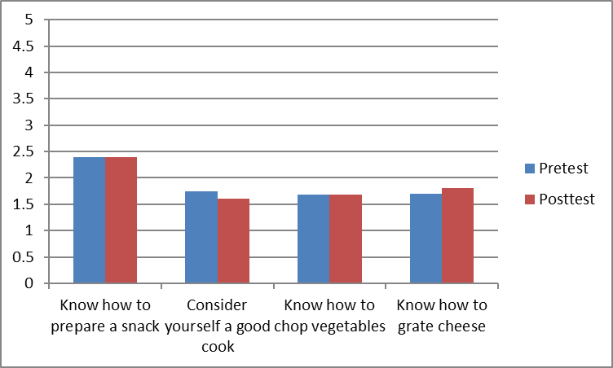
Program Impact: Food Preparation Knowledge
Graph showing mean pre- and post-test scores on Likert scale for cooking behaviors
from My Plate Pre & Post Survey.
Notes:
Impact on Students (Marianne)
This graph is from a different survey, the My Plate survey. It, too, is pre- and post-survey and its focus is on food preparation. It seems to verify what the EFNEP survey revealed, that there is no discernable difference between the pre and post surveys.
It raised the question if the virtual delivery of the program in the afterschool “day camps” may interfere with the students being able to actually practice cooking skills, especially with COVID protocols. I’d be interested to compare these findings with in-person evaluation.

Slide 15
Click on the video play:7mins
Notes:
Example of Teen Video (Svetlana) – 1 min.

