Slide 1
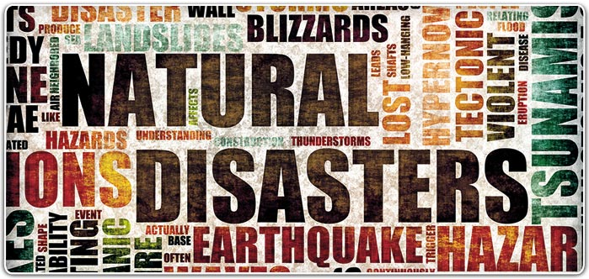
Emergency Preparedness
Franklin Bldg. - UCOP
ANR Staff Meeting
September, 2018

Slide 2
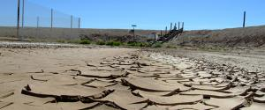
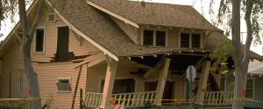
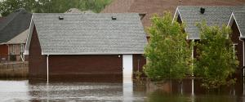
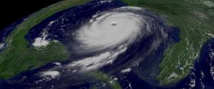
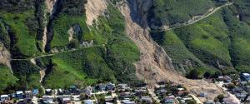
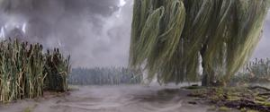
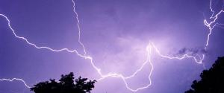
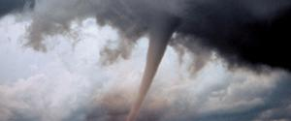
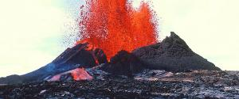
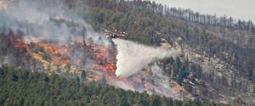
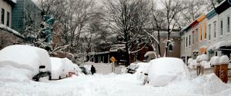
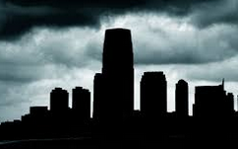
Disasters and Emergencies happen
Drought Earthquakes Extreme Heat Floods
Hurricanes Landslides/Debris Severe Weather Space Weather
Thunderstorms Tornadoes Tsunamis Volcanoes
& Lightning
Wildfires Winter Storms Power Outages Pandemics
Notes:
Disasters and emergencies happen
They affect our employees (and their families) and our workplace locations
In recent months, ANR locations have been affected by Power Outages, Wildfires, Drought, Earthquake, Tsunami advisory, etc.
Visit Ready.gov for information on disasters that may occur in the areas you live and work

Slide 3
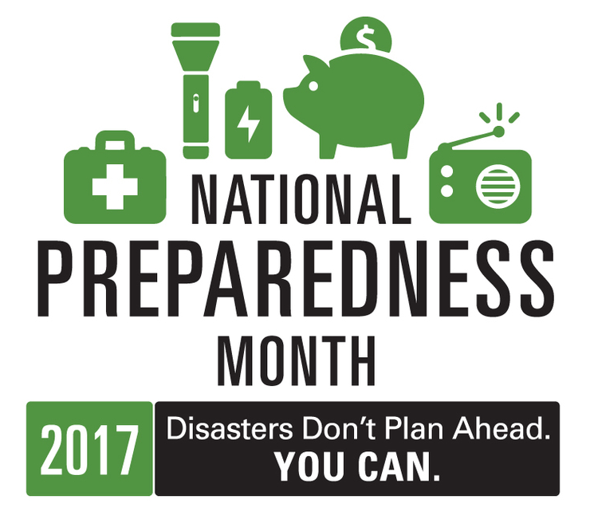
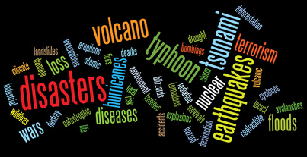
National Preparedness Month
A nationwide initiative encouraging Americans
to take simple steps to prepare for emergencies
in their homes, workplace and communities.
Visit https://www.ready.gov/september
Get started with the universal building blocks of emergency preparedness:
Be Informed
Make a Plan
Build a Kit
Don’t rely upon others, always prepare to be self-reliant for a minimum of 3 days (the first 72 hours).
Notes:
September is National Preparedness Month
Preparedness is a year round activity. However, September is the month for recognizing national preparedness. The Federal Emergency Management Agency (FEMA), in partnership with the Ready Campaign, will again kickoff National Preparedness Month (NPM) this September.
A nationwide initiative designed to encourage Americans to take simple steps to prepare for emergencies in their homes, workplace and communities.
Preparedness is everyone’s responsibility. The better prepared you are, the more likely you can help, or free-up First Responders for those in dire need.
This NPM will focus on planning, with an overarching theme: Disasters Happen. Prepare Now. Learn How.
Get started with the universal building blocks of emergency preparedness:
Be Informed
Make a Plan
Build a Kit
Build upon this foundation by getting involved, and by encouraging co-workers, friends, family and neighbors.
Share the message of preparedness and engage others in preparedness activities. People are more likely to hear and act on messages from people they know and trust.
Don’t rely upon others, always prepare to be self—reliant for at a minimum of 3 days (the first 72 hours).

Slide 4
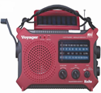
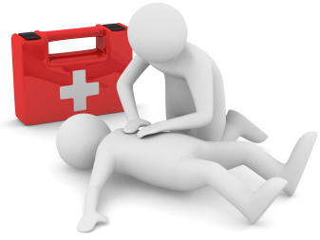
Be Informed
During business hours: In the event of an emergency, check your email and voicemail for emergency instructions & information. Follow any directions given over the building PA system or by your Floor Wardens.
After hours: UCOPAlert is an emergency notification system that allows UCOP employees to receive informational alerts on their personal phones or by personal email outside normal business hours. Register & update at: http://ucopalert.ucop.edu
UCOP Emergency Info Line: in the event of email/voicemail system failure, call this backup toll-free out-of-area number for recorded messages and instructions related to UCOP emergencies or closures. (866) 272-9009
Tune In: in the event of a major Bay Area emergency, tune your radio into: KCBS (740 AM), KGO (810 AM), or KNBR (680 AM).
Be informed about hazards and risks in your area
Ready.gov: http://www.ready.gov/be-informed
CalEMA MyHazards: http://myhazards.calema.ca.gov/
Be Trained in First Aid and CPR, at least one member of the household/office
Notes:
Stay informed of emergency information and updates.
During business hours listen for the building PA system and follow the direction of Floor Wardens.
After hours information will be available from the UCOP emergency information line (866) 272-9009, and sent to those who have registered to receive updates from the UCOP Alert emergency notification system.
Tune into Bay Area AM radio stations for local updates to large scale emergencies.
Text First. Talk Second. During large-scale emergencies, mobile call volume may simply overwhelm provider capacity. Experts recommend communicating via SMS text messaging as your first choice during the immediate aftermath
(a single one-minute call takes up the same bandwidth as 800 text messages)

Slide 5
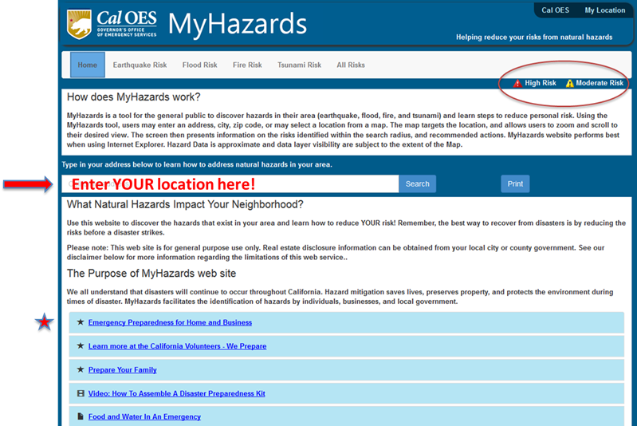
National Preparedness Month
Office/Locational Preparedness http://myhazards.caloes.ca.gov/
Know your Hazards:
Cal OES My Hazards website:
Enter an address, discover the hazards in your area and steps to reduce risk
Notes:
Reminder and refresher on information presented during the February 2017 webinar

Slide 6
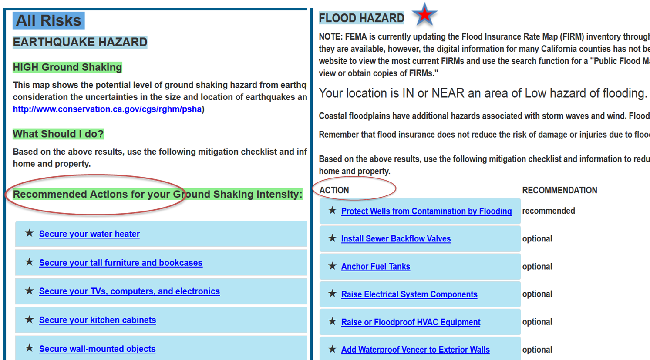
National Preparedness Month
Office/Locational Preparedness http://myhazards.caloes.ca.gov/
Know your Hazards:
Cal OES My Hazards website:
UCCE Humboldt: sample hazards
What You Can Do!
Enter your Office Location (and home)
Be aware of hazards and precautions
Follow guidance and recommendations
Share / communicate results
Notes:
Reminder and refresher on information presented during the February 2017 webinar

Slide 7
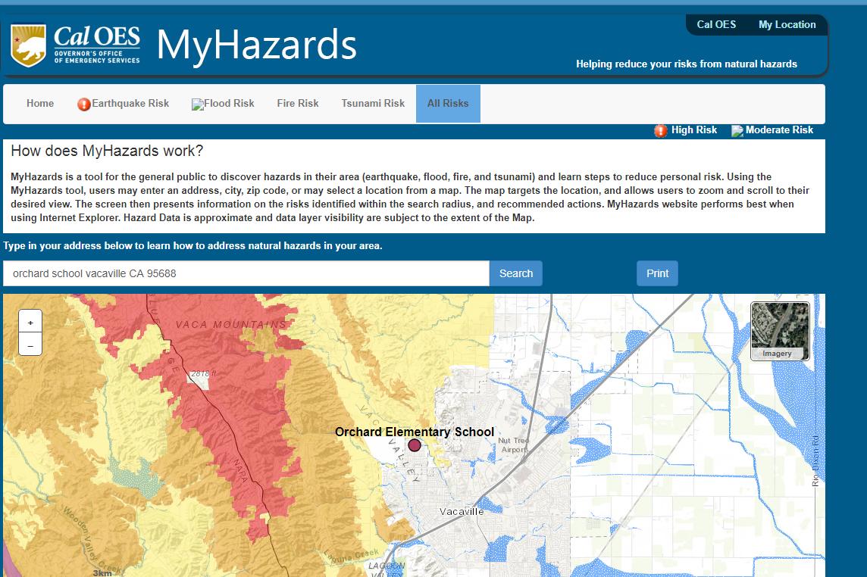
National Preparedness Month
Office/Locational Preparedness http://myhazards.caloes.ca.gov/
Know your
Hazards!
Example map:
wildfire risk in my suburban Vacaville neighborhood
Notes:
Reminder and refresher on information presented during the February 2017 webinar

Slide 8
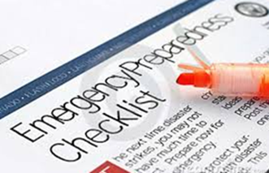
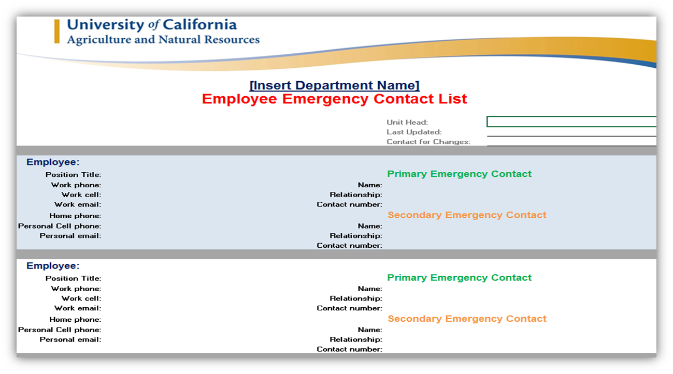
National Preparedness Month
Office/Locational Preparedness
Prepare your Workplace
Have employee contact info on hand and ability to communicate after hours.
Telecommuting – determine if employees can work from home, make the necessary arrangements in advance.
Vital records/documents/materials stored safely. Have backups / Continuity.
Elevate items and provide barriers if flooding is expected.
Know what to take if you ever have to Evacuate! Plan in advance!
Be able to Communicate
Contact List template (available from
Risk & Safety)
VOIP phone system back-ups
VOIP Broadcast Messaging
Cell phone battery back-ups

Slide 9
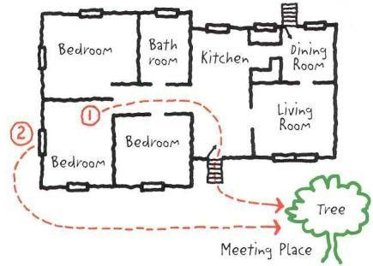
Make a Plan
Meet with your family and discuss how to prepare and respond to emergencies
Plan what to do if separated – choose two places to meet
Plan what to do if evacuation is necessary – from the home, from your community
Choose an out of the area contact - discuss “scripts” and responses ahead of time
Identify responsibilities – work as a team
Have copies of essential documents, household inventory
Know the location of utility shutoffs and keep tools nearby (http://www.ready.gov/utility-shut-safety)
Try to keep your car’s tank half-full
Notes:
When separated from family members consider ways to re-assure each other of reunion and express support. Decide on simple scripts and responses ahead of time to save battery life and avoid confusion. (OK/NOT OK, Need/Have, C U soon/@home/@grandmas/tomorrow, Love you)
Consider a practice drill of your communications plan.

Slide 10
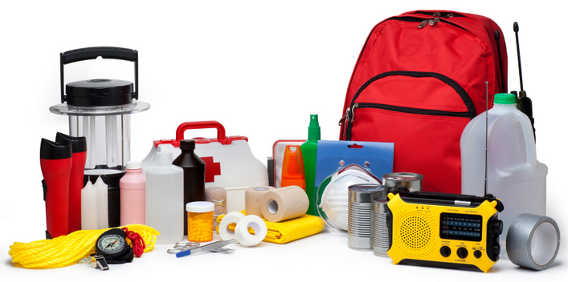
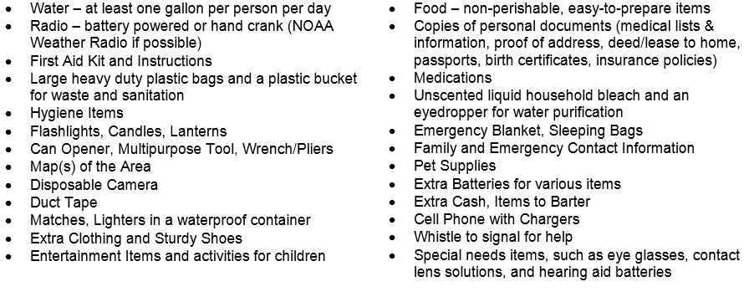
Build a Kit
Pre-packaged or build from home
Store in an easily accessible location
Use a large, watertight container (e.g. large plastic garbage can with lid & wheels)
Checklist are available from – Ready.gov, 72hours.org, Redcross, the CDC, etc.

Slide 11
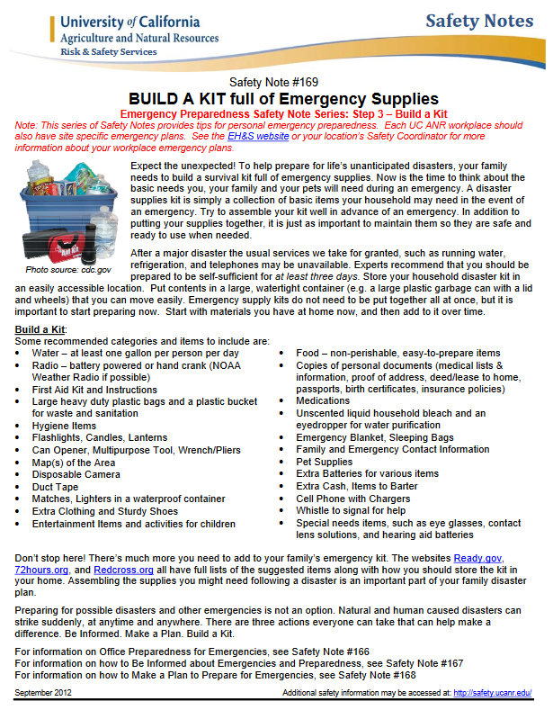
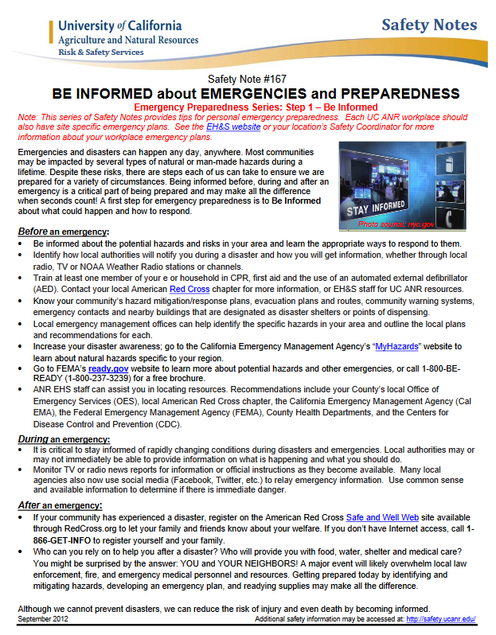
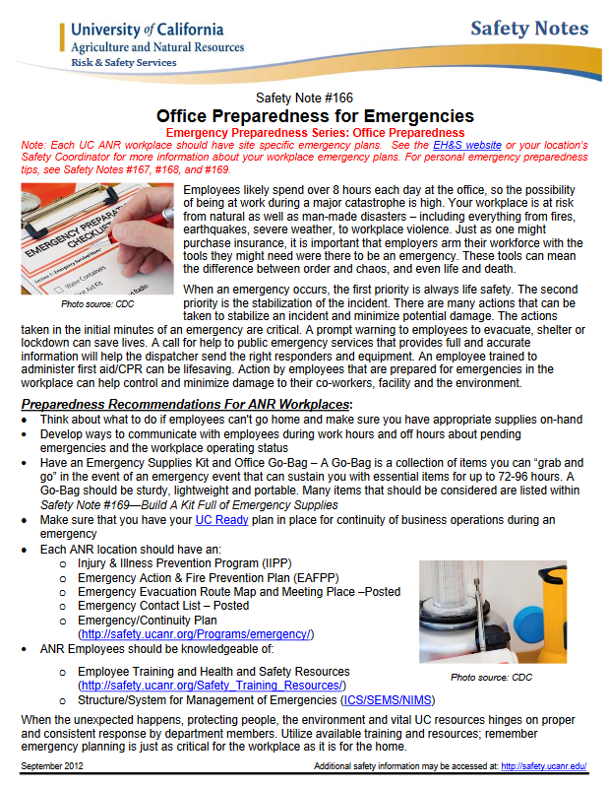
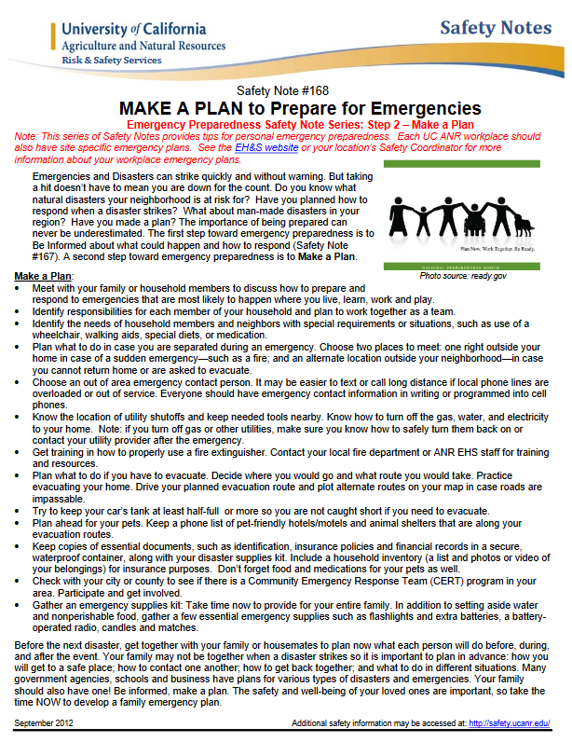
ANR Resources
Safety Notes Series on Emergency Preparedness
http://safety.ucanr.edu/Safety_Notes/
#166: Office Preparedness
employees likely spend near 8 hours each day at the office, so the possibility of being at work during a major catastrophe is likely.
#167: BE INFORMED
Be Informed about the potential hazards and risks in your area and learn the appropriate ways to respond to them.
#168: MAKE A PLAN
Make a Plan with your family or household members to discuss how to prepare and respond to emergencies that are most likely to happen where you live, learn, work and play.
#169: BUILD A KIT
Build a Kit full of disaster supplies and basic items your household may need in the event of an emergency - be prepared to be self-sufficient for at least three days.
Notes:
This series of Safety Notes provides tips for personal emergency preparedness. Each UC ANR work place should also have site specific emergency plans. See safety.ucanr.org or your location’s Safety Coordinator for more information about your workplace emergency plans.
1. Be informed about the different types of emergencies that can happen in your area and their appropriate
responses.
Learn about the hazards that may strike your community, the risks you face from these hazards and your
community’s plans for warning and evacuation. You can obtain this information by visiting
http://www.ready.gov/be-informed.
2. Create a family emergency plan
Your family may not be together when an emergency happens, so it is important to plan in advance. Think about
how you will contact one another, how you will get back together, and what you will do in different situations.
You can download a family emergency plan template from by visiting http://www.ready.gov/make-a-plan.
3. Put together an emergency supply kit
You may need to survive on your own after an emergency. This means having your own food, water and other
supplies in sufficient quantity to last for at least three days. Local officials and relief workers will be on the scene
after a disaster, but they cannot reach everyone immediately. You could get help in hours, or it might take days. In
addition, basic services such as electricity, gas, water, sewage treatment, and telephones may be cut off for days,
or even a week or longer. To find a complete checklist of the supplies your household may need in the event of an
emergency, visit http://www.ready.gov/build-a-kit.

Slide 12
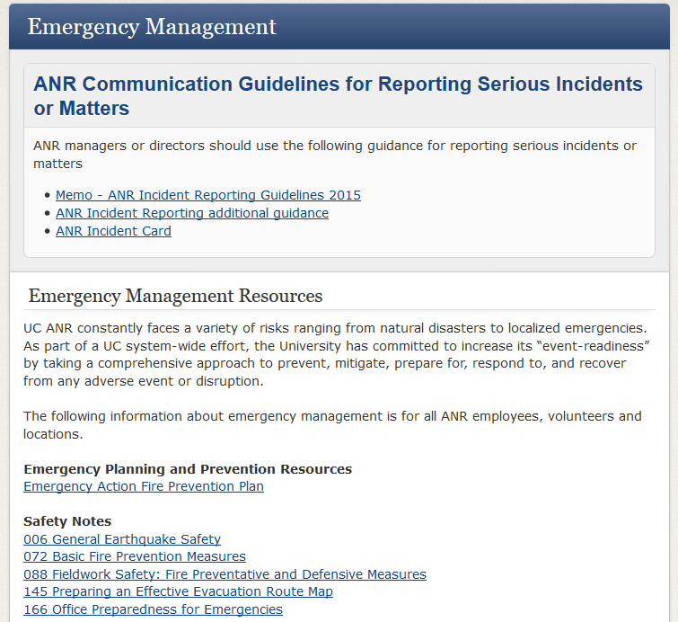
ANR Resources
http://safety.ucanr.org/Programs/emergency/
Notes:
Resources available on the ANR EH&S website include:
Emergency Management Program
Planning and Prevention Resources
Safety Notes in emergency preparedness
Recovery resources
Continuity Planning (UC Ready)
The structure/system used for response: SEMS/NIMS/ICS

Slide 13
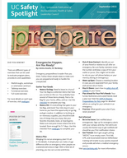
ANR Resources
Emergency Action and Fire Prevention Plan
Identifies the steps to take in an emergency
Emergency notifications/alarms
Location of emergency equipment
Fire extinguishers
First aid kits
Automated External Defibrillator (AED)
Evacuation routes and assembly area
Plan ahead, know the exits around you
Safety Spotlight Newsletter
UC monthly newsletter focusing on Safety
September’s topic is often “Preparedness”
http://www.ucop.edu/environment-health-safety/resources/safety-spotlight.html

Slide 14
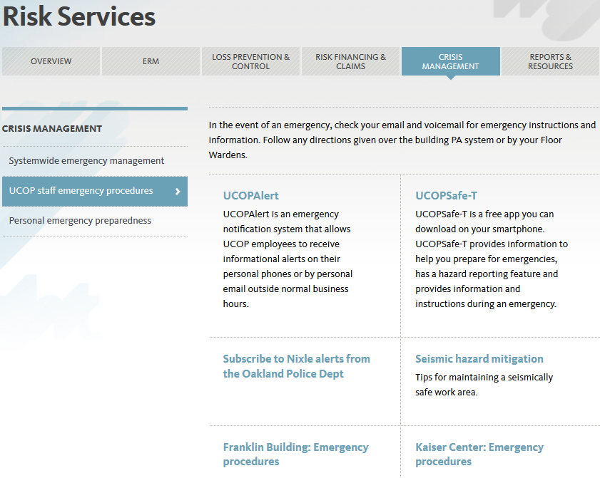
Internal Resources – Franklin Bldg.
Risk Services website
http://ucop.edu/risk-services/crisis-management/ucop-staff-emergency-procedures/
Notes:
Resources available on the UCOP Risk Services website include:
Crisis Management Program
Systemwide emergency management
UCOP staff emergency procedures
Personal emergency preparedness
UCOP Alert
Franklin building emergency procedures

Slide 15
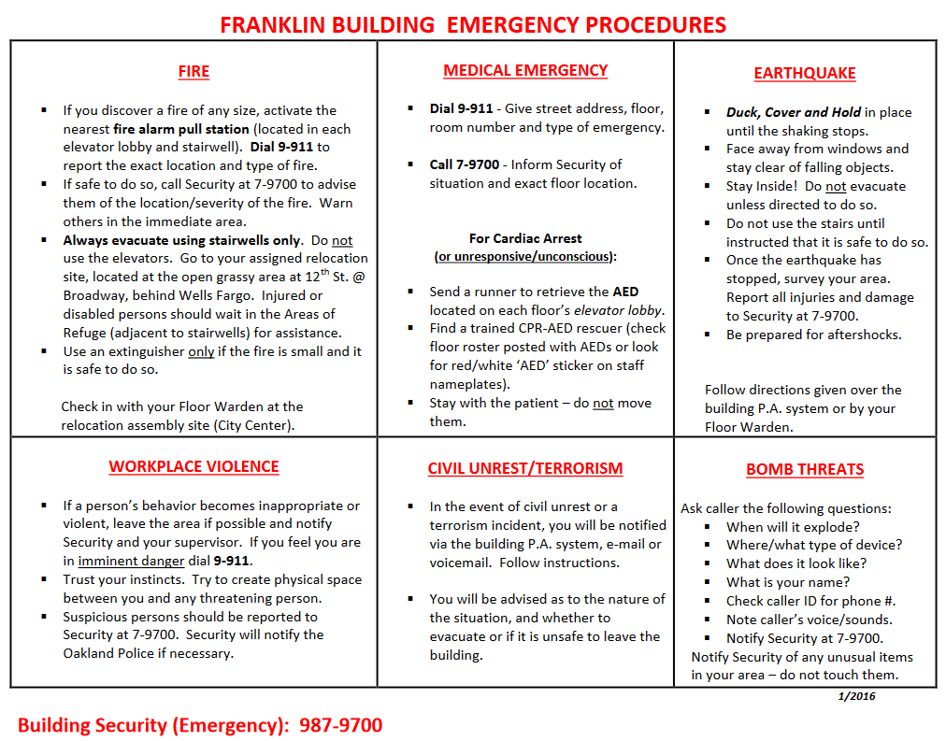
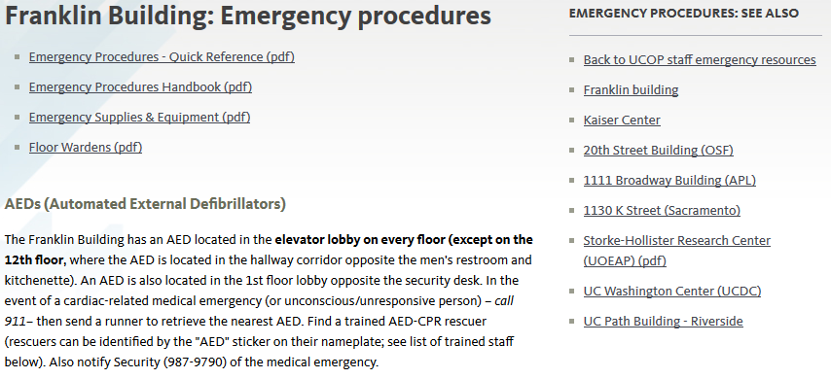
Internal Resources – Franklin Bldg.
Risk Services website
http://ucop.edu/risk-services/crisis-management/ucop-staff-emergency-procedures/franklin-building-emergency-procedures.html
Notes:
Franklin Building Emergency Procedures include:
Quick Reference Guide on what to do in various situations
Procedures Handbook
Supplies & Equipment
Floor Warden details and contacts

Slide 16
Evacuation Procedures – Franklin Bldg.
Details are on the Risk Services website
Floor Wardens: assist in the evacuation of occupants during a Fire Drill or Emergency; follow directions given by a Floor Warden or heard over the building PA system
Exit via the stairwells, NOT the elevators!
There are TWO EXIT stairwells: #1 is on the 11th st. side, #2 is on 12th st. side (north and south sides of building)
Evacuees who are mobility limited may shelter in place at the Area of Refuge adjacent to the Exit stairwell. An aide may be selected to assist. Floor Wardens will make note of non-ambulatory evacuees on posted “Blue Slips.”
The relocation area is behind the Wells Fargo Bank on the north east corner of 12th and Broadway.
http://ucop.edu/risk-services/crisis-management/ucop-staff-emergency-procedures/franklin-building-emergency-procedures.html
Notes:
A Floor Warden’s Role During an Evacuation is to Assist in the Evacuation of their Floor by:
- Making sure Exit Stairwells are passable and free of smoke before sending people down!
- Directing all floor occupants to the stairwells to exit.
- Making sure no one is using the Elevators.
- Checking Restrooms and other interior rooms for people who may not have heard the alarm or are trying not to evacuate…
- Checking perimeter conference rooms, corner offices etc. to make certain that everyone has evacuated,
When a complete sweep of the floor is done, head to the nearest exit stairwell and evacuate!
- Direct them to the Safe Relocation Area.
Get them to check in with the Floor Warden holding the Paddle!
Making sure your evacuees have checked in.
Keeping them together so as to be ready for when we Re-Occupy the building.

Slide 17
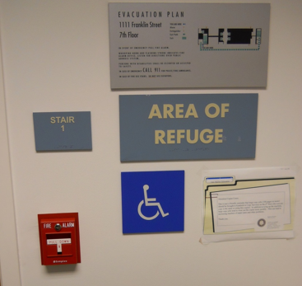
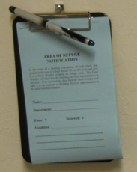
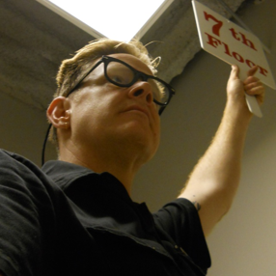
Evacuation Procedures – Franklin Bldg.
Details are on the Risk Services website
http://ucop.edu/risk-services/crisis-management/ucop-staff-emergency-procedures/franklin-building-emergency-procedures.html
- Areas of Refuge - Blue Slips & Floor Paddles

Slide 18
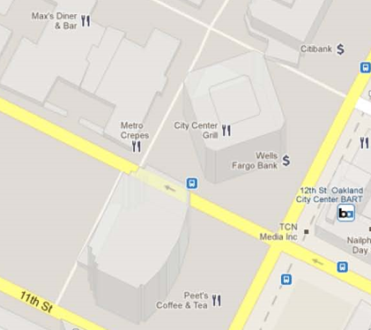
Evacuation Procedures – Franklin Bldg.
Details are on the Risk Services website
http://ucop.edu/risk-services/crisis-management/ucop-staff-emergency-procedures/franklin-building-emergency-procedures.html
Relocation / Assembly Area
Notes:
Remain at the relocation area while roll-call is taken, and until you are released for re-occupancy

Slide 19
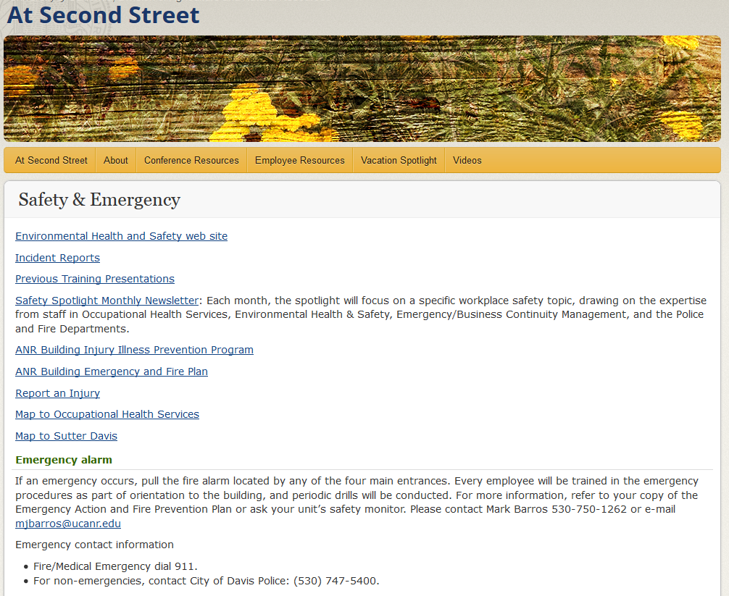
Internal Resources – Davis
http://ucanr.edu/2ndstreetsafety
Notes:
Resources available on the 2801 Second Street building website include:
Links to the UC Safety Spotlight, a monthly safety publication
Copies of the EAFPP and IIPP
Instructions for reporting an injury
Maps, etc.

Slide 20
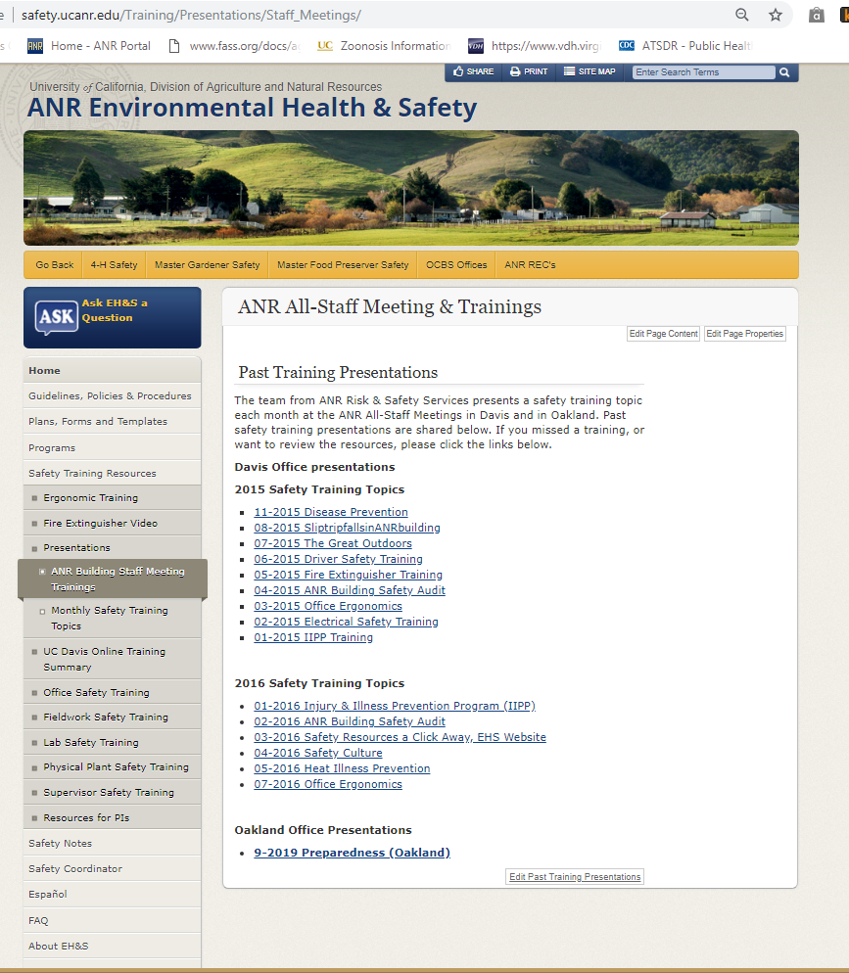
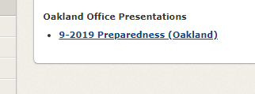
Website for Presentation Download
http://safety.ucanr.edu/Training/Presentations/Staff_Meetings/
Notes:
All-staff presentations are archived on our safety services website. We’re now adding in presentations for the Oakland office!

Slide 21
QUESTIONS?
please remember to sign-in

Slide 23
Why ShakeOut?
The Great California ShakeOut is an annual opportunity to practice how to be safer during earthquakes, and to improve preparedness
Over 10 million Californians participate annually, and over 25 million nation-wide
The occasion is also used as an opportunity to:
rehearse Drop, Cover, & Hold On
secure our space to prevent damage & injuries
review & update our emergency plans & supplies
discuss emergency preparedness & response
hold a fire drill / building evacuation exercise
What we do now will determine our quality of life after our
next big earthquake. Are you prepared to survive and recover?
Notes:
Annually, millions of Californians participate in the Great California ShakeOut earthquake drill. It provides an opportunity for us to rehearse the appropriate actions to take during an earthquake, and also provides the opportunity and reminder to review/update emergency plans and supplies, and to practice emergency actions such as evacuation of a building.
The ANR building in Davis participates annually, as do many other ANR locations. Will you be one? We encourage you to participate. Contact David Alamillo for more information, or visit Shakeout.org

Slide 24
What to Do During an Earthquake
“Drop, Cover, and Hold On” is the appropriate action to reduce injury during earthquakes
DROP to the ground (before the earthquake drops you!)
COVER your head and neck with your arms and seek shelter by getting under a sturdy desk or table if nearby; and
HOLD ON to your shelter and be prepared to move with it until the shaking stops
What NOT to do:
Do NOT get in a doorway
Do NOT run outside
Do NOT believe the so-called “triangle of life”—see EH&S FAQs website for info
Notes:
For detailed information, review Safety Note #006 (General Earthquake Safety) on the UC ANR website: safety.ucanr.edu

Slide 25
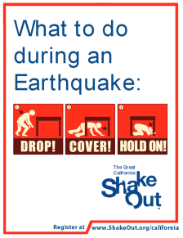
DROP! COVER! HOLD ON! continued
The main point is to not try and move, but to immediately protect yourself as best as possible where you are
If there is no table or desk near you, drop to the ground in an inside corner of the building and cover your head & neck with your hands & arms
If you must move to get away from heavy or falling/breaking items, first drop to the ground, then crawl only the shortest distance necessary
As you spend time in areas new to you, take a moment to look around:
What is above & around you that could move or fall?
What are your various routes of evacuation?
Identify safe places, & use your best judgment to stay safe!

