Slide 1
Welcome! November 18, 2017

Slide 2
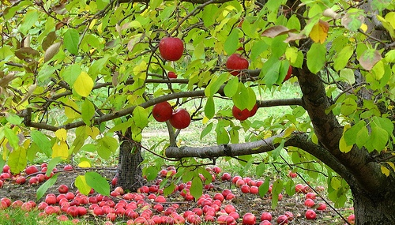
Fruit Tree Selection and Planting
Notes:
Mention today’s date: November 15, 2015. This is also so those watching this later will know when it was done. Like an archeological find.

Slide 3
Who We Are
Who we are
– Meredith
– Gayle – Helen – Jan
– Craig
UC Cooperative Extension Program
Scientifically based information
Receive 80 hours of initial training
Volunteers
Notes:
And we have several services we want to make sure you know about!
First, workshops—you already know that, because you are here!
We have a Help Desk (bricks and mortar), and here (Hold up business card) is the information for that. And we have Mobile Help Desks at various nurseries in the area in the spring, and we are generally a presence at all the valley Farmers Markets. Have any of you seen us around?
Our website is just packed with help! Google Napa County Master Gardeners. We are also linked to the Agriculture and Natural Resources library at UC Davis.
We have a weekly column in the Napa newspaper—have you seen it? You can find an archive of our newspaper articles on our website.
We have our Monthly Garden Guide specific to Napa County and have just completed an update to our book about Trees in Napa.
We want you to take advantage of all this information!
But wait, there’s more!
We train future Master Gardeners! Check our website to sign up to be notified when we begin recruiting for the 2019 class next summer! Our 2018 candidates are eagerly waiting for class to begin!

Slide 4
How Do We Do This?
Workshops
Help Desks: UCCE, Mobile & Farmers Markets
Weekly Newspaper Column
Tree Walks
Tomato Sale: April 14, 2018
Website
Train new Master Gardeners
Facebook
Books
– Trees to Know in Napa Valley – Month by Month Gardening Guide

Slide 5
Fruit Tree Selection and Planting November 18, 2017
Site Considerations: Helen Dake
Tree Selection and Varieties: Helen Dake
Pollination: Jan Hughes
Soil Preparation and Planting: Gayle Nelson
Post planting care, pests, disease:
Meredith Lavene

Slide 7
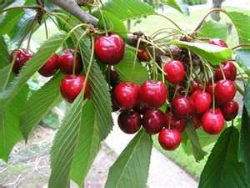
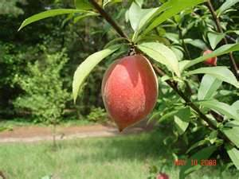
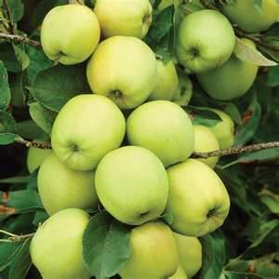
My Orchard

Slide 8
Climate
Climate Zones
USDA
Sunset
Microclimates – Property Issues
Slope
Aspect
Wind

Slide 9
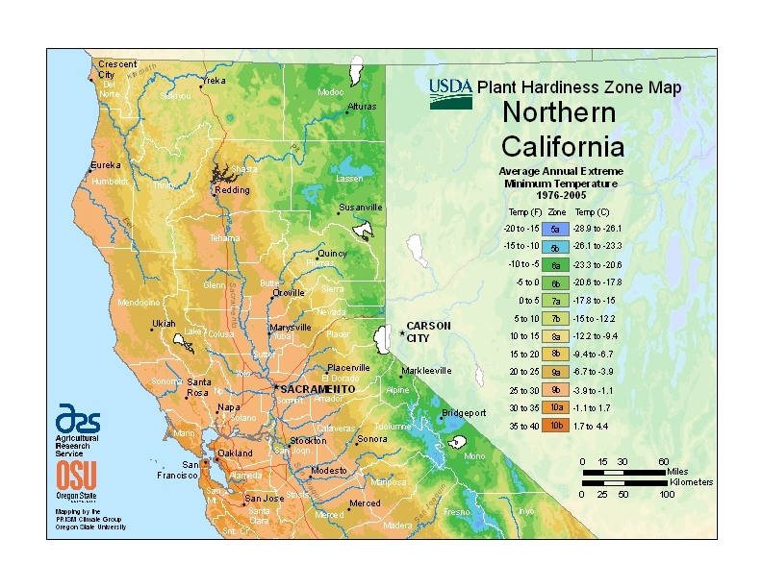
USDA Zones
Notes:
This is really hard to read—you can find it online by searching for USDA Zones.
What is important here is our USDA zones in Napa County indicating the average annual extreme minimum temperature.
Zone 9b, zip 94558, 94574, 94508: 25-30 F
Zone 9a, zip 94515: 20-25 F

Slide 10
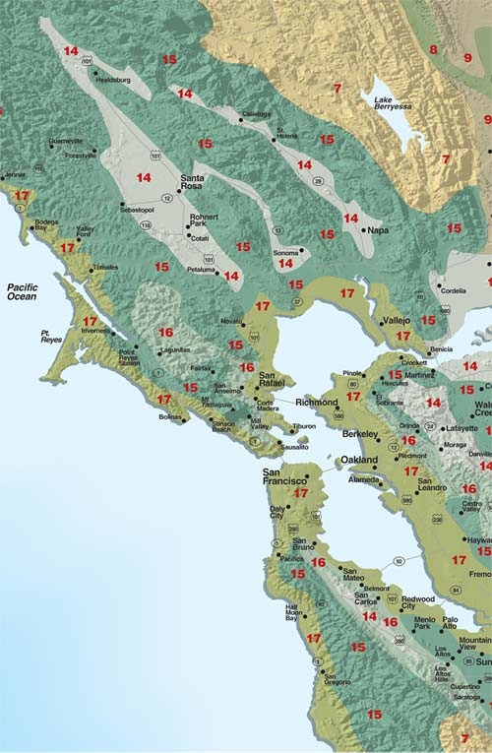
Notes:
Zone 7 owes its Foothill-Digger Pine name to the abundance of California foothill pines in the area. The zone comprises the eastern part of the county and includes Pope Valley and Lake Berryessa. These areas have a later spring and earlier frosts than the rest of the county, creating a growing season that may be as much as a month shorter. Summers are hotter and dryer. This is a good area for late- or long-blooming fruit and nut trees. This zone also defines most of Lake County.
Zone 14, the so-called Coastal Warm area, includes the major valley floors in the county. The coastal influence keeps this zone from being as hot as the Central Valley. It is protected from the summer fog by its distance from the ocean and the mountain ranges; thus, summers in this zone are very dry. Between April 1 and October 31, the area clocks more than 1,100 hours between 70°F and 90°F degrees. Most deciduous fruit trees and wine grapes do well here. Sonoma County’s valley floors, including the town of Sonoma, are in this zone, too.
Zone 15, nicknamed Coastal Cool, is affected by marine air 85 percent of the time and inland air 15 percent of the time. It covers the foggy hilltops above the valleys and the southern part of the county east of Napa and includes Mount Veeder, Spring Mountain and Howell Mountain. It logs from 800 to 1,100 hours between 70°F and 90°F during the growing season. Cane berries, some fruits and certain grape varieties prosper here. Many of the plants recommended for Zone 15 will not prosper in Zone 14 because they need moister air, cooler summers or both. The Coastal Cool area receives more chilling hours than Zone 14.
Zone 17, the Marine area, is the coolest zone in Napa County. It is also the largest, encircling the floor of the Napa Valley. It includes the Carneros District, American Canyon and the Soscol Ridge up to Napa. The heavy marine fog brings cooler temperatures and less intense sunlight here compared to other Napa County zones. The growing season may see as few as 800 hours between 70°F and 90°F. Consequently, growing sub-tropical plants here is a challenge.

Slide 11
Napa Climate
Apricots bloom February through early March
In Napa County we often have cold rainstorms during that time
“Consistent crops unlikely”

Slide 12
Microclimates
Within those zones are Microclimates:
Temperature, frost, rain, hours
of sunlight, wind, elevation, topography
exposure, structures, chill factor, soil, eaves,
drainage can vary, sometimes within your own
property

Slide 13
Microclimates

Slide 14
Site Constraints
Nearby structures and trees
Water availability
Fences, pavement, and utilities
Microclimates nearby

Slide 15
More Site Considerations
Soil quality and drainage
Space available
Chilling requirement—total hrs below 45
Temperature extremes
Spring rains
Late frost
Water needs

Slide 16
Location/Tree Size
Space availability: Site constraints
Type of tree(s) desired
-standard
-semi dwarf
-dwarf
Space saver: Espaliered trees
Fruit Tree hedge; Three in a hole

Slide 17
Relative sizes of Fruit trees
Notes:
These trees are on different rootstocks.
The height of these trees and their rootstocks are: (This is in one of the handouts in the workshop binder—fill in the blanks.)
Far left: 3 to 6 ft--Dwarf
Middle: 9 to 10 ft—Semi-dwarf. Rootstocks for this height: M7 (apple) , Pumiselect (prunus), Citation (prunus), OHXF333 (pear)
Right of middle: 12 to 13 ff—Semi-dwarf. Rootstocks for this height M111 (apple), OHXF97 (pear), Colt (cherry)
Far left: 18 to 20 ft—Standard size on standard rootstock

Slide 18
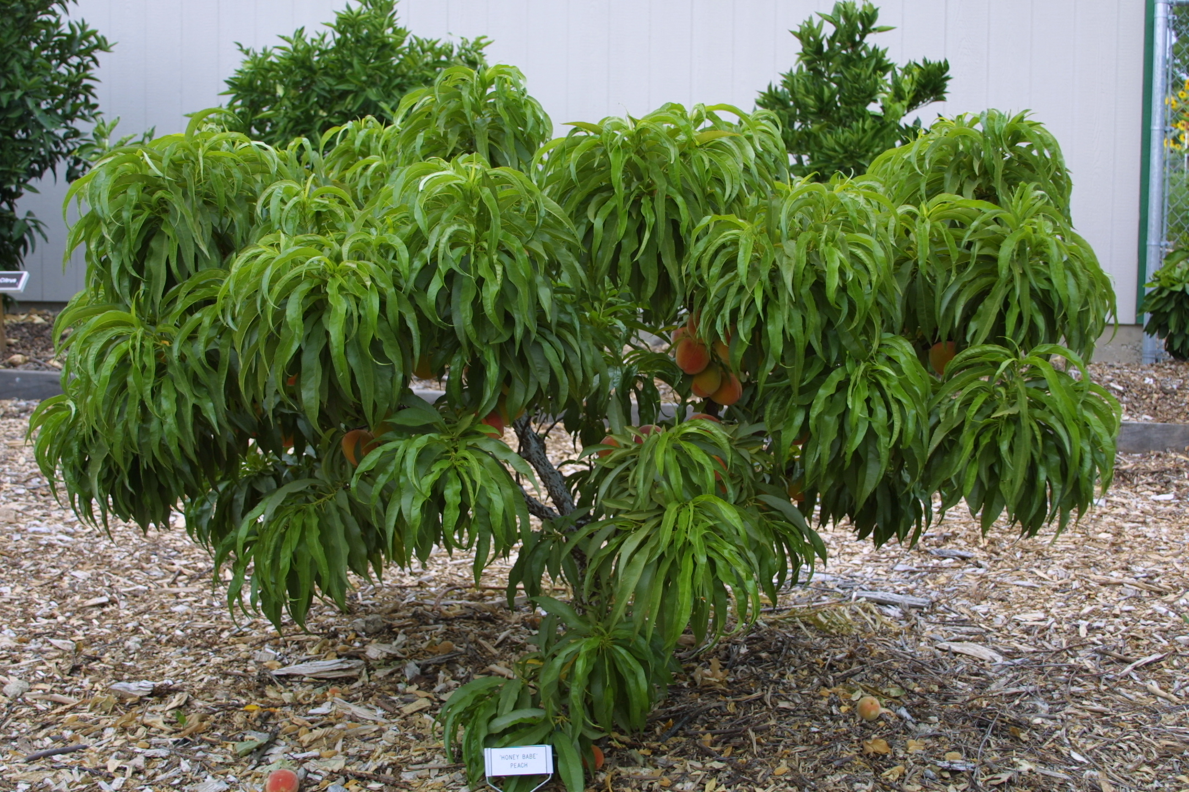
Genetic Dwarf Peach

Slide 19
Limited space ideas
Espaliered trees
Fruit Tree hedge
Three in a hole

Slide 20
Espalier Patterns

Slide 21
More Espalier

Slide 22
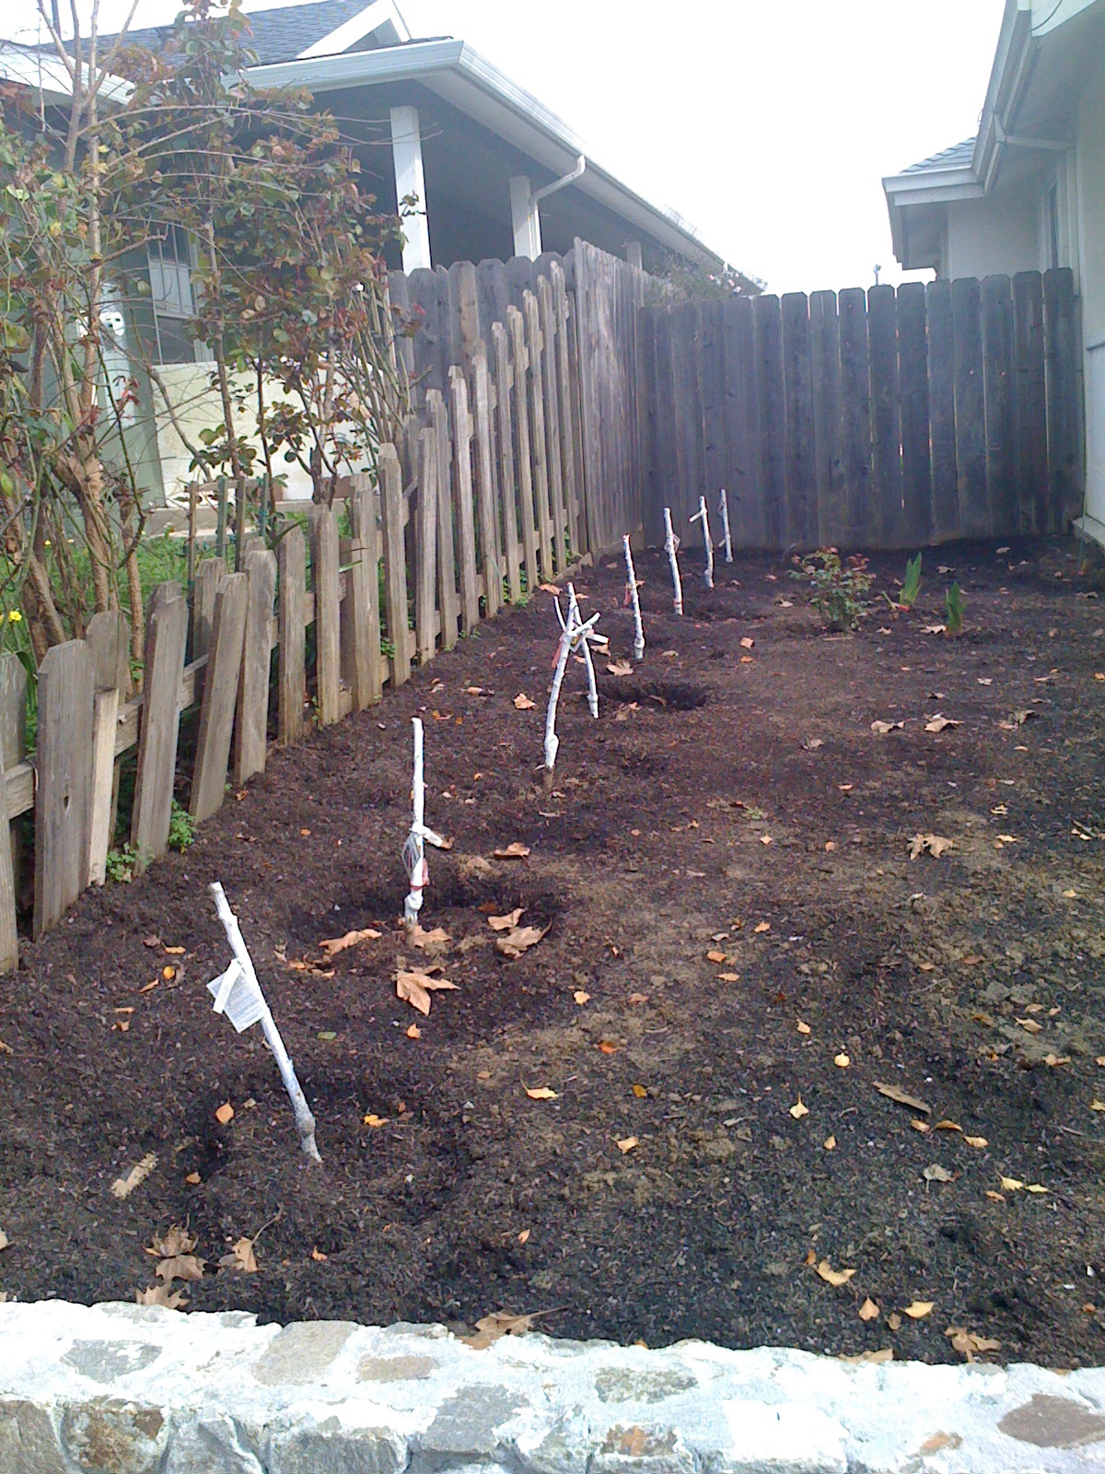
Fruit Tree Hedge

Slide 23
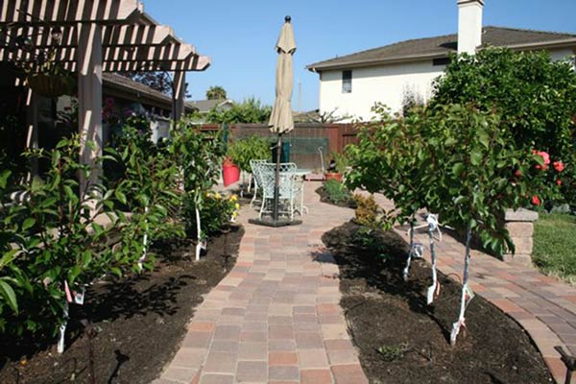
Fruit Tree Hedge

Slide 24
Fruit Tree selection: space considerations

Slide 25
Fruit Tree Terms
Rootstock/Stock: tree below graft union
Scion: tree above graft union; also grafted bud or shoot
Graft union: where bud has been grafted
Crown: trunk above ground; also the canopy
Notes:
Rootstock varieties will be discussed later.

Slide 26
Trees requiring good drainage
Cherry
Peach
Nectarine
Almond
Walnut

Slide 27
Trees tolerating clay soil and wet spring
Pear
Apple
Plum and Pluot
Pomegranate
Quince
Persimmon
Fig

Slide 28
Drought-resistant trees
Apple on seedling rootstock – not grafted
Fig
Persimmon

Slide 29
Fruit Tree Terms: Chill Hours
Chilling requirement:
Total number of hours of winter dormancy needed for good bloom and growth in spring
Chilling hours:
Accumulated hours at or under 45 degrees F during winter. Hours need not be continuous.
Notes:
Annual pattern of growth of deciduous fruit trees changes with seasonal transitions. Grow rapidly during spring and first ½ of summer. Later in the season the growth rate declines. In the fall growth of trees stops as day length an temp decrease and drop their leaves. Dormancy is due to hormone growth inhibition and the trees internal processes are in a state of rest. Dormancy is then broken after sufficient cold temperature breaks down the growth inhibitor.
A specific number of hours of cold weather (below 45 degrees F) are required for each variety of deciduous trees, called CHILL HOURS Below 45degrees F/ 7 degrees C

Slide 30
Chill Hours
Usual Average Hours at 45 or below at:
Napa: 700-1000 hrs
St Helena: 700-1000 hrs
Calistoga: >1000 hrs
Lake Berry: >1000 hrs
Sonoma: 400-900 hrs
Healdsburg: 700-1000 hrs
Notes:
It might be best to indicate that this is as of 2015, and although it is true that these parameters still hold true, but the current number of chill hours is closer to 800 than to 1000.

Slide 31
Current Chill Hours
Chill hours in Carneros, from 2011 – 2015
show a decrease in cumulative chilling hours between Nov. 1 to Feb. 28 of each year,
from an average of 1,200 hours per year in
2011, 2012, 2013 to an average in 2014 of 800 hours.
Chill hours during the 2016-2017 winter in
Carneros was 852: 2015-2016 was 801.
(information from UC Davis, Chill Calculators)
Notes:
This might be redone in a graph. Explaining that UCD has stations in Oakville and Carneros. This is just Carneros. And the time of calculation is from Nov.1 to Feb 28(29) of the following year.
Or leave the years out to say that it has decreased in cumulative CH from 2011 to 2014 of 1000 hours to 685 in 2014-2015; 801 in 2015-2016 and 852 in 2016-2017.

Slide 32
Good Performers, Napa County
Apple | Pollinator | Chilling |  | Harvest
Fuji | O | 800 hrs |  | November
Gala | O | 500-600 hrs |  | Late July
Gravenstein | + Fuji, Gala | 600 hrs |  | Late July
Golden Delicious | O | 700 hrs |  | September
Notes:
Many apple varieties are self-fruitful, including ‘Braeburn,’ ‘Empire,’ ‘Fuji,’ ‘Gala,’ ‘Granny Smith,’ and ‘Pippin.’

Slide 33
Rootstocks
Apple rootstocks:
MM111: Tolerates wet, poor soil; bears on young wood; ¾ standard size
M7: Resists fireblight and mildew; bears early and heavy; 2/3 standard size
Notes:
Note resistance to Fireblight

Slide 34
Good Performers, Napa County
Pear | Pollinator | Chilling | Harvest
Bartlett | +D’Anjou | 800 hrs | August
D’Anjou | +Bartlett | 800 hrs | September
Bosc | +Bartlett | 800 hrs | October
Comice | +Bartlett | 600 hrs | October

Slide 35
Good Performers, Napa County
Peach | Pollinator | Chilling |  | Harvest
Arctic Supreme | o | 700 hrs |  | July-August
Nectar | o | 700 hrs |  | July
O’Henry | o | 750 hrs |  | August
Notes:
Almost all citrus species are “self-fruitful.” Other self-fruitful species include quince, sour cherry, most apricots, fig (except the Smyrna type), peach (except ‘J.H. Hale’ and some others), and European-type plums and prunes. Some European pears are also self-fruitful. ‘Bartlett’ pear is parthenocarpic, which means that no pollination is required to set fruit (only in California). Some cherries are self-fruitful, such as ‘Lapins,’ ‘Stella,’ and ‘Sunburst.’ Many apple varieties are self-fruitful, including ‘Braeburn,’ ‘Empire,’ ‘Fuji,’ ‘Gala,’ ‘Granny Smith,’ and ‘Pippin.’
THIS INFORMATION MIGHT BE BETTER PLACED ELSEWHERE. (Pollination) slide 42.

Slide 36
Good Performers, Napa County
Nectarine | Pollinator | Chilling | Harvest
Arctic Queen | o | 600-700 hrs | August
Fantasia | o | 500 hrs | July-August

Slide 37
Good Performers, Napa County
Plum | Pollinator | Chilling | Harvest
Elephant Heart | +Santa Rosa | 500 hrs | August
Santa Rosa | o | 300 hrs | July
Pluot
Flavor King | +Santa Rosa | 500-600 hrs | August

Slide 38
Good Performers, Napa County
Persimmon | Pollinator | Chilling | Harvest
Fuyu | o | 300 hrs | November
Hachiya | o | 300 hrs | November
Pomegranate
Wonderful | o | 150 hrs | October

Slide 39
Good Performers, Napa County
Quince | Pollinator | Chilling | Harvest
Pineapple | o | 300 hrs | October
Fig
Black Mission | o | Low | Sept, October
Brown Turkey | o | Low | Sept, October
Notes:
Quince and Figs are not grafted, and grow on their own seedling root stock.

Slide 40
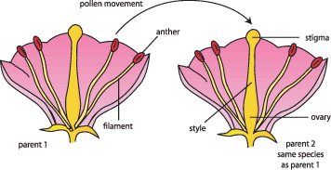
Pollination
Notes:
Fruit will not form until pollen from male parts are transferred to the female parts of a flower.
Without pollination, flowers may bloom abundantly, but will not bear fruit.
Pollination is the transfer of pollen from the stamens (male part) to the stigma (female part) of the same or a different flower.
Some species of fruit trees have perfect flowers—that is both the anthers which contain pollen, and the pistils which develop the fruit, are on the same blossom.
Trees THAT BEAR FRUIT from self pollination or from pollen from another tree of the same kind are called Self fruitful trees, or Self pollinating trees.

Slide 41
Pollination
Notes:
Pollination can be performed by animals, insects, wind, or water.

Slide 42
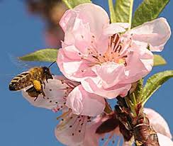
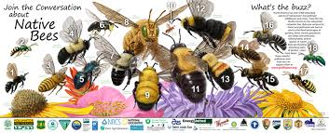
Pollination
Notes:
Mostly, fruit trees are pollinated by bees. Not just honey bees. Native bees make up a larger percentage of bees than the honey bees.
Fruit set refers to fertilized flowers that have developed fruit.

Slide 43
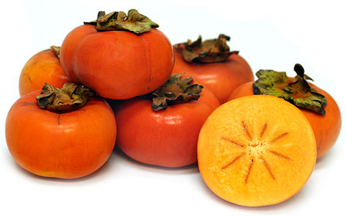
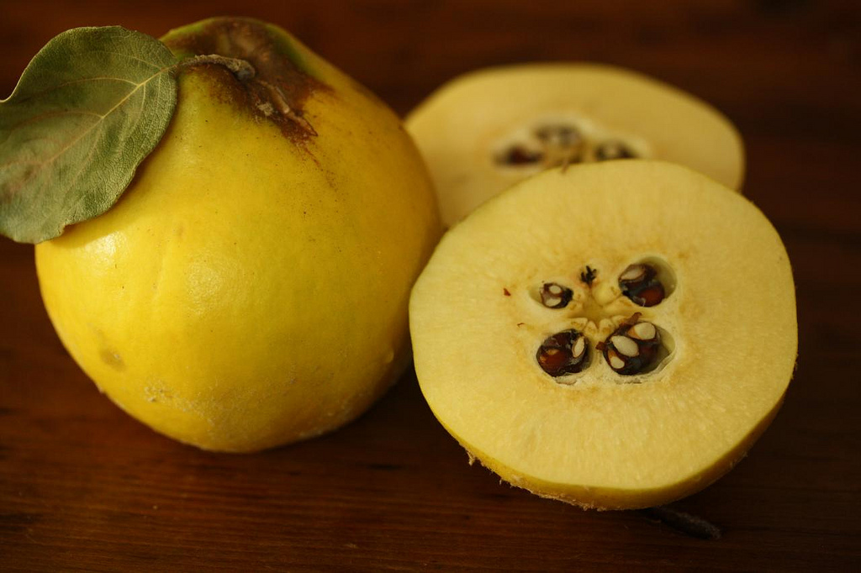
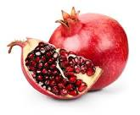
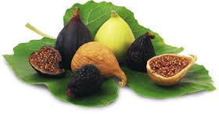
Self-Pollinating
Notes:
What do YOU as a home gardener need to know about pollination?
We talked about fruit trees with perfect flowers, that can bear fruit by self-pollinating.
Nearly all common varieties of apricot, peach, nectarine and sour cherry, persimmons, quince, and pomegranate are self-pollinating. MOST figs.
Almost all citrus species are “self-fruitful.” Other self-fruitful species include quince, sour cherry, most apricots, fig (except the Smyrna type), peach (except ‘J.H. Hale’ and some others), and European-type plums and prunes. Some European pears are also self-fruitful. ‘Bartlett’ pear is parthenocarpic, which means that no pollination is required to set fruit (only in California). Some cherries are self-fruitful, such as ‘Lapins,’ ‘Stella,’ and ‘Sunburst.’ Many apple varieties are self-fruitful, including ‘Braeburn,’ ‘Empire,’ ‘Fuji,’ ‘Gala,’ ‘Granny Smith,’ and ‘Pippin.’

Slide 44
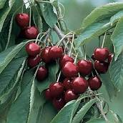
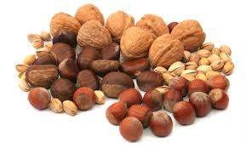
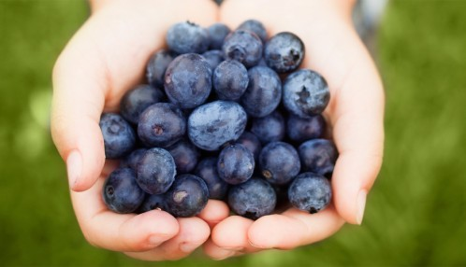
Self-Sterile
Notes:
Then there are Self sterile fruit trees.
However, there are many types of fruit trees with perfect flowers that cannot produce fruit from their own pollen.
They require pollen from a related cultivar.
That related cultivar is called a POLLENIZER.
In general, self-sterile types of fruit (and nuts) include many apples, sweet cherries, nuts, some pears, blueberries.

Slide 45
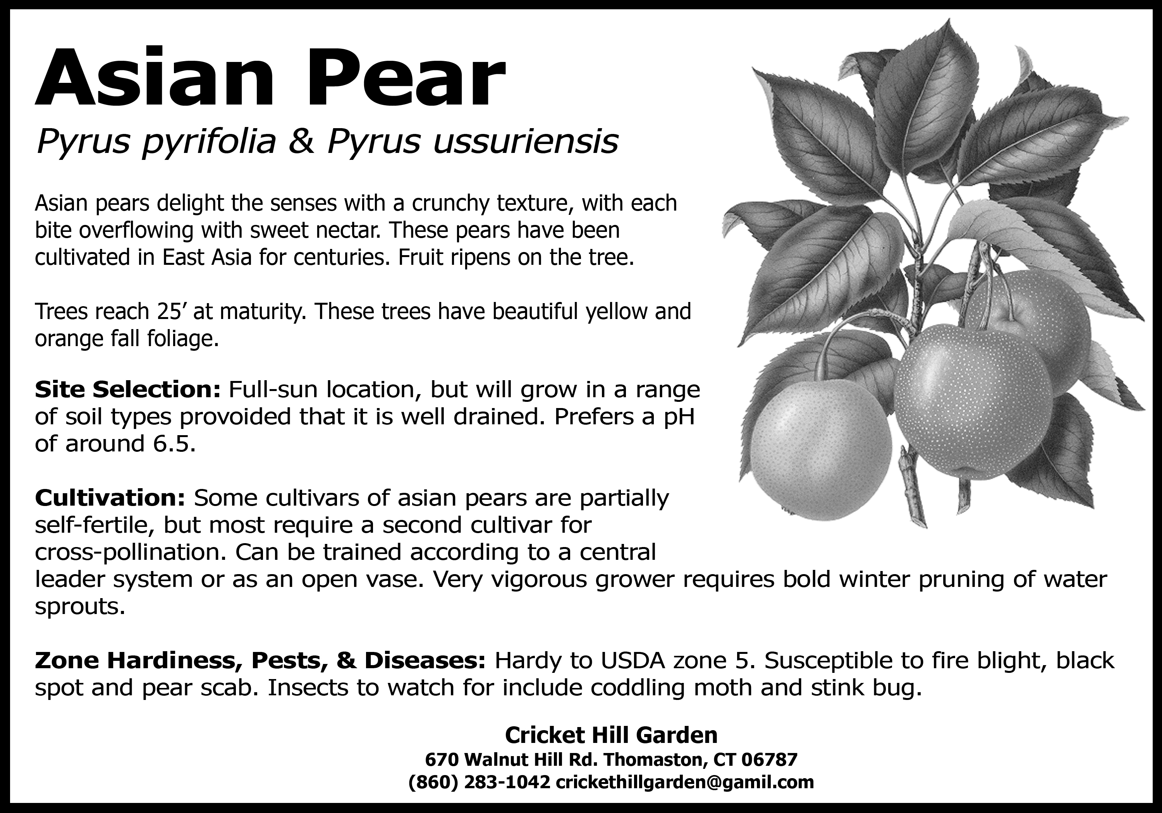
What’s a Home Gardener to do?
Read the tag!

Slide 46
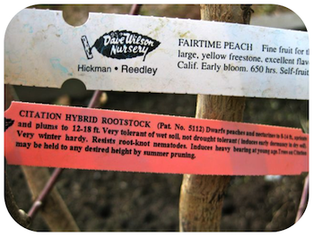
1st Step – Read the Tags
Top tag describes the variety
Bottom tag describes the rootstock
Notes:
Tag #1: The Variety
Harvested very late (early September), excellent freezer or fresh-market selection. Yellow-fleshed freestone peach with an attractive yellow skin and bright red blush where exposed to sun. The fruit features a very large size and a well-balanced peach flavor.
This tag shows the particular named variety of fruit, like an “Anna” apple, or a “May Pride” peach. This label lists the characteristics of that particular variety, such as the flavor, ripening time and chill hours required to set fruit. If you live near the coast, you need to be particularly careful in selecting a fruit tree that has a low chill hour requirement. After you’re done salivating over the fruit’s juicy details, pay close attention to other label.
Tag #2: The Rootstock
Citation
Peaches and nectarines dwarfed to 8 to 14 feet. Apricots and plums dwarfed to 3/4 of standard. Very tolerant of wet soil, induces early dormancy in dry soil. Very winter hardy. Resists root-knot nematodes. Trees bear at young age. (Zaiger)
The rootstock information is critical in determining whether the tree is best suited to your site. Fruit trees are grafted onto various rootstocks which impart particular attributes to the variety. For example, different rootsocks may extend the range for that tree, giving it the ability to grow where it might not normally be possible (due to sandy soils, wet soils, crown rots, nematodes, etc.). Rootstocks can also help control the height of the tree (creating dwarf or semi-dwarfing trees) or offer drought tolerance or more protection in cold winter areas. Generally, your local nursery will pick the combinations of variety and rootstock that will work best in your area. For additional information on varieties suitable for low chill coastal San Diego, check out this link to see a list of recommended fruit trees prepared by the California Rare Fruit Growers, San Diego Chapter.

Slide 47
What’s a Home Gardener to do?
Learn about what you want to plant
What’s in the neighborhood?
Plant a pollinator in your garden
Graft a cultivar that will provide pollen
Check University publications
Visit commercial nurseries—Read the tag!
Notes:
Learn the needs of the tree you want to plant—some fruit species bear male and female parts on the same flower, some bear male and female flowers on the same tree, some bear male and female flowers on SEPARATE plants.
Often neighbors have fruit tree varieties that will serve as pollinators.
With appropriate bee activity (we’ll get back to that in a moment), neighboring trees or even wild trees can provide a source of pollen. Maximum distance, 100 ft.
Plant your own pollinator.
Graft a cultivar that will serve as a pollinator branch, or place a bouquet of flowers from a pollinator in a jug or basket and place in the tree. Do this in the early morning before the bees arrive.
We have a full listing of resources you can consult—it’s one of your handouts.
Please note especially the UC references—The Backyard Orchard, The Home Orchard, ANR PDF downloads.

Slide 48
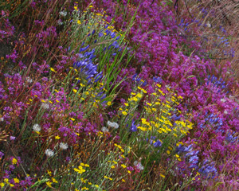
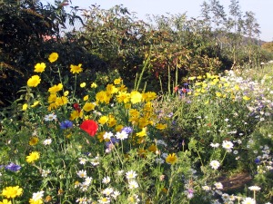
What else can you do?
Make sure you have bees!
Notes:
Make sure you have bees!
Invite them into your garden.
Find a little nook where you can plant some bee-friendly plants and let them become a little wild and alluring!
We suggest California natives, of course! For instance: Ceanothus, California buckwheat, coyote bush, penstemon, asclepius, and the salvias (sages)
Find a whole list of them at the California Native Plant Society website. Or stay after and look at the pictures we have here???
Also, be sure to have water available. Bees LOVE water, too!

Slide 49
What’s really important?
Helen’s points:
Climate
Space
Chill
Root stock
Jan’s points:
Pollination
Bees, and Flowers
Notes:
What’s really important about fruit tree selection and planting?
Helen had some good points about
Climate
Space
Chill requirements
Root stock
And the all important part, YOUR choices on what you would like to eat!
And Jan’s talk will help with understanding pollination and how every home gardener can optimize it. Flowers and native plants, right?!
And as always our UC IPM website, on your resource list, has much much more information about every fruit and nut than we can share in an hour and a half!

Slide 50
Planting Fruit Trees
Be excited about your tree!
Know your soil, and your drainage
Prepping the soil
Planting a bare root fruit tree
Planting a container grown fruit tree
Notes:
So you have your tree!
I’m going to give some general remarks about soil preparation and planting.
I will show you how to plant a bare root tree, and a container grown tree.
We have step by step slides for this which you can view on our website.
SWITCH TO OUR WEBSITE, previously prepped and tabbed open to show.
When I’m done, Meredith will have some guidelines about what to do after planting, and some pests and diseases to be on alert for.

Slide 51
Fruit Trees
Type
Bare root
Container grown
Best varieties for clay soil
Apple
Fig
Pear
Persimmon
Plum and Pluot
Pomegranate
Quince
Notes:
What you plant depends on what you like! Since Napa county is notorious for having clay soils, here are some varieties best suited to clay soils. Does this mean you CAN’T have nectarines or peaches, or even cherries or apricots? No. Home gardeners need to know the growing requirements of what they plant, and be the person that makes it happen!
That’s why Master Gardeners are here, to help you find the information you need. All YOU need to do is promise to follow the guidelines for YOUR tree!
Planting starts with the soil.

Slide 52
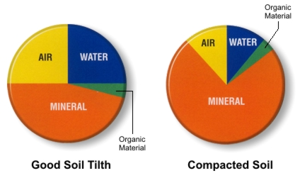
Good Soil Tilth
Has large pore spaces for air infiltration and water movement.
Roots only grow where the soil tilth allows for adequate levels of soil oxygen.
Also holds a reasonable supply of water and nutrients.
Notes:
The health of the soil is a key factor in the growth and health of your new fruit tree.
So let’s talk about it!
‘Good Soil Tilth’ is the Master Gardener way to say Good Soil Health.
Soil is made up of minerals, organic material, water, and air. There needs to be a balance of all four of them in order to have a healthy tree.
We can get the organic material and minerals in there with amendments and other methods.
The air and water components are measurable by you yourself.
The air and water need to move around within the minerals and organic material so that the roots can absorb water along with nutrients from the soil. That’s what ‘large pore spaces’ means on the slide. Roots grow only where there are sufficient levels of oxygen in the soil. Soil also needs to hold water long enough for the nutrients to dissolve into it and get taken up by the roots. Sandy or really gravelly soil can be just as challenging a soil condition as clay.
Water is a component of soil Let’s figure out how your soil absorbs water. Or does not.

Slide 53
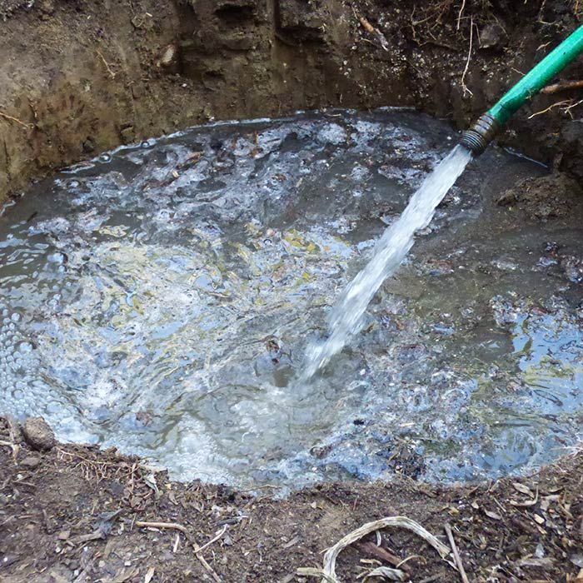
Test for Drainage
Dig hole at least 3’ deep, fill with water.
Empties in less than 24 hours = GOOD
Empties in 24-48 hours = marginal
Water standing after 48 hours = unsuitable.
Back-fill hole and look for a better site.
Notes:
Here’s how to determine how your soil drains, or holds water.
Dig a hole 3 feet deep near where you’re going to plant. Fill with water.
If it empties in less than 24 hours, you have good drainage.
If it empties in 24 to 48 hours, that is marginal, but you can still plant.
If it does not empty in 48 hours, select another site, or wait a whole year and in the meantime prepare the soil.

Slide 54
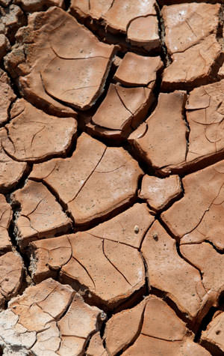
Clay?
Notes:
Most soils in Napa are composed of a lot of clay. Have you found that kind of soil in YOUR garden? The major problem with clay soil is that it is usually compacted, and lacks air, one of the four major components of soil. This can be overcome to some extent. I’m going to tell you how.
It’s called Sheet Mulching, or Lasagna method, or layering.

Slide 55
Sheet Mulching—Layers
Notes:
This method of soil preparation is good for EVERY soil, not just clay soil, so everyone should pay attention, no matter what kind of soil you have. This method improves all soil types!
This method requires cardboard and compost.
Large pieces of cardboard can be obtained at an appliance store or a big box store. Remove as much tape as you can. Lots and lots of newspaper works, too.
Compost can be obtained from Napa Recycling, from Upper Valley Disposal, Sonoma Compost Company in Nicasio—they have many different kinds of blends and mulches, Grab and Grow in Santa Rosa, and Soils Plus in Sonoma.
You can remove existing weeds from your site, or leave them. If you do this layering method correctly, they’ll die for lack of light!

Slide 56
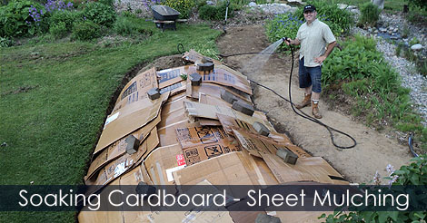
Sheet Mulching--Water it
Notes:
Layer the newspaper or cardboard in your planting area. Overlap the pieces. Water them down a bit if it’s not going to rain the next day.
Heck, water it down anyway!

Slide 57
Sheet Mulching--Compost
Notes:
Cover the cardboard with at least 3 inches of compost. At least. More if you have a lot of compost. It will seem like a lot, but it will settle over the winter.
Then just leave it until it’s time to plant your bare root or container grown tree. The cardboard will deteriorate with rain, and over the winter, and with help from earthworms.
What happens is that the compost and cardboard keep the rain from slamming on the soil, and compacting it.
Slowly, slowly, the cardboard deteriorates, and the organic goodness from the compost trickles into the clay.
In the meantime, earthworms will be racing to the cardboard—worms LOVE cardboard, and working their aeration magic from below.
The result is that a year later, or sooner perhaps, you will have a lovely, rich place to plant—a fruit tree or anything else.

Slide 58
Plant right through it!
Notes:
Prepare the soil now. This afternoon, or next Saturday at the latest. That will give you time to get or order some compost! You can also buy compost in bags from Orchard, or Home Depot, or Van Winden’s if you don’t have a large area to layer.
When it is time to plant, just make the hole right through the compost and cardboard. All that compost goodness around the edges is breakfast, lunch, and dinner for your baby tree.

Slide 59
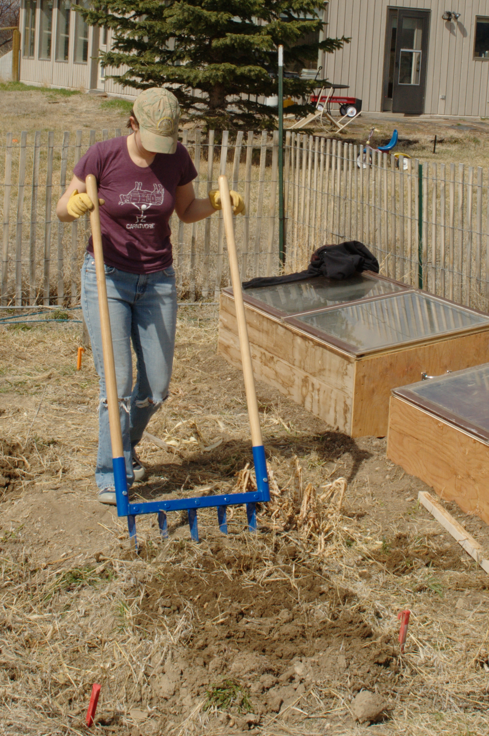
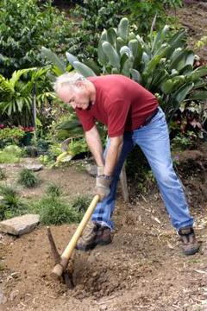
Breakup Surrounding Soil
Compacted or stratified soil can be broken up with a pickaxe
Breakup soil to a depth and width to allow for spreading of roots
Notes:
If you have packed clay, get someone to rough it up a bit by tilling or pick axe. And if you have packed clay and don’t want to do that, prepare the area anyway, and plant a container grown tree in the summer or bare root in January 2019.
Remember – roots grow out more than they grow down.

Slide 60
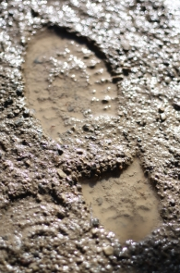
Other Clay Considerations
Never try to work wet clay soil as it is particularly susceptible to compaction and this will lead to poor drainage and the dreaded clods make working clay soil such a pain.
If your clay soil looks at all like this photo in January or February, don’t dig. Wait for drier weather and consider postponing your fruit tree planting until 2019.
Notes:
See that slide? If you have soil that routinely looks like this when it rains, by all means get that sheet mulching layering process started that I’m going to talk about in a minute, and wait till summer or even 2019 to plant.

Slide 61
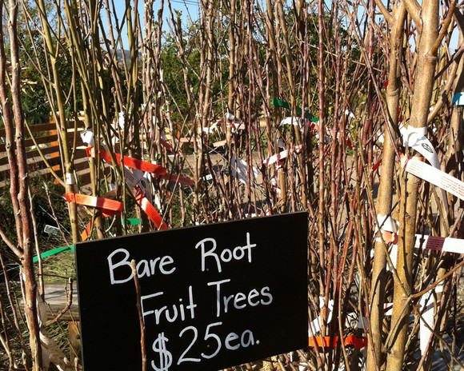
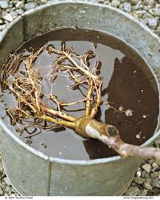
Bare Root Fruit Trees
Heeling in a bare root fruit tree for planting later
I’ve purchased a bare root tree so now what do I do?
Notes:
Now you have a bare root tree from a reputable nursery. If you’re going to plant it right away, soak it. If you’re not going to plant it right away, heel it in. This means put it on its side and loosely cover the roots with soil. Please don’t let it dry out or freeze. Get it planted as soon as you can!

Slide 62
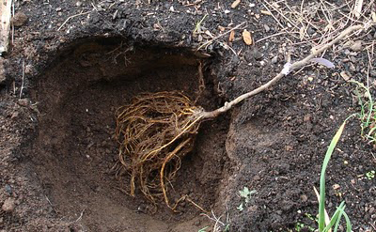
Planting Hole Preparation Bare Root Fruit Trees
Place tree in the hole to see if there is sufficient width and depth to accommodate the roots

Slide 63
Planting Preparation Bare Root Fruit Trees
Prune Roots
Examine the roots and remove any that are broken or kinked.
Avoid shortening roots – make the hole bigger to accommodate them.
Notes:
Have a look at the roots. Remove broken or kinked ones. Please don’t shorten a long root—make the hole wider.

Slide 64
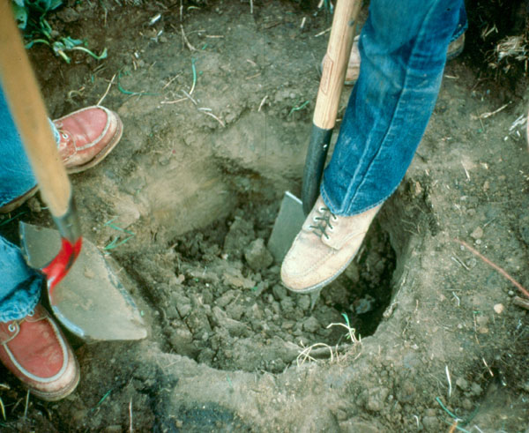
Planting Hole Preparation Bare Root Fruit Trees
Hole should be at least twice the width of the trees roots.
Hole should be no deeper than the length of the roots.
Notes:
The planting hole. Wider is much more important than deep. The hole needs to be only as deep as the bare roots are long. And at least twice as wide as the bare roots spread.
Please do not add fertilizer or amendments to the planting hole. They are not needed in our area, and especially if you have prepared your planting area with organic material—compost.
Remember, roots grow out, so it’s important that the areas the roots are growing in to have the nutrients that compost provides.

Slide 65
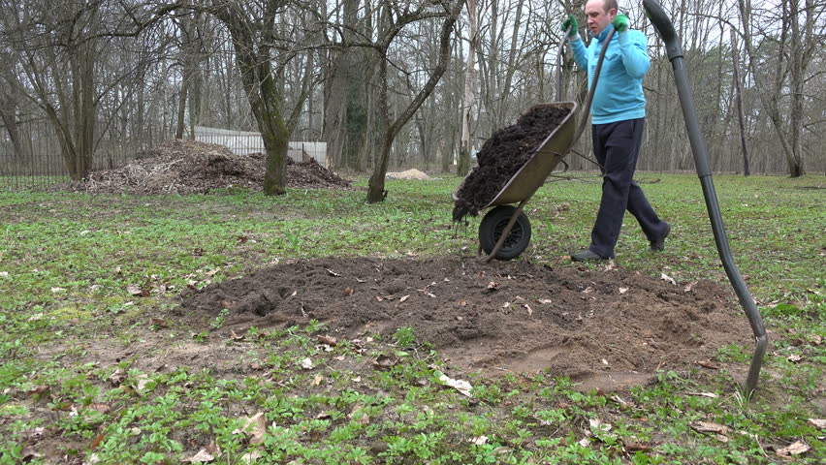
Add Amendments and Fertilizer?
No. Not needed in
Napa
Homeowner could prepare soil with lasagne method of composting
Notes:
Please do not add fertilizer or amendments to the planting hole. They are not needed in our area, and especially if you have prepared your planting area with organic material—compost.

Slide 66
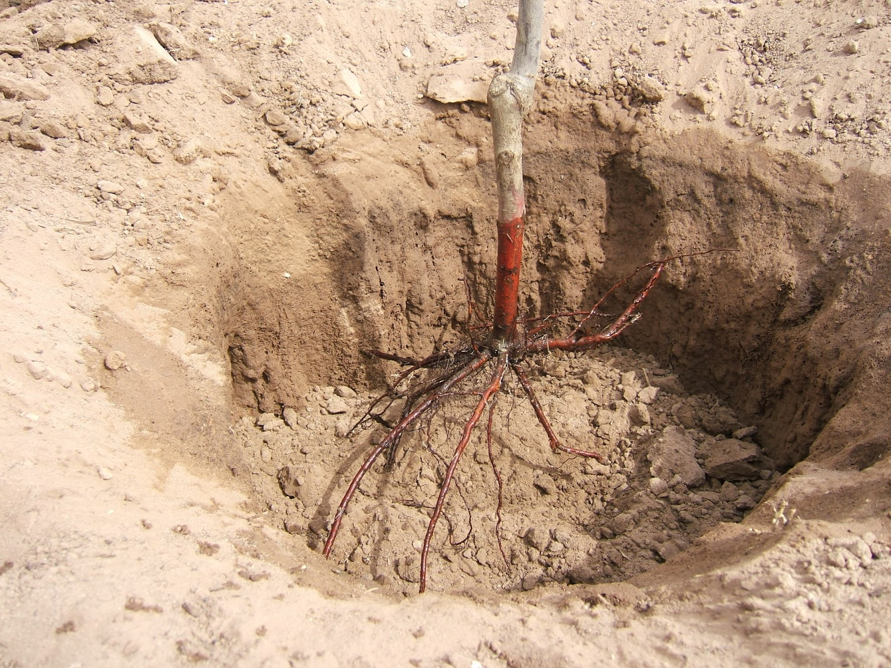
Planting Preparation Bare Root Fruit Trees
Build a dirt mound high enough to allow roots to drape over the mound.
Notes:
Place the tree in the hole to see if it is wide enough to accommodate the roots.
Build a mound in the bottom of the hole so the roots can drape over it. Adjust as needed!
Place the tree on top of the mound.
Position the graft union so it is 2 to 4 inches above the soil and facing northeast.
Fill the hole with the excavated soil. Tamp down the soil gently. Water it.
Make an irrigation basin around the newly planted tree for future watering. Meredith is going to have more to say about this in a minute.

Slide 67
Planting a Bare Root Fruit Tree
Now you’re ready to plant
Place the tree on top of the mound.
The graft union should be 2” to 4” above the soil surface and facing northeast.
Fill the hole with the excavated soil.
Tamp down the soil to remove air pockets.

Slide 68
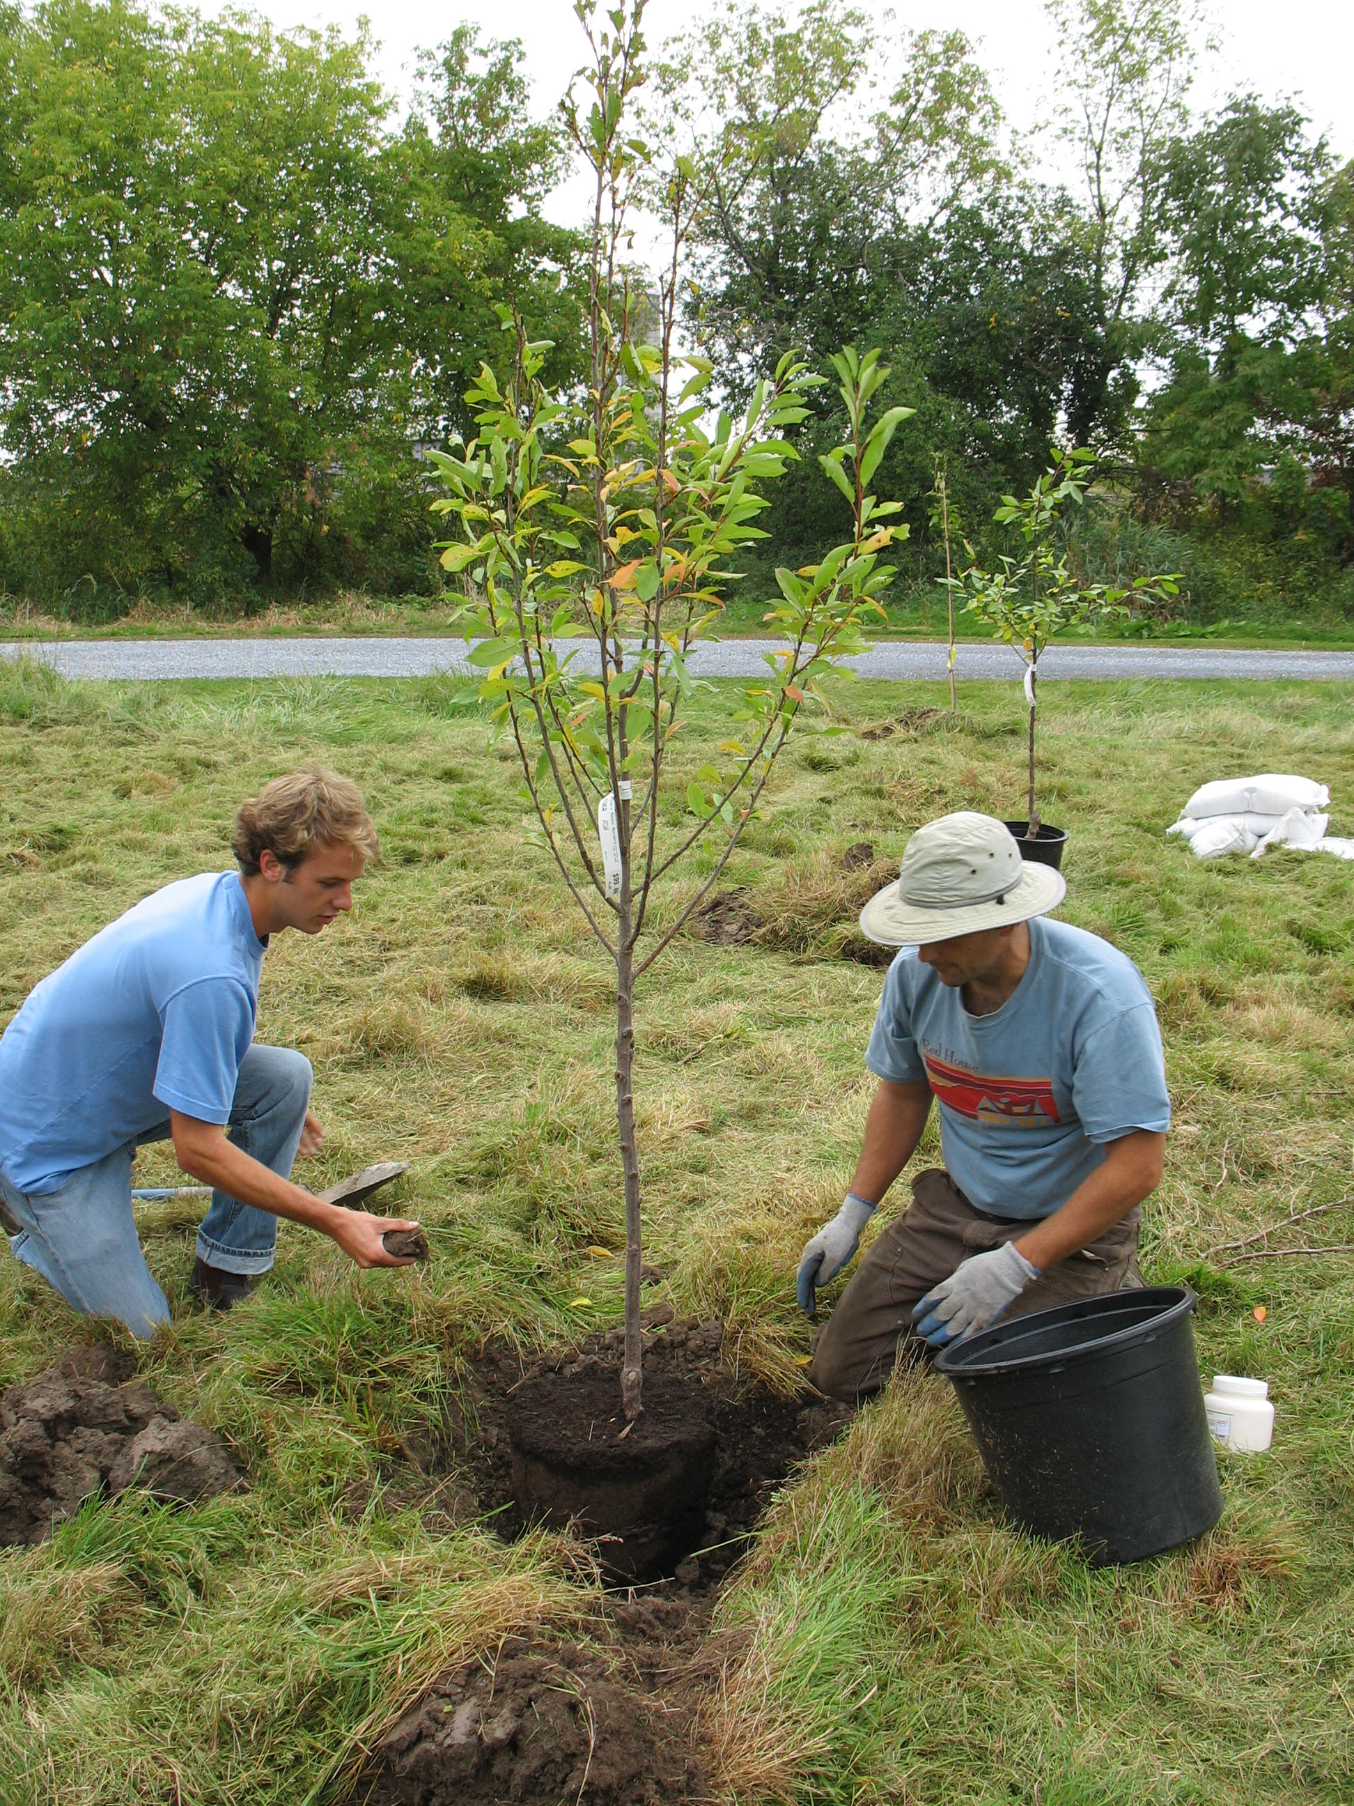
Planting Hole Preparation Container Grown Tree
Hole should be at least 2 to 3 times the width of the root ball.
Hole should be no deeper than the root ball.
Notes:
Here you have a container grown tree from a reputable nursery.
Once again, focus on wider rather than deeper. The planting hole for a container grown tree should be 2 to 3 times as wide as the root ball, but only needs to be as deep as the root ball.

Slide 69
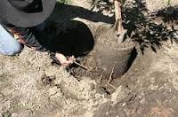
Planting a Container Grown Tree
Gently ease the tree from its container.
Check for girdling or circling roots and gently pull away from the root ball before planting.
Notes:
Gently ease the tree from the container. Please don’t pull on the trunk!
Check for girdling or circling roots. If there are some, pull them GENTLY away from the root ball before planting.

Slide 70
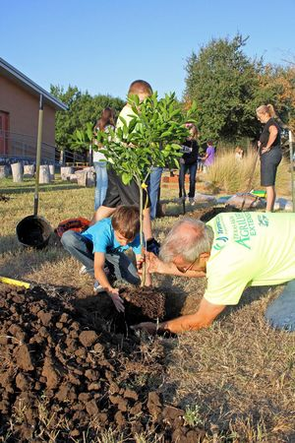
Planting a Container Grown Tree
Place the tree in the hole with the graft union at least 2” to 4” above the soil surface.
The protruding notch should face north/northeast to reduce the likelihood of sunburn.
Notes:
Place the tree in the hole with the graft union 3 to 4 inches above the surrounding soil, and face the graft union northeast. Adjust bottom of the hole with soil so tree is at the correct level.
As with the bare root tree, backfill with the excavated soil. Tamp gently, and water thoroughly. Make an irrigation basin, or prepare irrigation line right away. That’s more from Meredith.

Slide 71
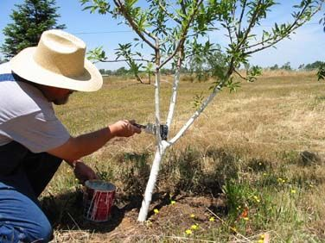
For Both Bare Root and Container Grown Trees
Paint the tree
Protect the bark from sunburn and infestation by borer insects..
Apply paint from 2” below soil surface up the entire trunk.
Notes:
Both bare root and container grown trees need some sunscreen. Sunscreen for baby trees is white (or light) interior latex paint and water, 50/50.

Slide 72
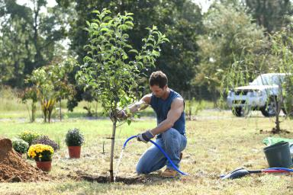
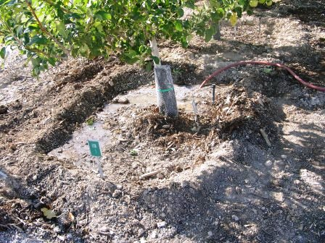
For Both Bare Root and Container Grown Trees
Construct a doughnut-shaped basin for watering. Should be slightly wider than the planting hole.
Thoroughly water to settle soil around the root ball.
Notes:
Both bare root and container grown trees need some mulch. If you’ve planted in your cardboard and compost layers, all you need to do is tidy it up. Keep the compost and soil away from the graft union and trunk of the tree.

Slide 73
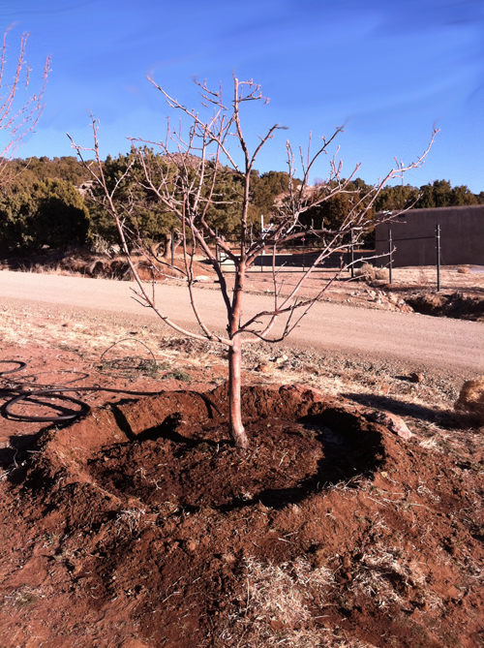
For Both Bare Root and Container Grown Trees
Thoroughly water to settle soil around the root ball.
Add a 3” to 6” layer of mulch to the basin to control weeds and conserve moisture.
Keep mulch several inches away from the trunk of the tree to minimize crown rot and hiding places for pests.
Notes:
Both bare root and container grown trees need some mulch. If you’ve planted in your cardboard and compost layers, all you need to do is tidy it up. Keep the compost and soil away from the graft union and trunk of the tree

Slide 74
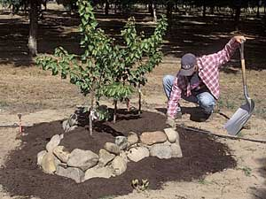
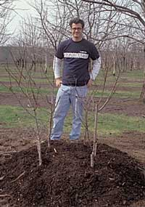
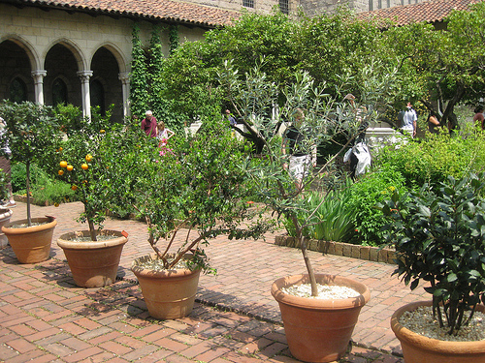
Options
Notes:
Are there other alternatives for planting bare root and container grown fruit trees?
YES!
Helen mentioned them earlier.
Consider planting in a raised bed. You can do the same soil preparation if you have an existing raised bed, or if it’s a new one, use a good quality planting mix. And here’s a caveat. Depending on how high your raised bed is, consider the root stock carefully. Even a tree on semi-dwarf rootstock in an 18 inch raised bed is going to be that much taller for all the care and cultivation tasks needed.
You can also plant in a VERY LARGE container. Or plant 3 or 4 in a hole.
If you are considering planting into a container, choose a tree with dwarfing rootstock, be consistent about repotting and root pruning, and use a good quality planting mix.
So. Questions before I turn this over to Meredith who will talk about what to do and what to look for after you’ve planted your tree?

Slide 75
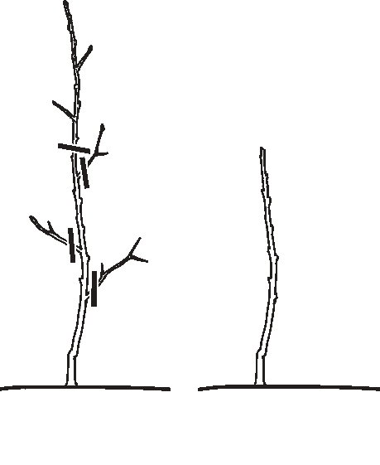
Planting Bare Root and Container Grown Trees
Heading the tree
Goal is to have a fruit tree that is relatively small, easy to prune and harvest.
By heading the tree to about knee height you force the tree to develop low branches.

Slide 76
Post Planting
Irrigation
Training and pruning
Fertilization
Pest problems

Slide 77
Post Planting: Irrigation
You will need to plan for irrigation beginning
in the spring when the climate warms.
Methods of irrigation
Hand watering and devices
What is most fool proof?
Irrigation workshop.
Notes:
Soil in the root zone should be moist at all times. Not wet but not dry. Think a squeezed sponge.
Irrigation method depends on the weather, the number of trees, amount of time you spend away from the garden. Hand watering is OK, depending. You can place a timer on the spigot and use the hose as the method. You set the timer to begin and end the watering. You need to decide how to keep your new tree watered. We have periods of very hot weather. If you rely on yourself to do the watering, you may not be in town when the weather changes. Think about it.
An entire irrigation system is the most reliable but you may not want to invest in something that costly. There will be an irrigation workshop in 2018. Check the list on our website. I have here the tree part of the irrigation system, in a circle. It receives water through the central intake and the holes are 12 inches apart. The amount of water can be changed on the electric monitor which controls the system.

Slide 78
Post Planting: Pruning
Pruning cuts:
Thinning cuts:
remove lateral branches
Heading cuts:
center or branch is cut shorter
Notes:
In the first and second years, choose the branches you want as the main structure of your tree and remove or trim other branches. You’ll be cutting the branches back by about half. Open Center or Vase-Shaped can be used on all fruit and nut trees. So that in the first year select three to four limbs distributed evenly around trunk. Leave small branches on these limbs for early fruiting and sunburn protection. Limbs should be about 24-30“ on a tree that had been cut down to 18-24” at planting.
There are two types of pruning cuts:
Thinning cuts are used to remove lateral branches at their origin or to shorten branch length. Lateral cuts should be angled and leave the “collar” on.
Heading cuts are when a plant is cut back to a stub, lateral bud or small lateral branch. Heading cuts may result in a flush of vigorous, upright growth. . I’m not going to explain how to make these cuts exactly because you need to go to a workshop to see it. There will be one in February
.

Slide 79
Post Planting: Fertilization
Napa Soils provide many of the elements that fruit trees need.
Amendments:
Compost
Mulches
Organic fertilizers
Synthetic fertilizers
Notes:
Napa county soils can provide many of the macro and micro elements that fruit trees need. Compost, mulches and organic fertilizers, however, can be an important part of fertility management of a backyard orchard, especially compost. Their nutrients are released slowly during the growing season and converted to a form that the trees can use. The difference between compost, mulch, and organic fertilizers on one hand and synthetic fertilizers on the other is that the nutrients in chemical fertilizers are released more quickly whereas composts and mulches may also improve the tilth of the soil. They are released slowly and in a manner that the trees use. Manures used as fertilizer can be full of seeds and high in salts as well as being “fresh’ which can burn the plants. Mulches are any material put on top of the soil to conserve moisture, suppress weeds, encourage beneficial organisms and reduce erosion. Compost can be used as a mulch, as well as leaves, grass clippings, and other chopped up yard waste.

Slide 80
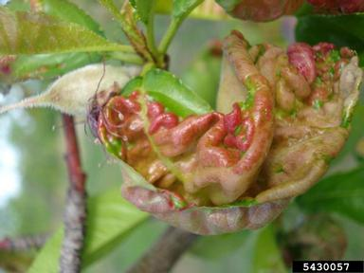
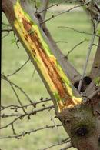
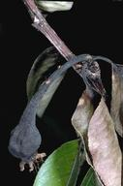
Focus on Common Problems
Peach leaf curl
Bacterial Canker
Fire Blight
Notes:
Who here has had issues with these. (name one at a time). Peach Leaf Curl, upper left, bacterial canker on the right and fire blight on the bottom. These are the focus of this part of the presentation, but there are other pests: aphids, coddling moths, birds, deer, gophers, Brown Rot, scale insects, borers. Search the website pest notes if these are suspected. Decide what you can live with, and use accepted control methods. Deciding what you can live with is very important in all your gardening. Do you want to give up 1/3 of your crop, how about 1/5th?
Peach Leaf Curl is the distorted, reddened foliage typical of an infection with PLC and is a familiar sight on peach and nectarine trees
Bacterial Canker is common in stone fruits and seldom seen in apples or pears. It is caused by a bacterium
Fire Blight. FB is most serious on pears, but may also damage apple, quince and loquat trees as well as a few ornamentals. It is characterized by the blackening and shriveling of affected shoots, flowers and young fruit, which truly look as like they have been singed by fire. The causative organism is a bacterium

Slide 81
Peach Leaf Curl
Notes:
Leaves produced in spring are thickened curled and colored red or yellow instead of green. Badly diseased leaves fall by early summer. It is caused by the pathogen Taphrina deformans, survives on tree surfaces and buds, is favored by cool wet weather during spring. It survives the dry summer as spores. Tree to tree spread of the fungus occurs by airborne spores which can be disseminated in splashing water. Infections occur only on young plant tissue. Management: the disease may be kept under control with a dormant fungicide application, in wet years, more than one spray application may be needed – November 15th and February 1st. Some experts say that removing the affected leaves may be helpful but if a tree is fully infected, removing the leaves will remove the photosynthesis that helps the tree grow. Do clean up the fallen leaves and dispose of them.

Slide 82
Bacterial Canker

Slide 83
Bacterial canker
Bacterial canker is caused by the bacterium Pseudomonas
Symptoms appear in late winter/early spring
Infected trees have a sour vinegar-y smell
The bacteria are always present on plants, and does not enter through pruning wounds.
Cultural practices are the only remedy.
Notes:
NEED PICTURE!! The canker is most common in stone fruits and symptoms appear as an irregularly shaped water or gum soaked area of bark. But it may grow to girdle and kill entire branches or trunks. It is active during the winter and ceases when warm weather returns and the trees start to grow.
Management strategies must depend on cultural practices, Fungicides and bactericides are not effective. Healthy vigorous trees suffer less. Avoid planting in a place where there had been bacterial canker. Provide optimum levels of key nutrients, especially nitrogen to maintain tree vigor without over fertilizing. If trees have been affected by bacterial canker, remove entire affected branches in the summer.

Slide 84
Fire Blight
Notes:
Who has experienced fire blight? It is very insidious, hideous bacterial disease. Not easy to deal with. It can kill branches & whole plants. Infections usually originate in the flowers.

Slide 85
Fire Blight
Notes:
Dead, blackened leaves and fruit cling to branches throughout the season, giving the tree a scorched appearance, hence the name “fire blight.” Infections can extend into scaffold limbs, trunks, or root systems and can kill highly susceptible hosts. Less susceptible varieties might be severely disfigured. Once infected, the plant will harbor the pathogen indefinitely. The first evidence of a fire blight infection usually is a tan ooze that begins to seep out of branch, twig or truck cankers as soon as growth begins in the spring. The ooze turns dark, leaving streaks on the bark. Flowers or shoots begin to shrivel and blacken. The disease spreads from blossoms into wood and the young branches develop brown dry leaves .

Slide 86
Fire Blight Management
Plant resistant varieties
Reduce new growth
Low or no nitrogen or heavy pruning.
Do not irrigate during bloom
Consider antibiotic spray
Notes:
The first management practice is to buy a fire blight resistant tree. The next three management practices are to avoid new growth. Clean & sterilize tools between cuts and plants. Copper products often don’t provide adequate control even with multiple applications. Sprays prevent new infections but won’t eliminate wood infections; these must be pruned out.

Slide 87
Fire Blight Management
Remove infections in summer or winter when bacteria are not spreading through the tree.
The climbing technique used here is not IPM approved!
Notes:
Very susceptible trees (pear, Asian pear, and some apple varieties) infections should be removed as soon as they appear in spring. Very important to read the IPM pest notes on Fireblight, including a list of resistant and susceptible varieties. Some apple and pear varieties are semi or completely resistent to fireblight.

Slide 88
For more details and more pests
ipm.ucanr.edu/PMG/PESTNOTES
And for more on gardening in general
ipm.ucanr.edu/PMG/menu.homegarden.html
Notes:
And the rewards of successful production of home-grown fruit greatly outweighs nature’s sometimes problems. Always first decide what you can live with. A sort of “détente”. And follow good cultural practices as has been covered earlier.

Slide 89
Your contact information is used to distribute a link
to a follow-up survey and relevant program information.
The short survey provides us the tools we need
to grow and improve the quality of our program.
We do not sell or share
your contact info with anyone else.
If you do not wish to receive the survey please email us at mgevaluation@ucanr.edu
Notes:
Notes:
“So we can better serve our communities and improve the content and value of our program’s events and workshops, please be on the look-out for an email to access our online survey. The survey typically takes less than 10 minutes to complete. We are so grateful for your support of the UC Master Gardener Program”.

Slide 90
UC Master Gardeners of Napa County

Slide 91
Slides below
Slides following were removed from the 2015 presentation in preparation for the 2017 one. But they were not deleted, only moved to the end of the program used for 2017.
They’re there for reference and if you want to use ‘em!

Slide 92
Identify Soil Problems
Chemical – Soil Test
pH High or Low
6.0 to 7.5 is OK / 6.5 is best
NPK
Salt level
Toxic elements
Sodium
Boron
Chloride
Notes:
Slide taken out of PPT and parked here.

Slide 93
Planting Bare Root and Container Grown Trees
The End
Notes:
Slide deleted from PPT and parked here.

Slide 94
Sunset Climate Zones
Notes:
Zone 7 owes its Foothill-Digger Pine name to the abundance of California foothill pines in the area. The zone comprises the eastern part of the county and includes Pope Valley and Lake Berryessa. These areas have a later spring and earlier frosts than the rest of the county, creating a growing season that may be as much as a month shorter. Summers are hotter and dryer. This is a good area for late- or long-blooming fruit and nut trees. This zone also defines most of Lake County.
Zone 14, the so-called Coastal Warm area, includes the major valley floors in the county. The coastal influence keeps this zone from being as hot as the Central Valley. It is protected from the summer fog by its distance from the ocean and the mountain ranges; thus, summers in this zone are very dry. Between April 1 and October 31, the area clocks more than 1,100 hours between 70°F and 90°F degrees. Most deciduous fruit trees and wine grapes do well here. Sonoma County’s valley floors, including the town of Sonoma, are in this zone, too.
Zone 15, nicknamed Coastal Cool, is affected by marine air 85 percent of the time and inland air 15 percent of the time. It covers the foggy hilltops above the valleys and the southern part of the county east of Napa and includes Mount Veeder, Spring Mountain and Howell Mountain. It logs from 800 to 1,100 hours between 70°F and 90°F during the growing season. Cane berries, some fruits and certain grape varieties prosper here. Many of the plants recommended for Zone 15 will not prosper in Zone 14 because they need moister air, cooler summers or both. The Coastal Cool area receives more chilling hours than Zone 14.
Zone 17, the Marine area, is the coolest zone in Napa County. It is also the largest, encircling the floor of the Napa Valley. It includes the Carneros District, American Canyon and the Soscol Ridge up to Napa. The heavy marine fog brings cooler temperatures and less intense sunlight here compared to other Napa County zones. The growing season may see as few as 800 hours between 70°F and 90°F. Consequently, growing sub-tropical plants here is a challenge.

Slide 95
Microclimate
Factors within Mediterranean Climate
Dry summer, rainy winter
Factors in Napa Climate
USDA and Sunset zones
Microclimate: temperature, frost, rain, hours
of sunlight, wind, elevation, topography
exposure, structures, chill factor, soil, eaves,
drainage.
Notes:
We have a “big tent party”: Mediterranean Climate. Our Golf umbrella are our Sunset Climate Zones for Napa Valley: Our specific gear (raincoat, hat) is microclimate
Microclimate includes temp (record daily high/low); frost (often, occasional); rainfall (direction, normal, drought, El Nino, which side of valley); sunlight in parts of year;
wind (direction, velocity, seasonal?); Elevation; topography (top or bottom of hill, open valley, under trees, rocky outcropping); exposure (placement of home, direction
of sun, note seasonal changes); structures (buildings, fences, walls, terraces, paved areas that cause wind, shade, heat, reflections); chill factor will talk about; Soil
(clay or sandy soil will impact drainage); eaves (direction of overhangs for frost protection); drainage (water table, percolation, standing water, run-off)

Slide 96
Fruit Tree selection: 3 or 4 in a hole
Plant more than one
tree in a hole
We are still looking
for definitive
research on this!
Notes:
In truth, we cannot find UC research on high density fruit tree planting, except for high density planting for commercial avocado growers.
The information on three or four in a hole comes from Dave Wilson Nursery (very reputable), and at least two speakers who have given presentations to Master Gardeners.
We are continuing to search for university-level information on this topic.
Anecdotal evidence exists that it is successful, as long as the trees planted in the hole are of the same variety.
Be aware that managing the trees for size and structure will require more intensive labor than routine summer or winter pruning of four separate fruit trees.

Slide 97
Rootstock
Pear rootstock:
OHXF 333: Fireblight resistant, 2/3 standard size

Slide 98
Rootstock
Peach rootstock:
Citation: Peach-plum hybrid; dwarfing; tolerates wet winter; not drought tolerant; young bearing
Lovell: Tolerates wet winter; needs good drainage; grows full size tree
Notes:
Peach rootstocks have names, not numbers!
Citation root stock is used frequently in Napa County fruit trees. It helps early fruiting, helps keep your tree short, and increases flavor by increasing sugar content but it more susceptible to bacterial canker than Lovell, the other frequently used rootstock. But in the end, unless you want to order special trees, it is easiest to go with the trees that your nursery stocks. They want the best for their customers if the nursery is a good one.

Slide 99
Good Performers, Napa County
Apple | Pollinator | Chilling | Rootstock | Harvest
Fuji | O | 800 hrs | M111* | November
Gala | O | 500-600 hrs | M7** | Late July
Gravenstein | + Fuji, Gala | 600 hrs | M111 | Late July
Golden Delicious | O | 700 hrs | M111 | September
Notes:
Many apple varieties are self-fruitful, including ‘Braeburn,’ ‘Empire,’ ‘Fuji,’ ‘Gala,’ ‘Granny Smith,’ and ‘Pippin.’

Slide 100
Good Performers, Napa County
Pear | Pollinator | Chilling | Rootstock | Harvest
Bartlett | +D’Anjou | 800 hrs | OXHF333 | August
D’Anjou | +Bartlett | 800 hrs | OXHF333 | September
Bosc | +Bartlett | 800 hrs | OXHF333 | October
Comice | +Bartlett | 600 hrs | Quince rootstk | October

Slide 101
Good Performers, Napa County
Peach | Pollinator | Chilling | Rootstock | Harvest
Arctic Supreme | o | 700 hrs | Citation* | July-August
Nectar | o | 700 hrs | Lovell** | July
O’Henry | o | 750 hrs | Citation | August
Notes:
Almost all citrus species are “self-fruitful.” Other self-fruitful species include quince, sour cherry, most apricots, fig (except the Smyrna type), peach (except ‘J.H. Hale’ and some others), and European-type plums and prunes. Some European pears are also self-fruitful. ‘Bartlett’ pear is parthenocarpic, which means that no pollination is required to set fruit (only in California). Some cherries are self-fruitful, such as ‘Lapins,’ ‘Stella,’ and ‘Sunburst.’ Many apple varieties are self-fruitful, including ‘Braeburn,’ ‘Empire,’ ‘Fuji,’ ‘Gala,’ ‘Granny Smith,’ and ‘Pippin.’
THIS INFORMATION MIGHT BE BETTER PLACED ELSEWHERE. (Pollination) slide 42.

Slide 102
Good Performers, Napa County
Nectarine | Pollinator | Chilling | Rootstock | Harvest
Arctic Queen | o | 600-700 hrs | Citation | August
Fantasia | o | 500 hrs | Citation | July-August

Slide 103
Good Performers, Napa County
Plum | Pollinator | Chilling | Rootstock | Harvest
Elephant Heart | +Santa Rosa | 500 hrs | Citation | August
Santa Rosa | o | 300 hrs | Citation | July
Pluot
Flavor King | +Santa Rosa | 500-600 hrs | Citation | August

Slide 104
Good Performers, Napa County
Persimmon | Pollinator | Chilling | Rootstock | Harvest
Fuyu | o | 300 hrs | Non-grafted | November
Hachiya | o | 300 hrs | Non-grafted | November
Pomegranate
Wonderful | o | 150 hrs | Non-grafted | October

Slide 105
Good Performers, Napa County
Quince | Pollinator | Chilling | Rootstock | Harvest
Pineapple | o | 300 hrs | Non-grafted | October
Fig
Black Mission | o | Low | Non-grafted | Sept, October
Brown Turkey | o | Low | Non-grafted | Sept, October

Slide 106
Identify Soil Problems
Physical – Dig a Hole
Texture
Too gravelly – not likely
Too heavy clay – very likely
Impervious layers
Clay, or compacted loam, that is resistant to water penetration.
Notes:
Impervious soil - a very fine-grained soil, such as clay or compacted loam, that is so resistant to water penetration that slow capillary creep is the only means by which water can enter.
Soil stratification - characterized by abrupt porosity changes at various depths within the potential active root zone. These changes in dimensions of the spaces between soil particles affect water and air movement and can limit the depth of the active root zone. In turn, this determines the total amount of soil water available to plant. Soil stratifications are caused by abrupt texture changes and compaction.
Soil compaction, also known as soil structure degradation, is the increase of bulk density or decrease in porosity of soil due to externally or internally applied loads.
Soil compaction - the process in which a stress applied to a soil causes densification as air is displaced from the pores between the soil grains. When stress is applied that causes densification due to water (or other liquid) being displaced from between the soil grains then consolidation, not compaction, has occurred. Normally, compaction is the result of heavy machinery compressing the soil, but it can also occur due to the passage of (e.g.) animal feet.

Slide 107
Identify Soil Problems
Physical – Dig a Hole
Stratification
Abrupt porosity changes at various depths within the potential active root zone.
Compaction
Increased density or decreased porosity of soil.
Notes:
Impervious soil - a very fine-grained soil, such as clay or compacted loam, that is so resistant to water penetration that slow capillary creep is the only means by which water can enter.
Soil stratification - characterized by abrupt porosity changes at various depths within the potential active root zone. These changes in dimensions of the spaces between soil particles affect water and air movement and can limit the depth of the active root zone. In turn, this determines the total amount of soil water available to plant. Soil stratifications are caused by abrupt texture changes and compaction.
Soil compaction, also known as soil structure degradation, is the increase of bulk density or decrease in porosity of soil due to externally or internally applied loads.
Soil compaction - the process in which a stress applied to a soil causes densification as air is displaced from the pores between the soil grains. When stress is applied that causes densification due to water (or other liquid) being displaced from between the soil grains then consolidation, not compaction, has occurred. Normally, compaction is the result of heavy machinery compressing the soil, but it can also occur due to the passage of (e.g.) animal feet.

Slide 108
Planting Preparation Bare Root Fruit Trees
Soak roots a minimum of 4 to 6 hours but no longer than overnight.
Notes:
Don’t drown the trees.
They need air at some point.

Slide 109
Planting a Container Grown Tree
Partially fill the hole with the same soil and firm gently.
Place a shovel across the hole while planting to endure the tree is level.

Slide 110
Planting Bare Root and Container Grown Trees
Staking
Not necessary for bare root and small container grown trees.
Necessary for larger container grown trees.

Slide 111
Other Considerations
To plant or not to plant? What to think about.
If you definitely want to plant a fruit tree in 2018 then prepare the planting area now before rain commences.
And . . . .

Slide 112
Another Option – Plant in a Container
A few Differences from planting in the ground
Requires dwarf rootstock
Requires annual repotting and root pruning
Requires a particular potting soil blend.
May require replanting in ground after a few years

Slide 113
Planting Bare Root and Container Grown Trees
Protection from critters.
Notes:
Dave Perazzo the consulting arborist with Parks and Recreation says they do not routinely basket trees that they plant (these are not fruit trees) but they are starting a study at one of the larger parks trying the use of baskets like the above.
Information from UC Davis notes “Individual wire cages around plants and cylinders of wire around trees may be effective also”

Slide 114
Who We Are
Workshops
Help Desks: UCCE, Mobile & Farmers Markets
Website
Weekly Newspaper Column
Monthly Guide to Gardening
Trees in Napa Updated Book
Tomato Sale: April 14, 2018
Train New Master Gardeners
Like us on Facebook!
Notes:
And we have several services we want to make sure you know about!
First, workshops—you already know that, because you are here!
We have a Help Desk (bricks and mortar), and here (Hold up business card) is the information for that. And we have Mobile Help Desks at various nurseries in the area in the spring, and we are generally a presence at all the valley Farmers Markets. Have any of you seen us around?
Our website is just packed with help! Google Napa County Master Gardeners. We are also linked to the Agriculture and Natural Resources library at UC Davis.
We have a weekly column in the Napa newspaper—have you seen it? You can find an archive of our newspaper articles on our website.
We have our Monthly Garden Guide specific to Napa County and have just completed an update to our book about Trees in Napa.
We want you to take advantage of all this information!
But wait, there’s more!
We train future Master Gardeners! Check our website to sign up to be notified when we begin recruiting for the 2019 class next summer! Our 2018 candidates are eagerly waiting for class to begin!

Slide 115
Post Planting
Irrigation
Start in the spring after the weather turns warm.
Soil in the root zone should be moist at all times.
Training and pruning
In the first summer prune to develop the desired structure.
Fertilization
Do not apply fertilizer before there is 6” to 8” of new growth.
Apply a high nitrogen fertilizer such as blood meal or feather meal or poultry or steer manure.
Notes:
Soil moist. Not wet. Remember that the root zone extends past the drip line of the tree.
You will have pruned the tree before planting to start branching low. Now the pruning should be for structure, as in a three limbed vase or a central leader type structure. Pruning will be discussed in a workshop in February.
Napa county soils can provide many of the macro and micro elements that fruit trees need. Compost, mulches and organic fertilizers, however, can be an important part of fertility management of a
backward orchard. Their nutrients are released slowly during the growing season and converted to a form that the trees can use. The difference between compost, mulch, and organic fertilizers and synthetic fertilizers is that the nutrients in chemical fertilizers are released more quickly whereas composts and mulches may also improve the tilth of the soil. Manures used as fertilizer can be full of seeds and high in salts as well as being “fresh’ which can burn the plants. Mulches are any material put on top of the soil to conserve moisture, suppress weeds, encourage beneficail organisms and reduce erosion. Compost can be used as a mulch, as well as leaves, grass clippings, and other chopped up yard waste.

Slide 116
Focus on Common Problems
Peach leaf curl
Fireblight
Bacterial Canket
Notes:
Who here has had issues with these. (name one at a time). These are the focus of this presentation, but there are other pests: birds, deer, gophers, Brown Rot, scale insects, borers. Search the website pest notes if these are suspected. Decide what you can live with, and use accepted control methods.
Peach Leaf Curl is the distorted, reddened foliage typical of an infection with PLC and is a familiar sight on peach and nectarine trees. The fungus, Taphrina deformans, is most active during wet springs but can somewhat managed with a dormant spray of fungicide in winter. Only peaches and nectarines are affected. One deterrent is to make an annual application of fungicide during the dormant season. There is little that can be done in spring. Some people remover the leaves, but it has not been shown to decrease disease. The correct type of antifungal mixture will be available at a reputable nursery.
Fire Blight. FB is most serious oj pears, but may also damage apple, quince and loquat trees as wll as a few ornamentals. It is characterized by the blackening and shriveling of affected shoots, flowers and young fruit, which truly look as like they have been singed by fire. The causative is a bacteria.
Also caused by bacterium is Bacterial Canker

Slide 117
Fireblight
Notes:
Who has experienced fireblight? It is very insidious, hideous bacterial disease. Not easy to deal with. Can kill branches & whole plants. I lost a young pear tree to it. Infections usually originate in the flowers.

Slide 118
Fireblight
Notes:
More symptoms.

Slide 119
Fireblight
Notes:
Dead, blackened leaves and fruit cling to branches throughout the season, giving the tree a scorched appearance, hence the name “fire blight.” Infections can extend into scaffold limbs, trunks, or root systems and can kill highly susceptible hosts. Less susceptible varieties might be severely disfigured. Once infected, the plant will harbor the pathogen indefinitely.

Slide 120
Fireblight Management
Reduce new growth
Low or no nitrogen or heavy pruning.
Do not irrigate during bloom
Plant resistant varieties
Consider antibiotic spray
Notes:
All three are to avoid new growth. Clean & sterilize tools between cuts and plants. Copper products often don’t provide adequate control even with multiple applications. Sprays prevent new infections but won’t eliminate wood infections; these must be pruned out.

Slide 121
Fireblight Management
Remove infections in summer or winter when bacteria are not spreading through the tree.
The climbing technique used here is not IPM approved
Notes:
ACA may not cover avoidable accidents. Very susceptible trees (pear, Asian pear, and some apple varieties) infections should be removed as soon as they appear in spring. Very important to read the IPM pest notes on Fireblight, including a list of resistant and susceptible varieties. Some apple and pear varieties are semi or completely resistent to fireblight.

Slide 122
Presented by UC Master Gardeners of Napa County
Welcome!
Who we are
What we do
What today is all about
The future
Notes:
2017: It might be best for Jan to introduce herself and the rest of us at this point: Helen Dake, Gayle Nelson and Meredith Lavene

