Slide 1
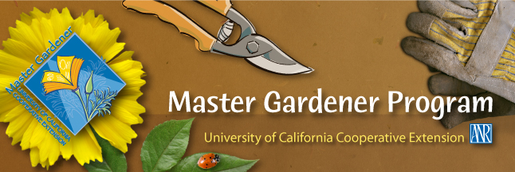
UC Master Gardener Program University of California Cooperative Extension Napa County
Welcome to Spring & Summer Vegetables March 2016
Notes:
Welcome and Introduction.
WORKSHOP INTRO
Who likes to garden?
Who LOVES to garden?
GREAT! Because Master Gardeners are here to share some useful gardening information with you!
Alright—then I have another question for you--
Who has told a friend about our workshops?!
OR
Who is here for a Master Gardener Workshop on Citrus care?
No one?! Good, because this workshop is about Getting Your Garden Ready for Winter!
OR
Who has been to a Master Gardener workshop before?
No corny questions, just launch into the Introduction, which follows.
Note:
Underlined, italicized words will need to be replaced to describe the workshop being presented that day.
This document is in MS Word, so changes are easily made.
WELCOME to our UC Master Gardener’s of Napa County workshop! My teammates and I have some helpful information to share with you today that your garden and the gardener in you will appreciate.
We will give you some guidelines for getting your garden ready for winter and winter planting, if you decide to do it.
We are glad you are here for this great information!
I am _____________, UC Master Gardener.
Before we get to our talk, allow me to
Tell you who Master Gardeners are,
Give you an overview of today’s workshop, and
Introduce the Master Gardeners who are here today.
First things first.
The bathrooms are ______________________________.
We will not be taking a formal break, and please feel free to get up at any time.
What are Master Gardeners all about?
The Master Gardener program is designed to provide scientifically-based gardening information to you, the home gardener.
Home gardeners such as yourselves are the reason we have this program.
We are all volunteers, and we are part of the University of California Cooperative Extension system.
We receive 80 hours of initial training to become certified. We also take continuing education classes each year.
And we have several services we want to make sure you know about!
First, workshops—you already know that, because you are here!
We have a Help Desk, and here (Hold up business card) is the information for that. And we have Mobile Help Desks at various nurseries in the area in the spring, and we are generally a presence at all the valley farmers markets. Have any of you seen us around?
(CLICK) Our website is just packed with help! Google Napa County Master Gardeners. We are also linked to the Agriculture and Natural Resources library at Davis.
We have a weekly column in the Napa newspaper—have you seen it? One of your handouts today is this week’s article on . . . Landscape Pruning!
You will find us at all the county farmers markets—Napa, St Helena, Calistoga. You can bring your questions there or to the Help Desk.
We have a comprehensive demonstration garden in Napa at Connolly Ranch, at Browns Valley and Thompson roads. Have any of you been there?
Please check our open garden schedule on our website and come have a look!
We want you to take advantage of all this information!
We have our Monthly Garden Guide specific to Napa County and are working on an updated book about Trees in Napa.
But wait, there’s more!
We train future Master Gardeners! Check our website to sign up to be notified when we begin recruiting for the 2016 class next spring! Our 2015 class is full—and FYI, the training runs from January through mid-March.
In the next couple of weeks, we will be sending you a very short online survey about this workshop. We want your feedback! We will use your replies as part of our obligation to report our effectiveness and outreach to the University of California.
Now, finally, I’m going to tell you about today!
With me today are these Master Gardeners:
Melody Kendall
JoAnn Boland
Jennifer Loebs
Rachelle Benney
Questions. (Discuss with your team how you/they would like questions handled.)
Even though our time is limited and we have a lot of workshop material to cover, we will all be here to answer questions individually afterwards if you have a question about your own garden.

Slide 2
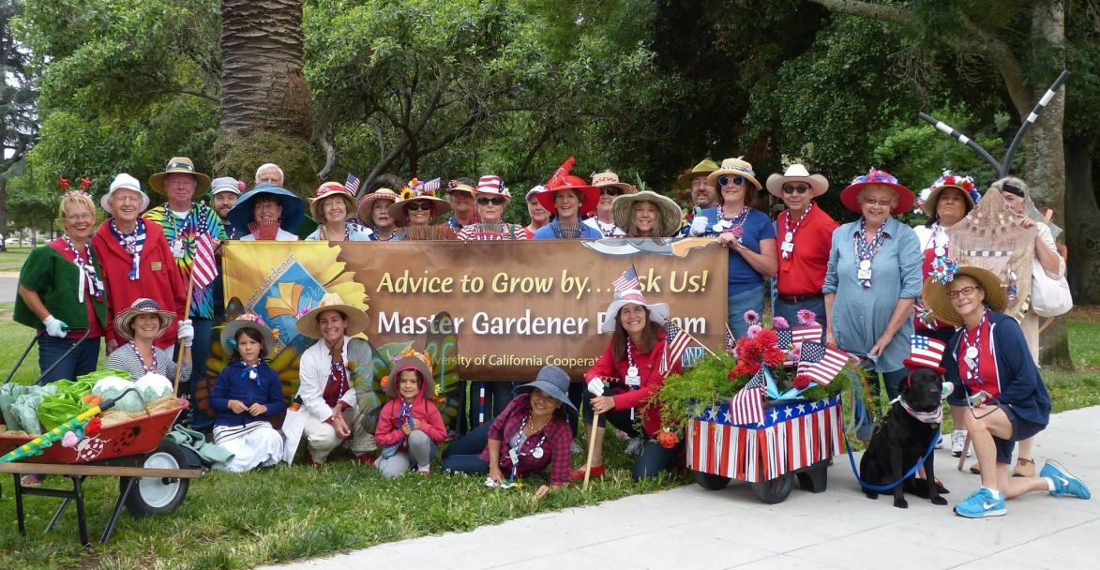
Who Are Master Gardeners?
Volunteers providing practical horticultural information to Napa County residents, based on extensive training , and staying updated on UC gardening research.

Slide 3
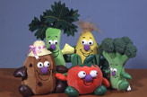
A Brief Advertisement
UC Cooperative Extension Trained Volunteers
Help Desk
Public Workshops
Public Speakers
Notes:
About 150 active; 88 hour course; Help Desks: m-w-f; Tues Farmer’s market;

Slide 4
Today’s Agenda
Introductions & Interests
Preparing Your Site
Soil: Amendments & Fertilizers
What to Plant & When
Notes:
Reference Handouts

Slide 5
And There’s More
Irrigation
Online Resources
Samples of Good & Bad Transplant Material
Demonstrations : Planting Seeds & Transplanting

Slide 6
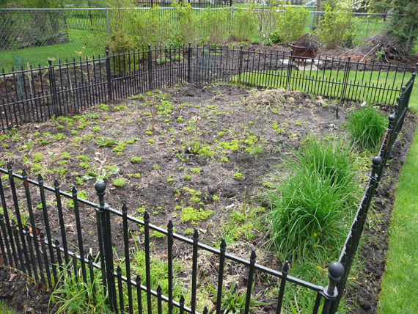
Preparing Your Garden Site

Slide 7
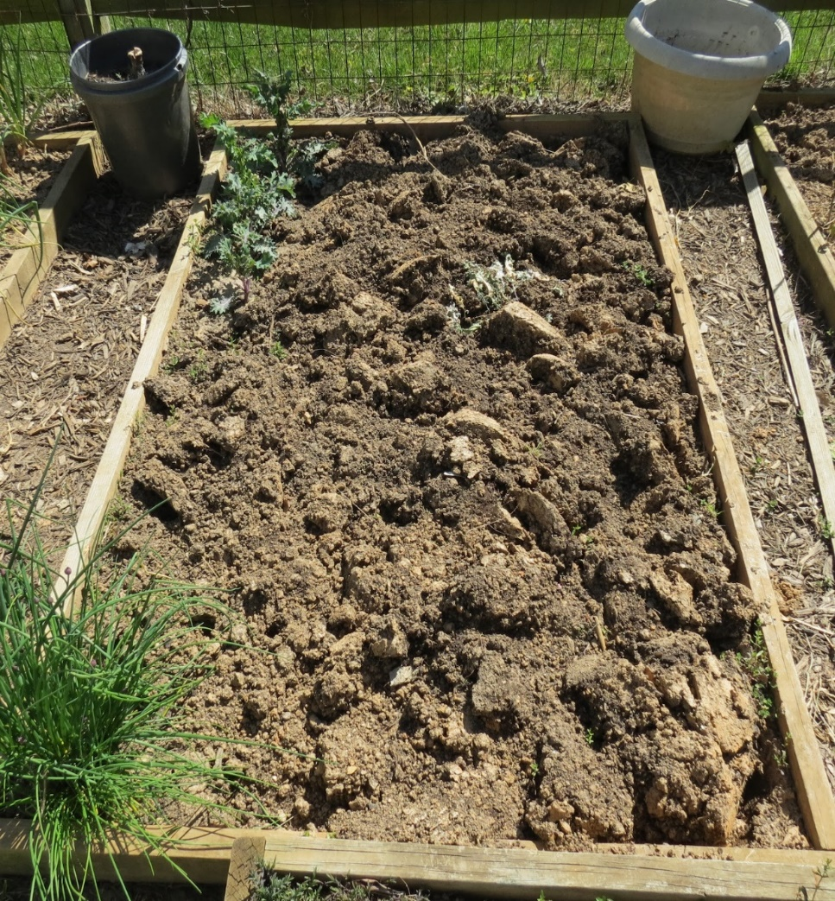
1st Rule of Garden Soil Preparation: DO NO HARM!
Avoid compaction. Never try to work wet soil.
Avoid excessive soil disturbance.
Worms and microbes can be destroyed by a rototiller.
Can bring up weed seeds.
Avoid overuse of chemical and synthetic fertilizers, herbicides and pesticides, over-fertilizing, over-watering, severe under- watering. Moderation is key.

Slide 8
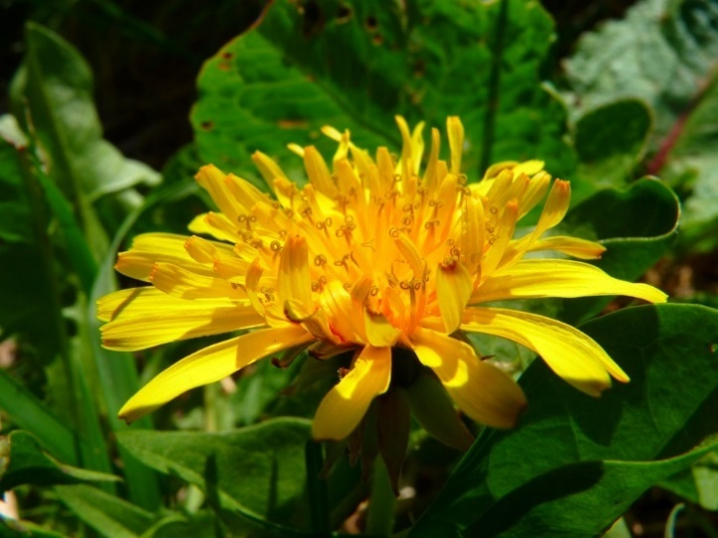
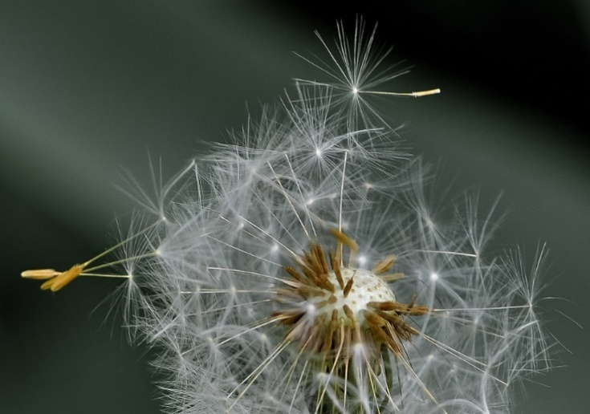
2nd Rule of Garden Soil Preparation: REMOVE ALL WEEDS!
To hoe or not to hoe…..that is the question!
PULL THEM – CUT THEM – ROTOTILL

Slide 9
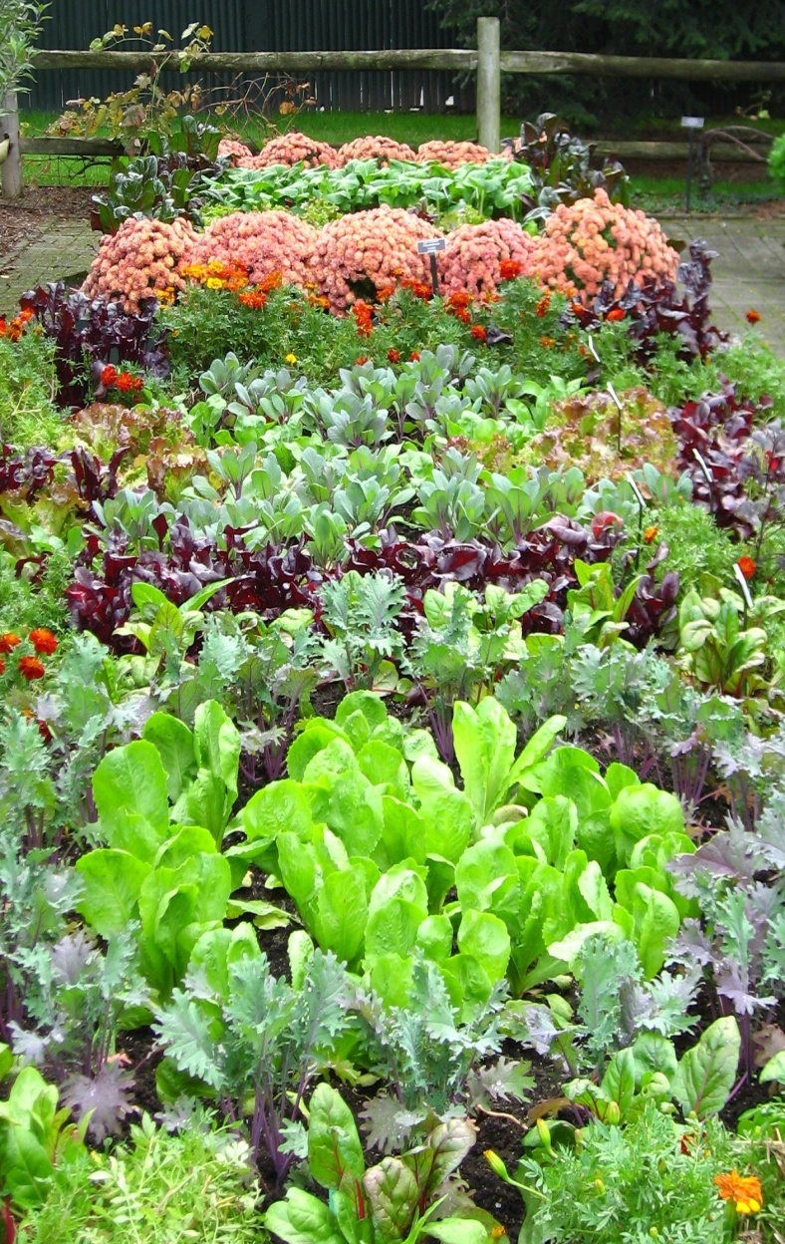
3rd Rule of Garden Soil Preparation: Know What You’re Doing Before You Do It!
Good Soil – Our native soil is often clay-based. Incorporate organic soil amendments to improve poor soil and increase yield.
Level Ground – Level ground is easier to prepare, plant and irrigate.
Water Supply – Locate your garden near a water supply easily reached with a hose.
Adequate Light - Vegetables need at least 6-8 hours of sunlight each day.
Close to Home – Plant your garden near your home, making it easier to work in and carry tools back and forth.

Slide 10
Plan ahead
Plant vegetables that your family likes and in quantities that you will use.
Plant only as large a garden as you can maintain easily.
Plant disease-resistant varieties that are adapted to your area.
Think about sharing produce.
Use mulch to help conserve soil moisture, reduce frequency of irrigation, and control weeds.
Check irrigation system periodically for leaks or clogs.

Slide 11
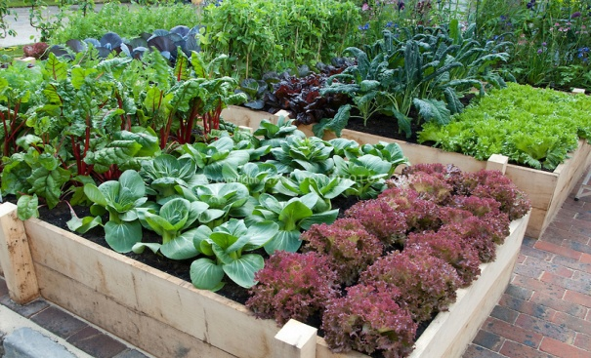
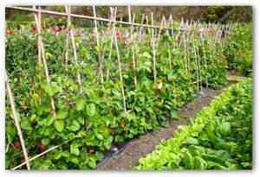
When you plan your garden….
Set up your garden in blocks rather than rows
Provide windbreaks as needed
Keep tall plants from creating unwanted shade
Plant some crops now that take advantage of cool weather

Slide 12
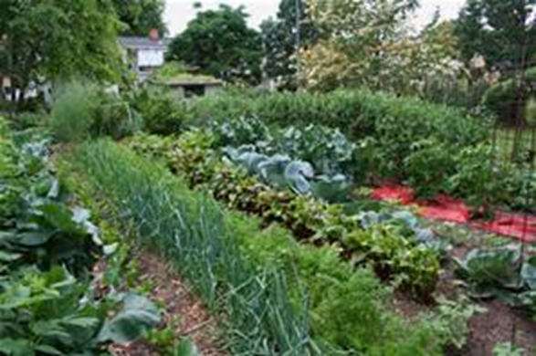
Plants grow well in soil that …
Has a healthy physical structure
Contains essential micronutrients
Notes:
First thing to know is….

Slide 13
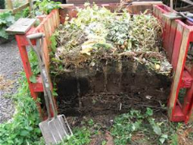
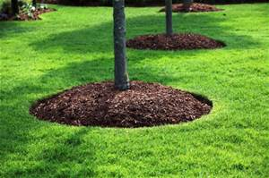
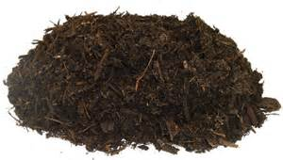
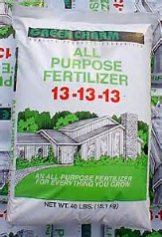
Some essential garden terms that people sometimes mix up
Compost
Mulch
Amendments
Fertilizer
Notes:
Before we proceed ……want to clarify…understandably so, Because they are related and sometimes overlap. I know I used to mix them up.

Slide 14
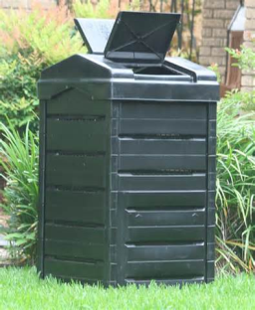
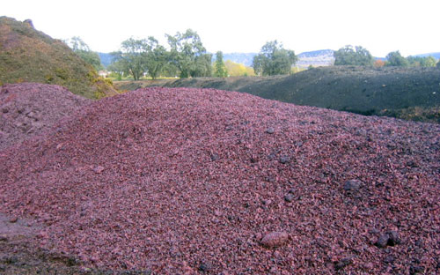
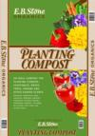
Compost: A mixture of organic matter that is decomposed, i.e., been digested by organisms
Make it at home
Buy it from recycling plants
Buy it in bags from stores (expensive option)
Notes:
Compost: A whole another workshop, You already know it is good stuff

Slide 15
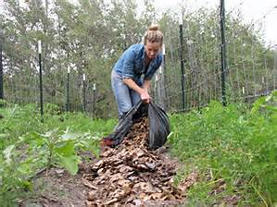
Mulch: Material layered on top of the soil to cover and protect it.
Mulch serves many purposes: preserves moisture, reduces weeds, prevents erosion, also can slowly add some micronutrients.
Mulch is usually organic (leaves, grass clippings, compost, straw, etc.) but can be inorganic (e.g. plastic).
One of the best mulches is compost
Notes:
Woman spreading leaves as a mulch

Slide 16
Amendments: Material mixed into the soil to improve the texture or physical condition of the soil to support healthy plant growth (tilth).
Some examples of amendments include:
Barnyard manure
Green Manure and Cover Crops
(E.g. Fava Beans, Mustard, Vetches)
Packaged mixes

Slide 17
One of the best amendments is compost
Compost develops into humus to improve soil structure
Improves drainage and aeration
Conserves soil moisture
“Finished” compost can be mixed into the soil right before planting
Notes:
And guess what…one of the best amendments is compost.

Slide 18
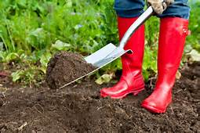
Distinguish between amendments that can be added right before planting and those that can’t
Some amendments (animal manure, green manure) should be added early enough that organic materials can break down.
Notes:
If materials are added before they break down, they can take nitrogen that the plants need

Slide 19
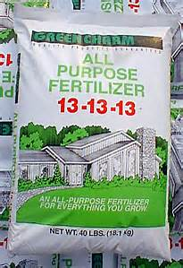
Fertilizers: Substances added to soil to provide plants with essential micronutrients
Nitrogen–Phosphorous--Potassium
X-X-X
The three numbers on fertilizer bags and boxes sold in stores show how much of the three most essential micronutrients the product will provide
Notes:
Our 4th garden term

Slide 20
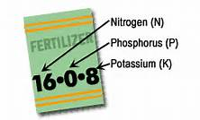
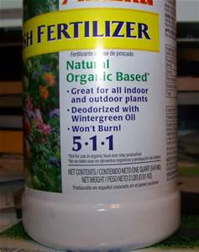
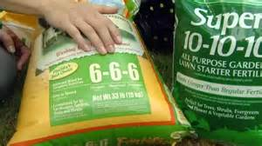
5-X-X Nitrogen (N) promotes green leafy growth
X-5-X Phosphorus (P) assists in flower, seed, and fruit production
X-X-5 Potassium (K) helps develop root and tubers
Notes:
Especially nitrogen does not last in soil, and needs to be replenished

Slide 21
Organic Fertilizers
Include variety of nutrients.
Can amend and improve soil.
Encourages micro-organisms in soil
Slow release.
Less likely to “burn” plants
Notes:
Two kinds of fertilizers

Slide 22
Organic Fertilizer Examples
Commercial organic fertilizers
Animal manures
Seaweed (kelp)
Fish meal or emulsion
Soybean meal
Alfalfa pellets
Bone and blood meal

Slide 23
Synthetic Fertilizers
Fast-acting
Often less expensive
Can be hazardous to plants or soil if used incorrectly or too much
Key: Use according to the direction on the bag/box and in moderation to avoid environmental pollution due to overuse.

Slide 24
Ways to Fertilize
Add to soil before planting (slow release forms are an option)
Foliar feed: spray a mist solution to be absorbed by osmosis.
Liquid solutions: Watering can
“Side-dress” by working a granular fertilizer into top inch of soil near plant roots and water in well.

Slide 25
When Do I Plant?
Cool season vs warm season plants
Our climate considerations for spring and fall
Use a reliable resource

Slide 26
Cool Season Crops
Grow best in day time temperature range of 55 to 75 degrees Fahrenheit
Tolerate some amount of short-term freezing (frost tolerant)

Slide 27
Warm Season Crops
Grow best at 65 to 95 degrees Fahrenheit
Are injured or killed by frost

Slide 28
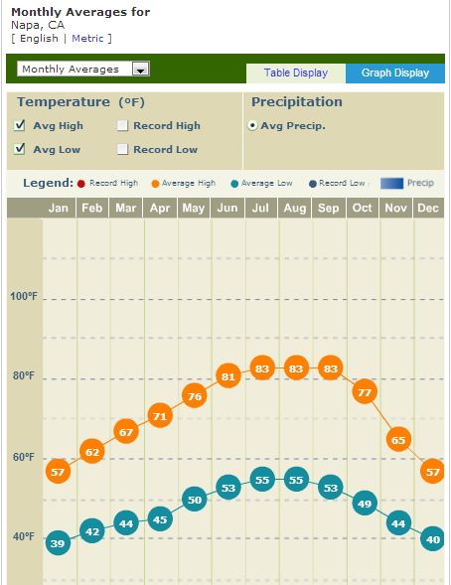

Slide 29
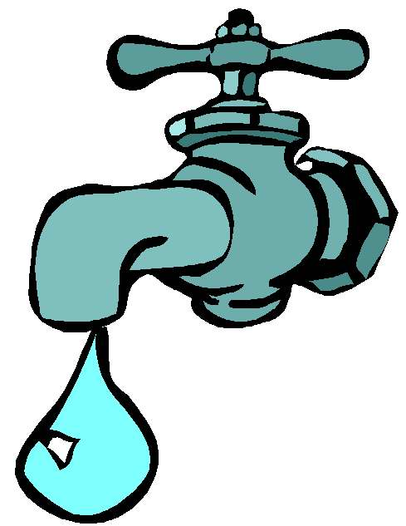
IRRIGATION, VEGGIES & YOU
Water needs depend on many factors
Soil Condition (sandy, clay, loam)
Weather and wind
Ambient temperature
Type of vegetable
Notes:
What is your current method, or plan to irrigate your veggies? This section will cover three main methods--

Slide 30
More Rain Coming?
Don’t count on it: Plan your garden and watering methods accordingly

Slide 31
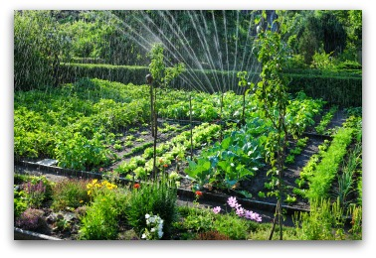
Over Head Sprinklers?
Low labor time, BUT need to water a long time to get deep into roots; water loss to evaporation
Notes:
Takes great deal of water to get the same effect of a long, steady rain

Slide 32
Hand Water?
Labor intensive; Unlikely to get to roots. Need to get down to base of plant. Water evaporation
Notes:
Maybe as an additional soaking--but at the base of the plant if drip system isn’t doing the job. Much time to replicate a 1-2” rainfall.

Slide 33
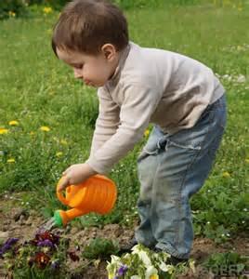
Here’s the Right Way!
Get to the root of the issue
Notes:
Just seeing the top of the soil wet isn’t enough. Check to see if you are getting deep enough.

Slide 34
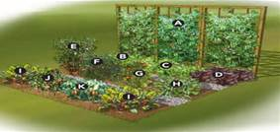
Plan Before Planting
Lay out: Blocks vs. long rows
Group plants by water needs
Install drip systems with built in emitters before planting
Notes:
Options: Built in emitters vs manually installed emitters. Avoid planting tall plants so they shade smaller ones.

Slide 35
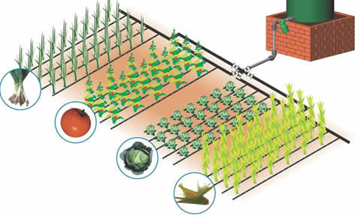
DRIP System By Zones
MG OK
Provides deep watering at roots
Notes:
Provides deep watering at roots; no waste; minimal labor (after one-time installation); needs monitoring for leaks, plugged emitters and if need different emitter

Slide 36
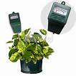
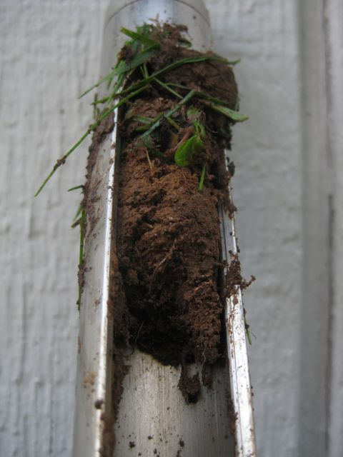
When to Water
Test: Water if dry at 3-4 inches
Monitor Regularly Avoid over watering.
NOTE: Drooping leaves does NOT always mean the need for watering. Check the soil. Avoid overwatering. Roots can drown.
Notes:
As we will see in the next set of slides

Slide 37
Critical Periods for Adequate Watering:
Vegetable | Period
Pea | Flowering & seed enlargement
Pepper | Flowering through harvest
Pumpkin | Fruit forms
Squash | Bud forming & flowering
Swiss Chard | When true leaves form
Tomato | Flowering through harvest
Lettuce | When true leaves form
Notes:
What part of the plant do you eat?

Slide 38
Critical Periods for Adequate Watering:
Vegetable | Period
Bean | Flowering/forming pods
Broccoli | Forming heads
Corn | Silking, tasseling, forming ears
Cucumber | Flowering; fruit forming
Eggplant | Flowering through harvest
Melon | Fruit set & early development
Onion | Bulb enlargement

Slide 39
Master Gardeners Online
Search: “Napa Master Gardeners”
Or: http://ucanr.edu/sites/ucmgnapa/

Slide 40
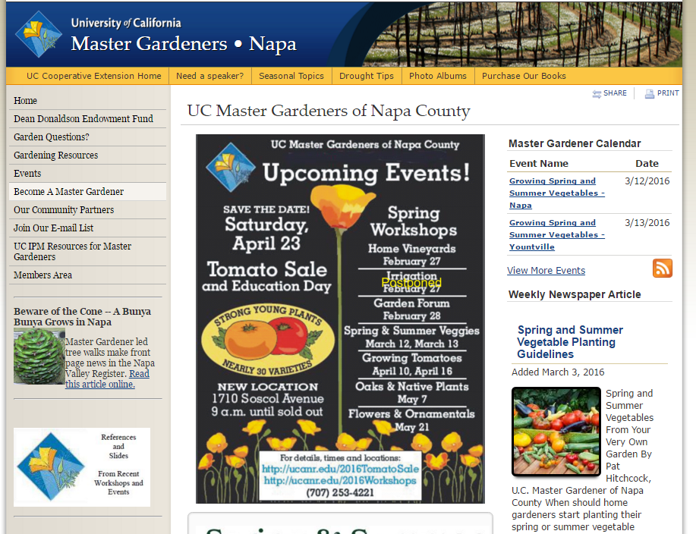
Gardening Resources

Slide 43
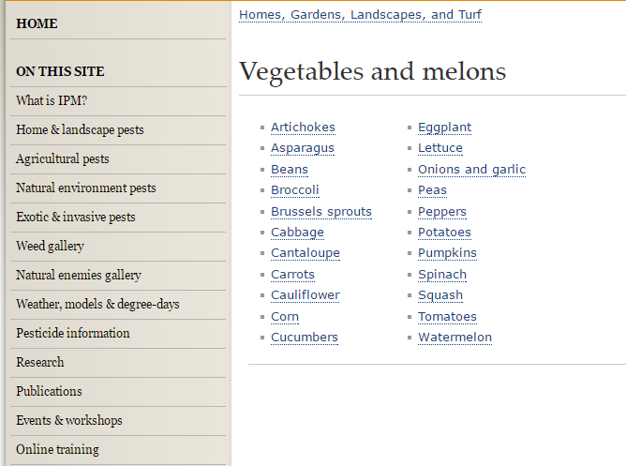
Example

Slide 44
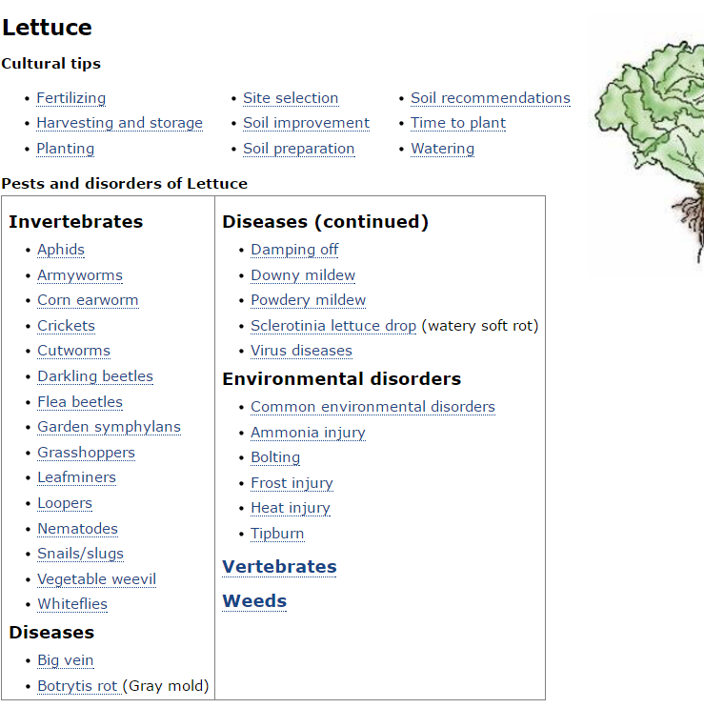

Slide 45
Garden Questions
Notes:
Help Desk hours, phone no., email, submit problems

Slide 46
Workshop Documents Online
Click Here
Notes:
Slides, handouts for this and other workshops

Slide 47
Ready to Get Down & Dirty?
Demonstrations on how & then it’s your turn
(You get to take them home)
Planting seeds
Transplanting seedlings
Demonstrations Only:
Planting seeds in ground (carrots, peas, etc)
Planting tomato seedlings
Using row covers

Slide 48
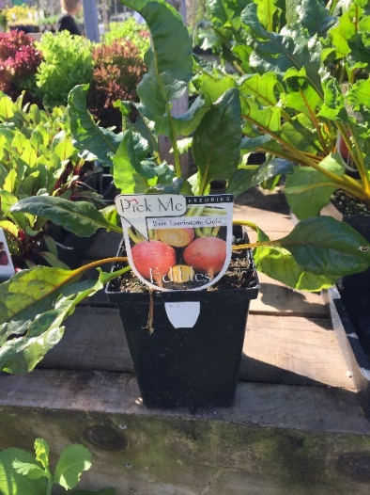
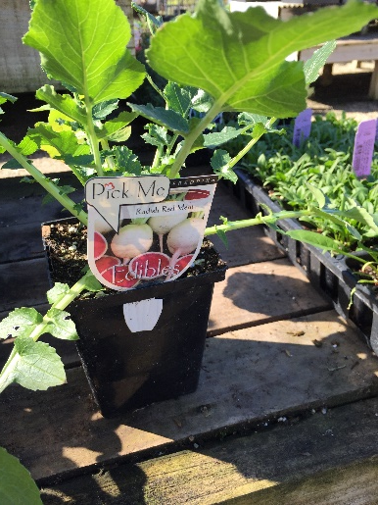
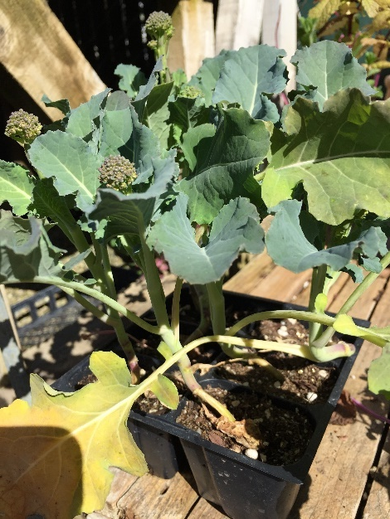
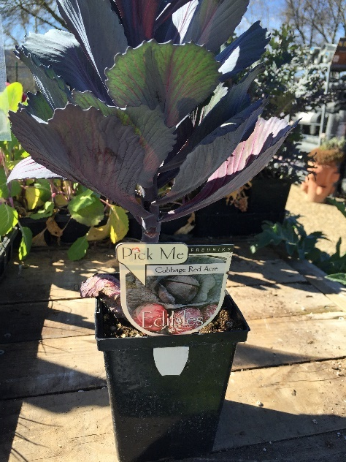
Tips on Buying Seedlings
Would you buy any of these examples?
Beet
Radish
Why?
Broccoli
Cabbage
Broccoli Red Cabbage
Modified slide # 8

Slide 49
Burning Questions

Slide 50
Thanks!
Be sure to complete the evaluations before leaving

