Slide 1
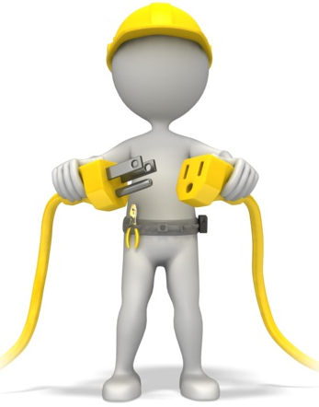
Electrical Safety
ANR Building, Davis
Staff Meeting
February, 2015

Slide 2
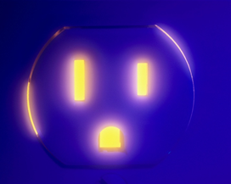
Electrical Hazards/Injuries
Electrical equipment used in office areas is potentially hazardous and can cause:
Shock – most common hazard, occurs when the human body becomes part of the path through which the current flows
Burns – most common shock related nonfatal injury
Fires – enough heat or sparks can ignite combustible materials
Explosions – electrical spark can ignite vapors in the atmosphere
Falls – indirect or secondary injuries, worker falls off ladder when shocked
Electrocution – death due to electrical shock
Notes:
Electricity is essentially electrons in motion.
Electrical hazards cause more than 300 deaths and 4,000 injuries in the workplace each year.
During the workday, a worker is hurt every 30 minutes so severely from electricity that it requires time off the job.
Electrical accidents on the job cause an average of 13 days away from work and nearly one fatality every day.

Slide 3
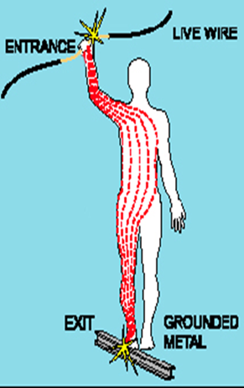
Electrical Shock
occurs when the body comes into contact with:
wires in an energized circuit
one wire of an energized circuit and a path to the ground
a “hot” metallic part that is a conductor
severity depends on:
the amount of current flowing through the body,
the current’s path through the body,
the length of time the body remains in the circuit, and
the current’s frequency
Notes:
An electric shock can result in anything from a slight tingling sensation to immediate cardiac arrest

Slide 4
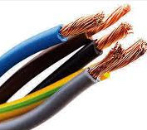
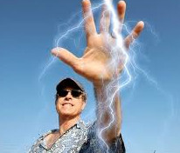
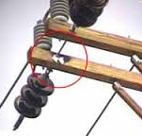
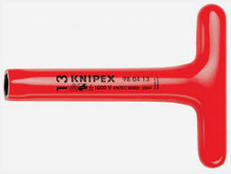
Conductors
Substances that have little resistance to electricity:
Wires
Metals – e.g. Cu, Al, Au
Water
People
Insulators
Substances that have high resistance to electricity:
Wood
Rubber / Plastic
Clay
Glass

Slide 5
Controlling Electrical Hazards
To keep you from becoming part of the circuit, electrical hazards can be controlled or safeguarded in several ways:
Electrical Isolation – keeping electricity away from us, preventing contact
Equipment Grounding – a conductive connection to the earth which acts as a protective measure/pathway for stray current to go
Circuit Interruption – automatically shutting off the flow of electricity in the event of leakage, overload, or short circuit
Safe Work Practices – eliminating hazards, engineering and administrative controls, PPE, training, etc.
Notes:
Purpose of electrical isolation is to prevent worker contact with electricity.
Insulate the conductors. Example: The insulation on extension cords.
Elevate the conductors. Example: Overhead powerlines.
Guard the conductors by enclosing them. Example: Receptacle covers, boxes, & conduit.
Equipment grounding helps to safeguard the equipment operator in the event that a malfunction causes the metal frame of the tool to become energized.
Ground prong on the extension cord is very important. It provides a low resistance path to ground (or source).
Grounding gives the stray current somewhere to go and keeps you from becoming part of the circuit.

Slide 6
Practical Applications
What to look out for!

Slide 7
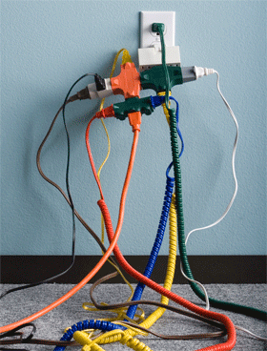
Electrical Outlet Safety
Hazards:
Too many devices plugged into circuit = wires heat to very high temperature = potential fire
Too many items plugged into a single circuit can cause circuit overload and tripping of the main breakers
WARNING SIGNS: warm switches, blowing fuses, tripping circuits, flickering/dimming lights
Safe Practices:
Do not use adapters to add plugs into an outlet
Do not overload the circuit
Follow manufacturer’s instructions
Plug high-wattage appliances directly into a wall receptacle, only one at a time
Notes:
Plug high-wattage appliances directly into receptacle

Slide 8
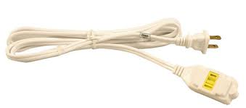
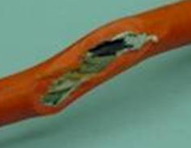
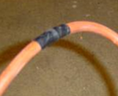
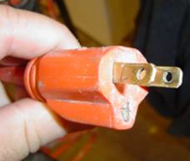
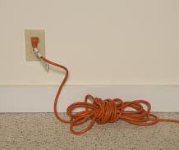
Extension Cord Safety
Extension cords
permitted only for temporary uses
must be visually inspected before each shift use
damaged jacket/insulation - pinches/interruptions
grounding pin - safety instructions
NOT for large appliances, for electronics/tools only
black electrical tape does not provide suitable insulation, and is not an adequate repair
If additional outlets are needed consult Facilities

Slide 9
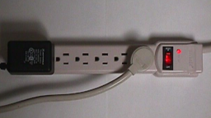
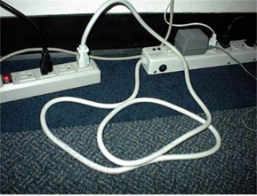
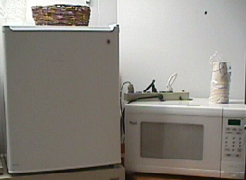
Power Strip Safety
Power Strips
Connect directly to outlet/wall
NO extension cords plugged in; NO other power strips connected
No daisy-chaining or piggy-backing
Number of outlets on the power strip does NOT indicate how many devices can be connected – do not overload
Visually inspect regularly
damaged jacket/insulation - pinches/interruptions
grounding pin - safety instructions
NOT for large appliances, for electronics only

Slide 10
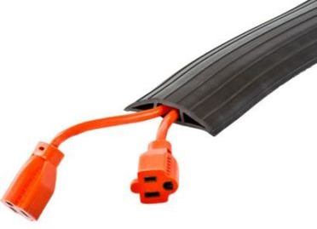
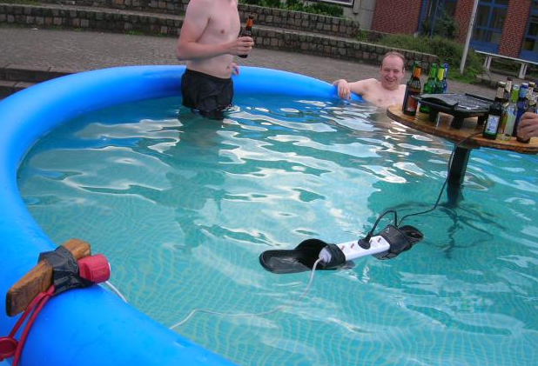
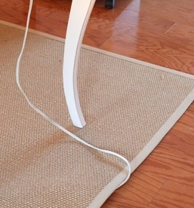
Cord Placement to Prevent Hazards
Do Not run through doorways, windows, pinch hazards
Do Not place (conceal) under floor mats or carpets
Do Not use staples, tacks or nails to secure cords
Do Not place cords where they can become an electrical or trip hazard
Cords should not undergo severe bending, crimping, pressure, or use in high risk areas

Slide 11
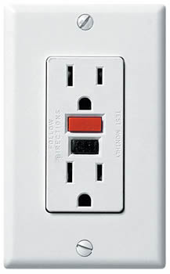
Placement and Use of GFCI’s Ground-Fault Circuit-Interrupters
Used when using electrical equipment in a wet or high risk environment
Designed to detect any leakage of current in an electrical circuit
Turn off or “trip” the circuit when there is a difference in current leaving/returning
Test monthly using test button. Have something plugged into the circuit when testing
Designed to protect the wiring/equipment from overheating and possible damage – NOT THE USER

Slide 12
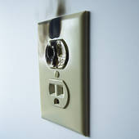
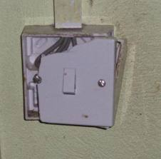
Is All Electrical Equipment in Good Condition?
Electrical equipment must be maintained in good operating condition
Equipment must have all panels and covers securely affixed
Wall outlets must have the wall plate affixed
Look for signs of damage or overheating
If equipment is defective, take it out of service immediately; report the hazard!

Slide 13
Is Equipment (>50 Volts) NRTL Approved?
All electrical equipment greater than 50 volts should be certified by a Nationally Recognized Testing Laboratory (NRTL) - provide product safety testing & certification services to manufacturers
Includes power strips, electrical cords, small appliances & electronics
Typical NRTL logos to look for:

Slide 14
Is Equipment Turned Off After Hours?
Where possible, electrical equipment should be turned off during non-business hours
Area motion sensors should be used when feasible to prevent lights being left on
Use equipment with the EPA “Energy Star” logo affixed when possible

Slide 15
Agricultural Electrical Safety Tips
While ‘In the field’ electrical hazards may be above and below you
Work safely to avoid accidents, isolate equipment from energy sources
Keep equipment and extensions clear of power poles/lines
Do not raise irrigation pipes into the air, carry/rotate them horizontally
Buddy up! Work with a spotter
Look Up! Always check for power lines before beginning work:
Before throwing tie-downs
Before parking vehicles with extensions
While near or under trees
seattle.gov
Notes:
"Call Before You Dig" number, 811, helps protect you from unintentionally hitting underground utility lines while working on digging projects.

Slide 16
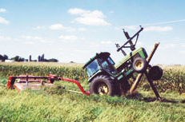
Agricultural Electrical Safety Tips
Energized Equipment
Any piece of equipment that comes in contact with a live power line will become energized; and any person who is on the ground within close proximity of this equipment is in the most danger.
In an electric emergency, if your equipment contacts a power line:
Move the equipment away from the line if you can do so safely
Warn others to stay away, and have someone call 911
Stay on/within the equipment
If fire or other danger forces you off:
jump clear, keeping both feet together
without touching the ground and equipment at the same time

Slide 17
Resources
This month’s UC Safety Spotlight & Poster of the Month http://ucanr.edu/sites/ucehs/Safety_Spotlight/
EH&S Safety Notes, Video Library & Training Materials (Safety Notes #19, #144, and Clover Safe Note #53)
Your Supervisor and/or your location’s Safety Coordinator
EH&S
Visit us in person
Visit our website: http://safety.ucanr.edu
Use the EH&S Ask Button
Notes:
Take a few minutes to look around your area using the electrical tips provided

Slide 18
QUESTIONS?
Please remember to Sign-in before leaving

Slide 19
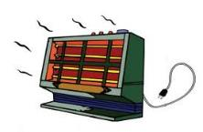
Is a Portable Space Heater in Use?
Space heaters should be limited to small personal office areas only.
If possible, have Facilities make temperature adjustments to your area.
If a portable space heater is used, it must have:
A grounded (three prong) plug.
? A maximum rating of 1500 watts or 13 amps. ?
Auto tip-over shut-off feature.
36” clearance in front and 18” on sides and back.
Do not plug heaters into extension cords or power strips. They must be plugged directly into a wall outlet.

